Slide 1

Yolo County
AB 109 Realignment Public Planning
Winters
April 9th, 2014
Yolo County Board of Supervisors
And Community Corrections Partnership

Slide 2
Yolo County
Board of Supervisors
Introductions And Overview

Slide 3
Brent Cardall,
Chief Probation Officer
AB 109 Realignment in Yolo County

Slide 4
What is Realignment in CA?
On October 1, 2011 California's Corrections Realignment Plan, one of the most significant changes to California's criminal justice system in decades, went into effect.
AB 109 Public Safety Realignment
The plan shifts responsibility from the state to counties for the custody, treatment, and supervision of individuals convicted of specified nonviolent, non-serious, non-sex crimes.

Slide 5
Public Safety Realignment
Local Jail Custody for convictions under Penal Code 1170 for:
  non‐violent,
  non-serious,
  non‐sex offenders
Changes to State Parole
  Local Post‐release Supervision
Local Planning (Executive Committee)

Slide 6
Community Corrections Partnership
Shall Recommend A Countywide Plan To The Board Of Supervisors For The Implementation Of The 2011 Public Safety Realignment.
FY 13/14 Executive Committee (7 Voting Members):
  Chief Probation Officer Brent Cardall (Chair)
  Municipal Police, Davis Police Chief Landy Black
  Yolo County Sheriff Ed Prieto
  District Attorney Jeff Reisig
  Public Defender Tracie Olson
  Yolo Superior Courts, Court Executive Officer Shawn Landry
  Public Health Director Jill Cook

Slide 7
Anticipated and Current Impacts
Jail Overcrowding
  Currently Full
  80% of Jailed Sentenced Offenders from AB 109 Realignment
More Higher Risk to Re-offend Supervised Offenders
  To date, 398 Post-Release Community Supervision (PRCS) Felons came back to Yolo County from State Prisons
  700 total High Risk Offenders Under Case Managed Supervision
Increase in Local Incidents of Crime
Additional Burden on County Court Attorneys

Slide 8
Early Planning Efforts
The County’s goal in 2011 was to triage criminal justice services that would receive immediate impacts from AB 109
Year 1: FY 2011/12,
  Re-Open and Maintain Jail Beds at Leinberger Detention Facility
  Expanded Sheriff Electronic Monitoring: from 30 to 100 capacity
  Expanded Probation Supervision: lowered caseloads from 300/1 down to 50/1 for more intensive community supervision
  Funded Frontline City Police Departments
  Funded Severely Mentally Ill (SMI) Offender Emergency Hospitalization
  Supplemental Funding to District Attorney and Public Defender
  Planning Facilitation and Data Management

Slide 9
Early Planning Efforts
Year 2 Additional Priorities: FY 2012/13
  Established a Day Reporting Center (50 In-Custody;75 Out-of-Custody)
  Expansion of funding for District Attorney Services
  Expansion of Jail Bed Support for Sheriff’s Department
  Funded Transportation, clothing and Hygiene Products as needed by re-entry population
  Technical Assistance Reviews of Year 1 Strategies using the Crime and Justice Institute
  Support of Probation Pre-Trial Operations
  Expanded Substance Abuse and Mental Health Treatment
    4th and Hope (Residential/Transitional Housing)
    Cache Creek Lodge (Residential/Transitional Housing)
    CommuniCare (Outpatient and Dual Diagnosis)
    Alcohol, Drug and Mental Health (SMI Treatment)

Slide 10
Current Fiscal Year
Year 3, FY 2013/14
  Expanded Services for the Day Reporting Center
    GED
  Probation Case Management System
  Victims Services Advocate
  Jail Re-entry Senior Social Worker
  In-Custody (Jail) GED and Vocational Education Services
  Additional Support of Probation Pre-Trial Services
  Additional Support of Sheriff Jail Beds
  Police/Probation Collaborative Operations
  Public Safety Board Ad Hoc Technical Planning Review
    Crime and Justice Institute

Slide 11
Jeff Reisig
District Attorney
CCP Mission, Principles, and Goals

Slide 12
New AB 109 Planning Process
Intent to Continue to Strengthen and Update Yolo County Criminal Justice System Through Community Corrections Partnership Planning Efforts
Crime and Justice Institute Technical Planning Assistance
  Organized and Facilitated County Planning Work Sessions on March 13th and 17th
Work Session Objectives
  How CCP plan connects to the larger system plans
  Revise and review the planning work from the Board Ad Hoc Committee
  Finalize CCP Mission, Principles, and Goals
  Begin Developing An Implementation Plan
  Agree On Process For Next Steps
    Public Outreach Presentations to Engage Members Of The Public In This Planning Effort

Slide 13
CCP Mission
The mission of the Yolo County Community Corrections Partnership is to protect the public by holding offenders accountable and providing opportunities that support victim and community restoration, offender rehabilitation and successful reintegration.

Slide 14
CCP Principles
Use Evidence-Based Practices
Integrate Data Into Decision-making Through Reporting, Quality Improvement Plans, and Program Evaluation
Emphasize Behavior Change For Criminal-Justice Involved Individuals
Integrate A Restorative Justice Approach
Focus On Long Lasting Public Safety

Slide 15
CCP Goals
Goal 1: Ensure A Safe Environment For All Residents And Visitors By Reducing And Preventing Local Crime
Goal 2: Restore Victims And The Community
Goal 3: Hold Offenders Accountable
Goal 4: Build Offender Competency And Support Reintegration
Goal 5: Reduce Recidivism

Slide 16
Breakout Sessions: Objectives
The Board of Supervisors and the CCP believe that for public policy to be effective, the public should be involved in planning the solutions to achieving these Goals
Developing Objective Ideas For Each CCP Goal With You
  5 Tables with CCP Voting Members Representing each Goal
  Develop Objective Ideas under each Goal with that CCP Member
    3 ten minute rotations
    Summaries from each planning session will inform CCP planning priorities at their next meeting, April 14 in Woodland
    Board of Supervisors to review with recommendations from the CCP

Slide 17
Sergio Gutierrez
Winters Chief of Police
Winters Crime Stats

Slide 18

Winters Police Department
Crime Trends

Slide 19
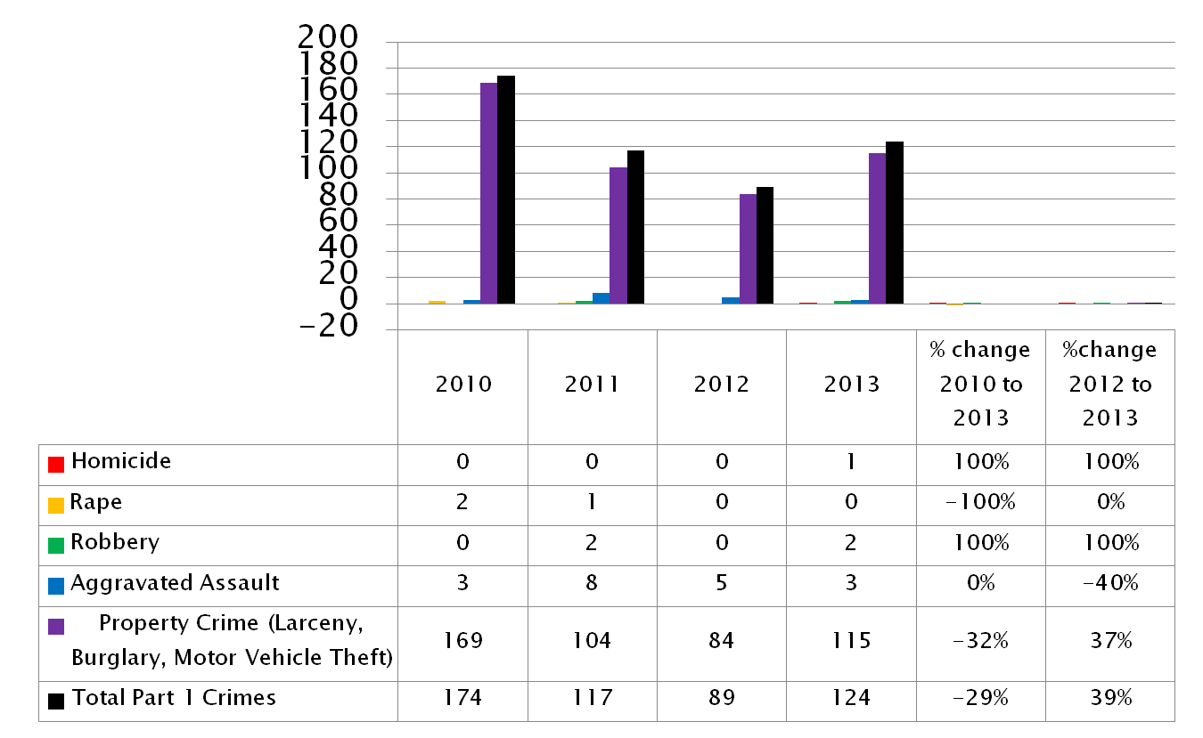
Part I Crimes

Slide 20
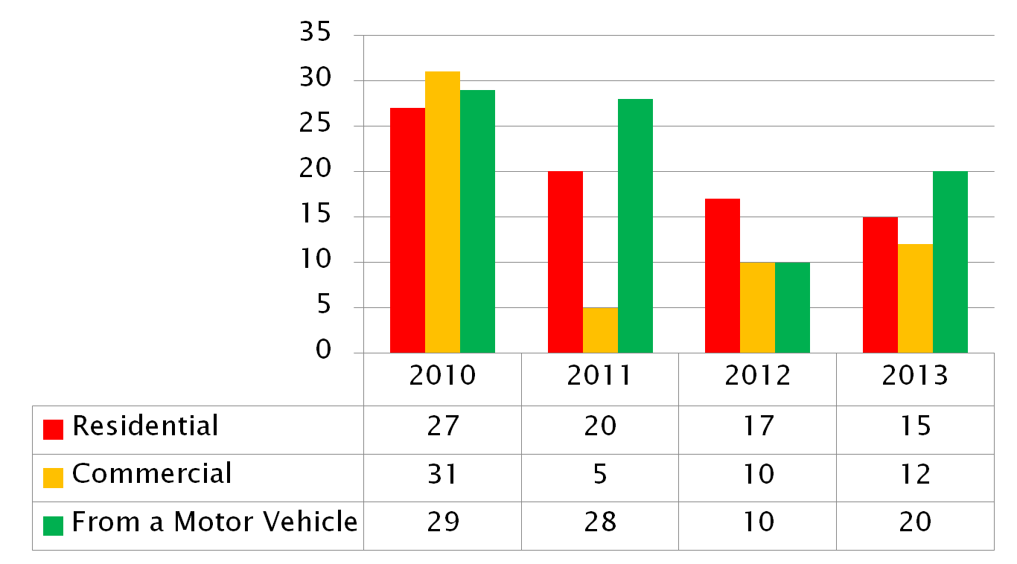
Burglary Types

Slide 21
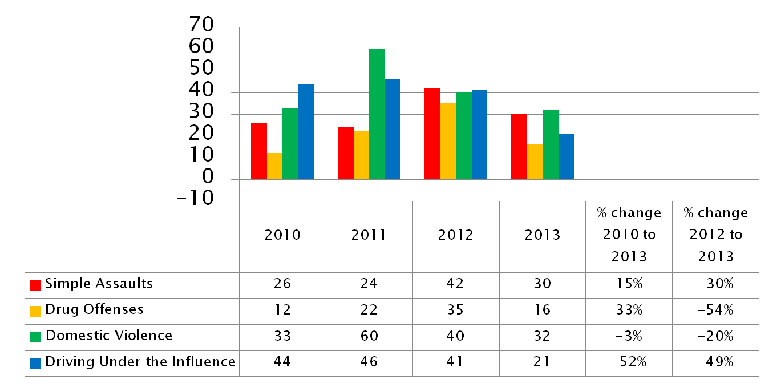
Part II Crimes

Slide 22
2013
Community Correction Program
 | Probation | Parole | 1170(h) | AB 109
79 Contacts | 45 | 18 | 2 | 14
 | Warrants | Fresh Charge
Arrests | 2 | 14
113 Hours of Overtime Utilized
 | Violated Parole/ Probation | Moved
Violations | 6 | 2

Slide 23
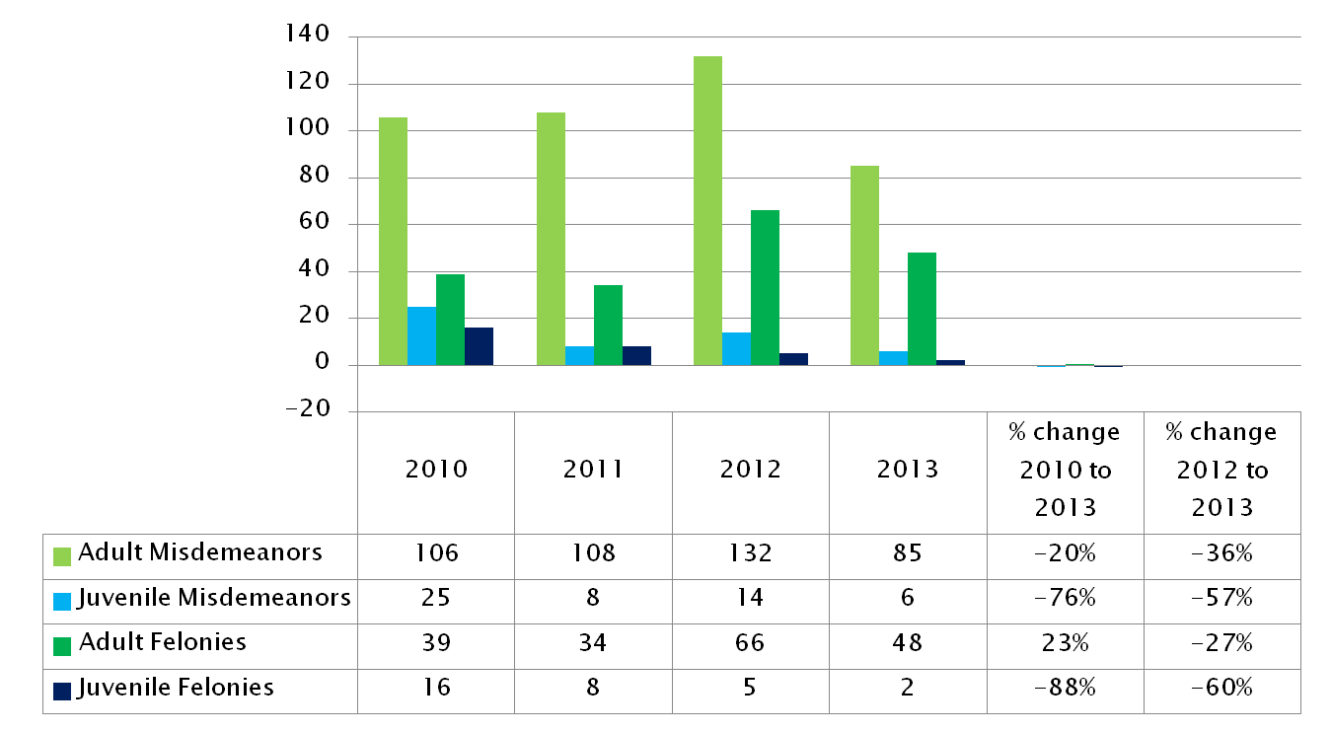
Arrests

Slide 24
Questions

Slide 25
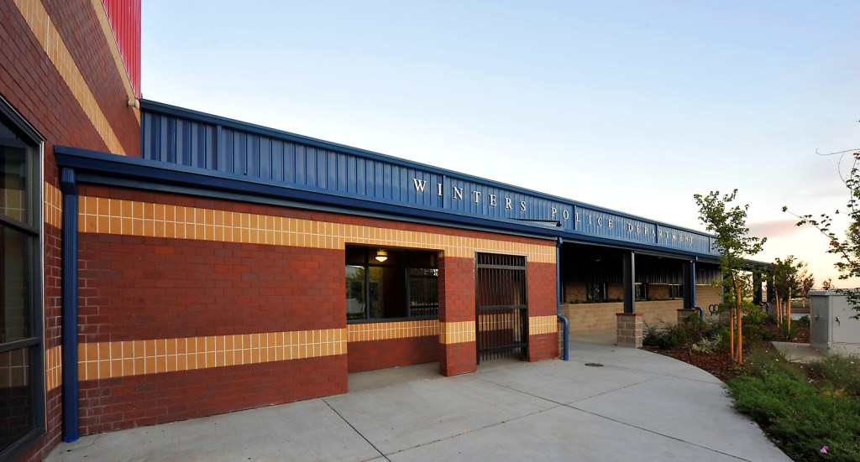
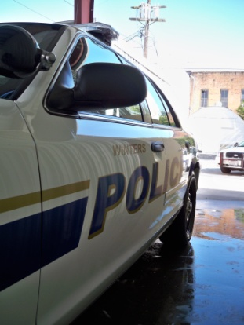
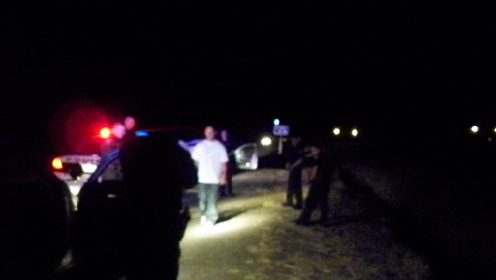
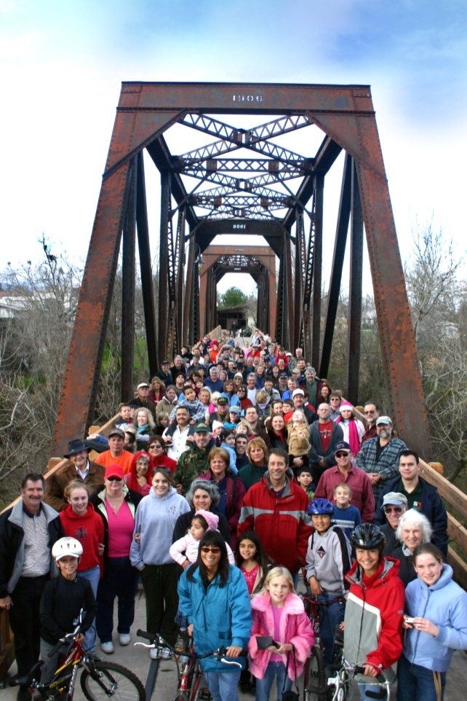
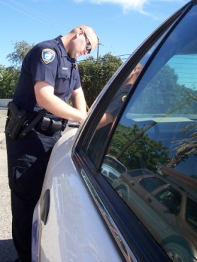
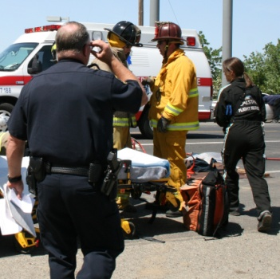
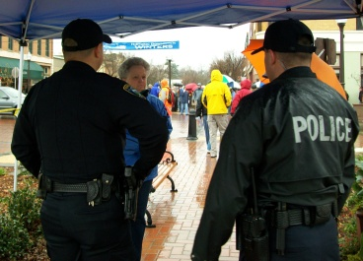
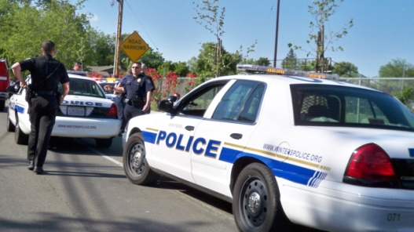
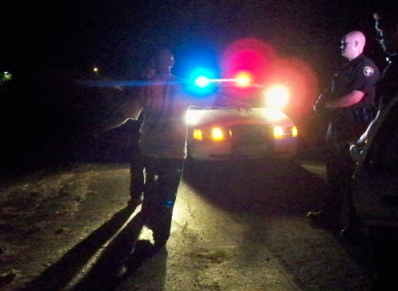
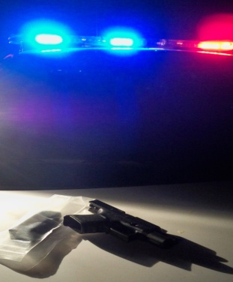
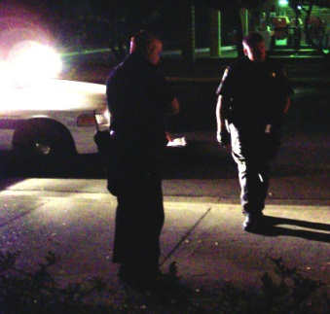
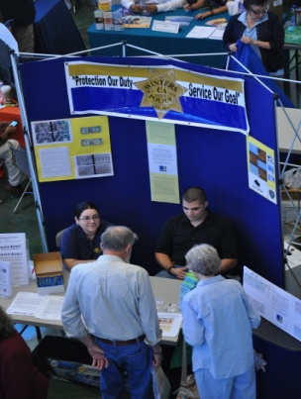

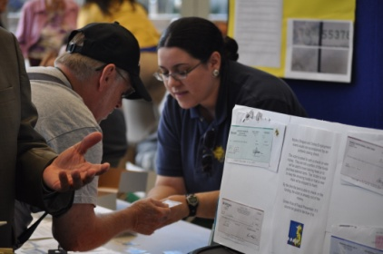
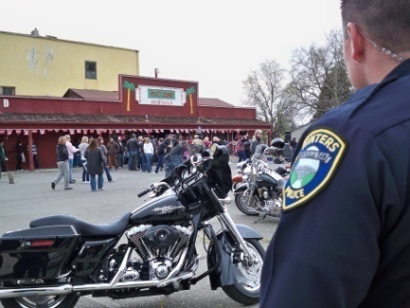
  PROTECTION + SERVICE + ENFORCEMENT = SAFE COMMUNITY
Notes:
What’s our vision: To create a safe community through these three simple elements.

Slide 26
Breakout Sessions
CCP Facilitators
Goal 1: Chief Gutierrez
Goal 2: District Attorney Reisig
Goal 3: Sheriff Prieto
Goal 4: Tracie Olson, Public Defender
Goal 5: Chief Probation Officer Cardall

Slide 27
Question and
Answer
(20 Minutes)

Slide 28
Thank you for your
Involvement!
Contact Information:
Yolo County Probation Department
2780 East Gibson Road
Woodland, Ca 95776
(530) 406-5357 nate.palmer@yolocounty.org

