Slide 1
Do your part, be septicsmart! www.epa.gov/septicsmart

Slide 2
THE BASICS
What Is a Septic System?
Common in rural areas without centralized sewer systems, septic systems are underground wastewater treatment structures that use a combination of nature and time-tested technology to treat wastewater from household plumbing produced by bathrooms, kitchen drains, dishwasher and laundry.
It is the end point of your home’s plumbing system like your furnace is for your heat and AC!

Slide 3
Do You Have a Septic System?
You may already know you have a septic system. If you don’t know, here are tell-tale signs that you probably do:
You use well water.
The waterline coming into your home doesn’t have a meter.
You show a “$0.00 Sewer Amount Charged” on your water bill.
Your neighbors have a septic system.
If you have a septic it is YOUR responsibility to maintain it!

Slide 4
How does a septic system work?
This is a simplified overview of how a septic system works.
All water runs out of your house from one main drainage pipe into a septic tank.
The septic tank is a buried, water-tight container usually made of concrete, fiberglass or polyethylene. Its job is to hold the wastewater long enough to allow solids to settle down to the bottom (forming sludge), while the oil and grease floats to the top (as scum). Compartments and a T-shaped outlet prevent the sludge and scum from leaving the tank and traveling into the drainfield area.
The liquid wastewater then exits the tank into the drainfield. If the drainfield is overloaded with too much liquid, it will flood, causing sewage to flow to the ground surface or create backups in toilets and sinks.
Finally, the wastewater percolates into the soil, naturally removing harmful bacteria, viruses, and nutrients.
1
2
3
4
1
2
3
4
Groundwater = source of your well water

Slide 5
WHY MAINTAIN?
Saves you $
- A few hundred dollars every 3-5 years for maintenance or ranging ~$8k - ~25k to replace.
Protects your property value
- Homes with failing septics could be more difficult to sell.
Protects your and your neighbors’ well water
- A failing septic can contaminate well water; test your well water quality (untreated to your tap).
Protects your and your neighbors’ health
- A failing septic can bring wastewater above the surface, creating a health hazard for you, your neighbors and animals.

Slide 6
Failure Symptoms – Mind the Signs!
A foul odor isn’t always the first sign of a malfunctioning septic system.
Call a qualified professional if you notice any of the following:
Wastewater backing up into household drains.
Bright green, spongy grass on the drainfield, even during dry weather.
Pooling water or muddy soil around your septic system or in your basement.
A strong odor around the septic tank and drainfield.
One call to a qualified professional could save you thousands of dollars!
Contact your state/local health department for more information:
Yolo County Environmental Health Division: (530) 666-8646.

Slide 7
PROPER CARE
Inspection & Pumping
Inspection – Alternative septic systems with electrical float switches, pumps, or mechanical components need to be inspected more often, generally once a year.
Pumping and Servicing your System - Four major factors influence the frequency of septic pumping:
Household size
Total wastewater generated
Volume of solids in wastewater
Septic tank size
Household septic tanks are typically pumped every three to five years.
Call a qualified professional and/or follow your state/local health department's recommendations.

Slide 8
Protect it and Inspect It
Think at the Sink
Don’t Overload the Commode
Shield Your Field
Don’t Strain the Drain
Sam’s Do’s and Don’ts

Slide 9
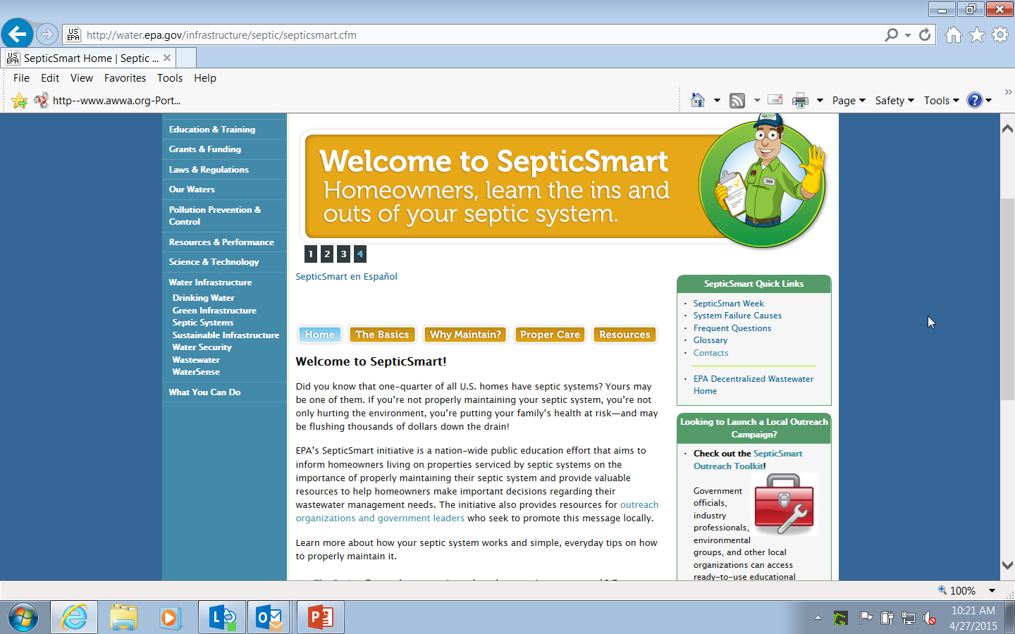
SepticSmart Website
www.epa.gov/septicsmart

Slide 10
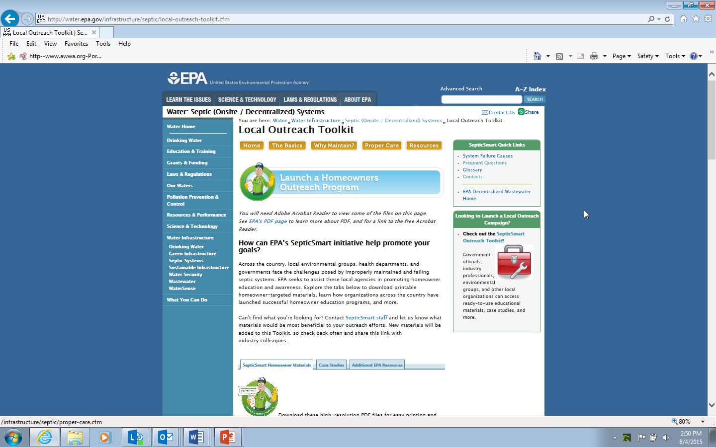
SepticSmart ToolKit

Slide 11
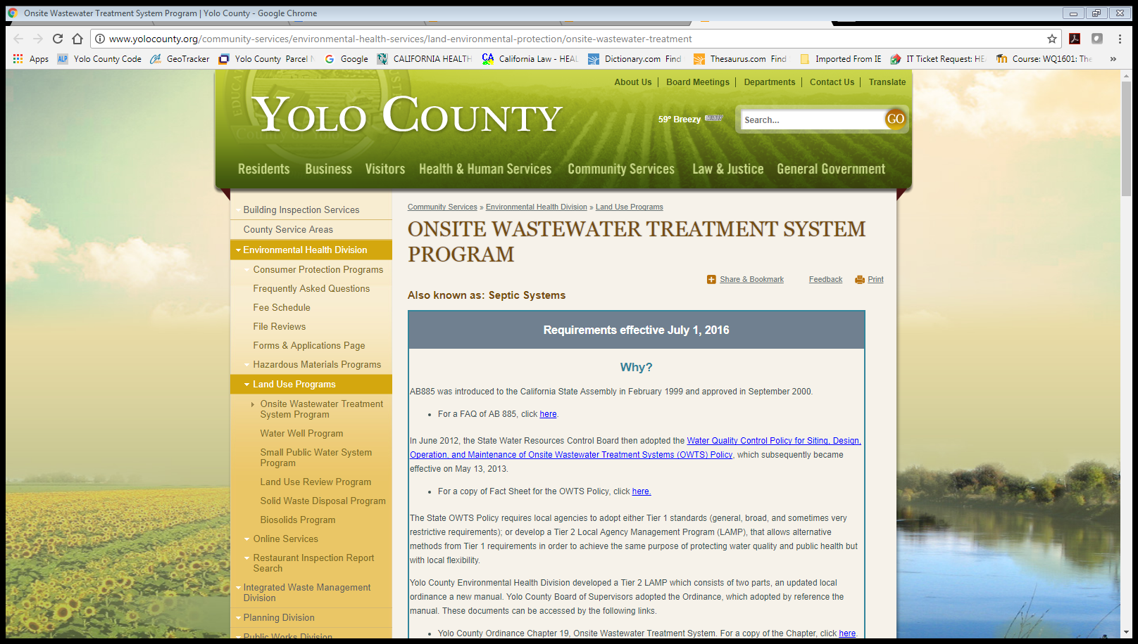
Yolo County Septic System Webpage:
www.yolocounty.org/community-services/environmental-health-services/
land-environmental-protection/onsite-wastewater-treatment

Slide 12
RESOURCES
Toolkit Materials (English & Spanish):
http://water.epa.gov/infrastructure/septic/local-outreach-toolkit.cfm
Homeowners’ Guide (short and long)
Do’s and Don’ts (for conventional and advanced systems)
Mail Insert
Graphics
Door Hanger
Post Card Mailers
Proper Landscaping
Top 10 List
Suggested Activities for Homeowners

Slide 13
Last full week of September each year
The purpose is to educate using the messages of the SepticSmart program across the country about the importance of maintaining and properly caring for your septic system through your daily activities.
Highlighted Activities from past years:
- Dedicated webpage
- Community highlights map
- Blogs
- News articles
- Workshops
- Exhibit of materials
- Proclamations
- PSAs/Radio Spots
Annual SepticSmart Week

Slide 14
September 24-28, 2018
Mark Your Calendars!
SepticSmart Week

