Slide 1
Community Corrections Partnership
Refresh of Strategic Plan

Slide 2
History
Community Corrections Partnership (CCP)
Est. through Senate Bill 678 (2009)
CCPs are to advise each county on best practices in sentencing and probation
Assembly Bill 109 (2011)
Transferred responsibility for supervising specified low level inmates and parolees from state prison/supervision to counties

Slide 3
CCP Strategic Plan 2014-2019
Mission
The mission of the Yolo County Community Corrections Partnership is to protect the public by holding offenders accountable and providing opportunities that support victim and community restoration, offender rehabilitation and successful reintegration.
Goals
Goal 1: Ensure A Safe Environment For All Residents and Visitors By Reducing and Preventing Local Crime
Goal 2: Restore Victims and the Community
Goal 3: Hold Offenders Accountable
Goal 4: Build Offender Competency and Support Community Reintegration
Goal 5: Reduce Recidivism

Slide 4
Reason for Refresh
Population Shift:
Criminal population shift as a result of Prop 47 (switched a number of drug and property related felonies to misdemeanors)
Funding Changes:
Projected budget gap for 2018-19 FY per DFS at current spending levels
Two years into implementation(2016-17), CCP has begun to cut and scale funding for initial strategies

Slide 5
Outreach Goals
Based on your knowledge/experience, what are some key areas of need in the criminal justice system?
Are there areas in need of focus?
What are the needs of individuals in the system?
Are there concerns regarding crime? Or concerns regarding the criminal justice services provided?

Slide 6
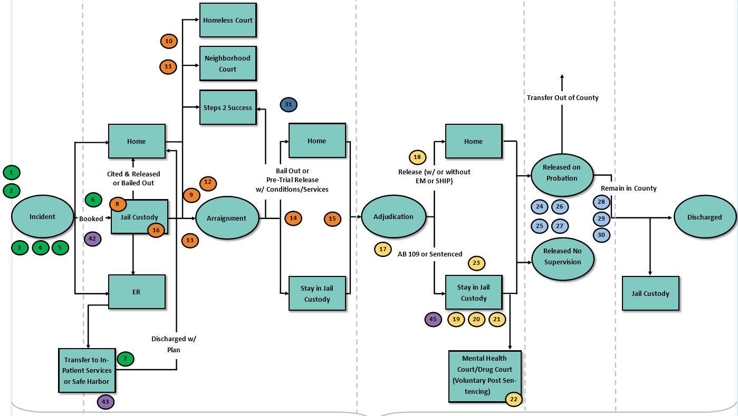
Example: Stepping Up Review

Slide 7
Stepping Up Review
Loss of CIP
Increase law enforcement involvement in diversion programs
Need for Urgent Care Center
Improve VA verification at jails
Connect individuals to outpatient treatment early on
Potential diversion program needed for those later deemed competent
Expand Mental Health Court
Explore ways to fast track or mitigate time in jail awaiting trial for those with mental illness
Limited hours out of jail cell
Jail release planning (Need medication in hand and Medi-Cal reinstated)
Transportation
Case management out of custody to coordinate services
Evaluate 5150 process
Need for greater data sharing

Slide 8
Outreach Goals
Based on your knowledge/experience, what are some key areas of need in the criminal justice system?
Are there areas in need of focus?
What are the needs of individuals in the system?
Are there concerns regarding crime? Or concerns regarding the criminal justice services provided?

