Slide 1
Community Corrections Partnership Strategic Plan Revise Public Input Meeting

Slide 2
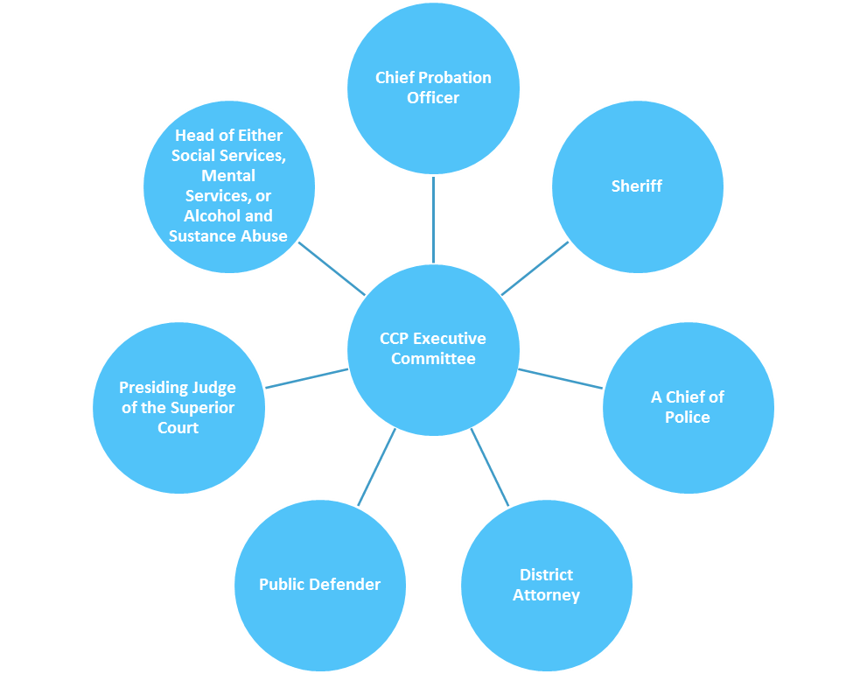
History (Continued)
In May, 2011, Federal Court required that the prison population of California be decreased from 180% of prison capacity to no more than 137.5% of capacity.
Public Safety Realignment Act - Assembly Bill 109 (2011)
Transferred responsibility for supervising specified low level inmates and parolees from state prison/supervision to counties
Created the CCP Executive Committees, which were given funding, and directed to take the lead on realignment efforts.

Slide 3
History (Continued)
Due to the shift in responsibilities, the Counties were forced to shift in their methods for handling the offender populations as well:
Policy changes – Realignment necessitated a shift from departments working independently to working collaboratively.
Philosophical Changes – Due to certain felony offenders being the responsibility of the counties, alternative incentives and methods had to be implemented. Treatment as well as enforcement. Positive incentives in addition to sanctions.

Slide 4
2014-2019 CCP Strategic Planning Process
Background
Board elected to revise initial AB 109 Realignment Mitigation Plan in 2014
Board Ad-hoc Subcommittee established
Included Probation, Sheriff’s Office and District Attorney
Crime and Justice Institute (CJI) Consultant Hired:
Reviewed previous Realignment planning efforts
Completed assessment of funded strategies
Facilitated public planning meetings across Yolo County
Plan approved by CCP and Ad-hoc for 2014-2019

Slide 5
CCP Strategic Plan
Mission
The mission of the Yolo County Community Corrections Partnership is to protect the public by holding offenders accountable and providing opportunities that support victim and community restoration, offender rehabilitation and successful reintegration.
Goals
Goal 1: Ensure A Safe Environment For All Residents and Visitors By Reducing and Preventing Local Crime
Goal 2: Restore Victims and the Community
Goal 3: Hold Offenders Accountable
Goal 4: Build Offender Competency and Support Community Reintegration
Goal 5: Reduce Recidivism

Slide 6
Reason for Revise
Population Shift:
Criminal population shift as a result of Prop 47 (switched a number of drug and property related felonies to misdemeanors)
Progress on Strategic Plan:
Many of the objectives and tasks outlined in the Strategic Plan have been completed.
Funding Changes:
Projected budget gap for 2018-19 FY per DFS at current spending levels
Two years into implementation(2016-17), CCP has begun to cut and scale funding for initial strategies

Slide 7
Community Input
Outreach to advisory bodies and work groups
Local Mental Health Board
Provider Stakeholder Work Group
Substance Use Disorder Providers
Homeless Poverty Action Coalition
Electronic Survey
Public Input Meetings

Slide 8
CCP Strategic Plan Revise Process
Hire new CCP Analyst
Conduct environmental scan
Incorporate public feedback
Reassess mission, goals, and objectives
Draft an action plan
Implement any changes outlined in the Strategic Plan Revise

