Slide 1
Network Adequacy Standards and Certification HHSA Overview
Preliminary Status update
Presented at: Provider Stakeholder Workgroup 6.21.18

Slide 2
Presentation Outline
The 438 Final Rule and Parity
Network Adequacy Standards
Exhibits & Network Adequacy Certification Tool (NACT)
Geographic Information Systems (GIS) Mapping
Reporting Timeline
Next Steps
Managed Care Final Rule, Federal Register, Vol. 81, No. 88, §438.68; §438.206; §438.207; §438.14 : https://www.gpo.gov/fdsys/pkg/FR-2016-05-06/pdf/2016-09581.pdf

Slide 3
The 438 Final Rule & Parity
Who?
CMS
Medicaid Beneficiaries
All County MHPs and DMC-ODS
What?
Mental Health Parity and Addiction Equity Act of 2008
Medicaid and Children’s Health Insurance Program Managed Care Final Rule
When?
Enacted 2016
NA Standards July 1, 2018 & July 1, 2019
Why?
Align Medicaid with other healthcare coverage
Strengthen access to MH/SUD
Notes:
Compliance
Failure to comply will subject Plans to fines, sanctions, penalties, and withholding of FFP

Slide 4
Network Adequacy Standards
Timely Access: Timeliness
Mental Health
Outpatient 10 business days to appointment from request
Specialty (psychiatry) 15 days to appointment from request
SUD
Outpatient 10 business days to appointment from request
Opioid Treatment Program 3 business days to appointment from request
Availability of Services: Time and Distance Requirements
Mental Health
Under 45 miles or 75 minutes from residence
SUD
60 miles or 90 minutes from residence
Assurances of Adequate Capacity and Services
http://www.dhcs.ca.gov/formsandpubs/Documents/FinalRuleNAFinalProposal.pdf

Slide 5
Required Exhibits & Network Adequacy Certification Tool-NACT
Supporting documentation:
Policies and Procedures
Network Adequacy
Out of Network Access
Timely Access
Service Availability
Physical Accessibility
Telehealth Services
24/7 Access Line Requirements
24/7 Language Assistance
Provider Subcontracts
Provider Directory
Results of Beneficiary Satisfaction Surveys
Grievances and Appeals
Language Line Utilization
NACT Tool
NACT
Network Provider Data
Am Indian Health Facilities
Provider Counts & Utilization
Network Org/Site Data
Community Based Services
County Owned and operated providers; Contracted organizational providers

Slide 6
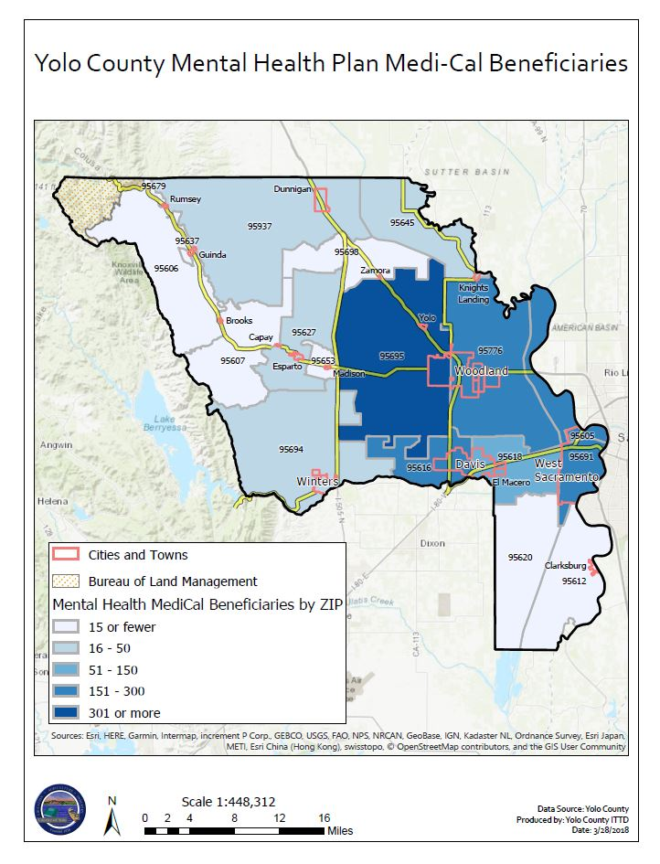
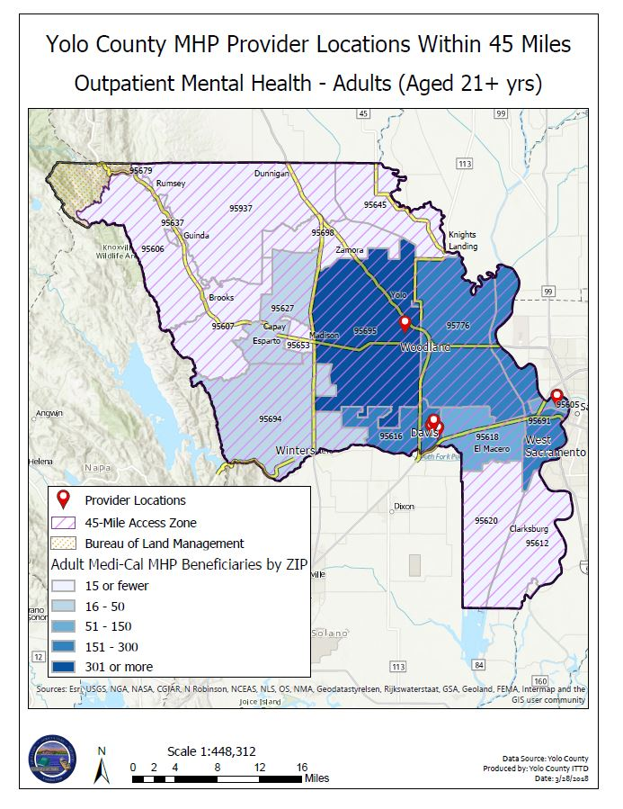
Geographic Information Systems (GIS) Mapping: Visual Storytelling

Slide 7
Reporting Timeline
Quarterly & Annual Deadlines:
Quarterly Update - October 1, 2018 (reporting period: March 1, 2018 – August 31, 2018)
Quarterly Update - January 2, 2019 (reporting period: September 1, 2018 – November 30, 2018)
Annual Update - April 1, 2019 (reporting period: December 1, 2018 – February 28, 2019)
Quarterly Update - July 1, 2019 (reporting period: March 1, 2019 – May 31, 2019)
DMC-ODS – Timeline begins April 1, 2019

Slide 8
Next Steps…
Post NACT submission March 29, 2018 5pm ☺
DHCS to contact MHPs within the next two weeks regarding network analysis, preliminary findings, and required corrective actions
DHCS will require additional information to fulfill network adequacy requirements (e.g. timely access and network infrastructure)
Clarification and revised NACT tool forthcoming
Quality Management will reach out to providers upon receipt of this new information

Slide 9
Questions?
Contact:
Fabian Valle, QM Analyst
530-661-2745
fabian.valle@yolocounty.org
References:
Managed Care Final Rule, Federal Register, Vol. 81, No. 88:
https://www.federalregister.gov/documents/2016/05/06/2016-09581/medicaid-and-childrens-health-insurance-program-chip-programs-medicaid-managed-care-chip-delivered
Medicaid Mental Health Parity Final Rule Federal Register:
https://www.gpo.gov/fdsys/pkg/FR-2016-03-30/pdf/2016-06876.pdf
DHCS MHSUDS Information Notice 18-011:
http://www.dhcs.ca.gov/services/MH/Documents/Information%20Notices/IN%2018-%20Network%20Adequacy/MHSUDS_IN_18-011_Network_Adequacy.pdf

