Slide 1
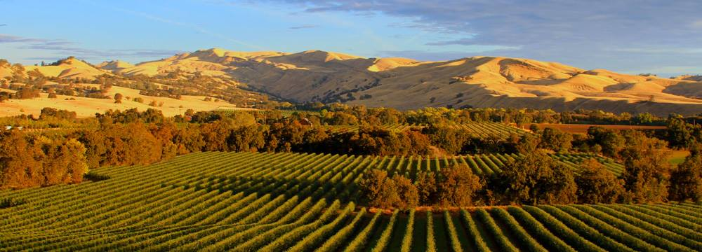
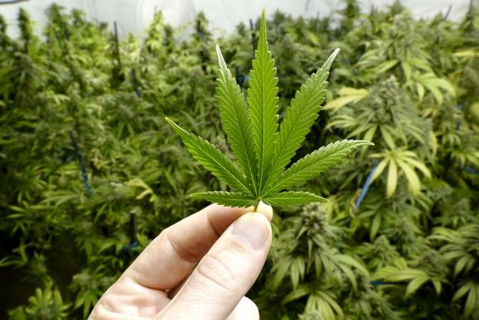
Cannabis Cultivation Regulatory Program
Harihar Nepal (M.S.)
Environmental Scientist
Cal EPA – Water Board, Central Valley Region

Slide 2
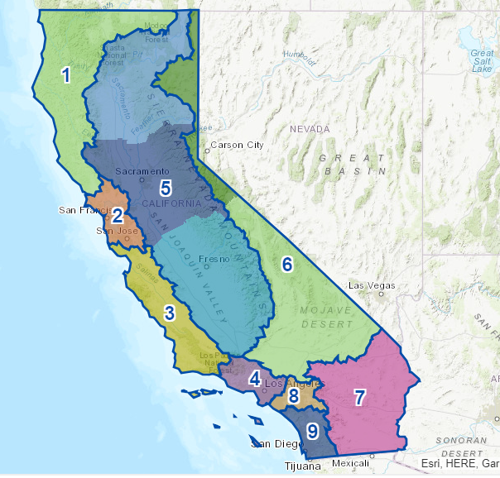
WHO WE ARE
“To preserve, enhance, and restore the quality of California's water resources and drinking water for the protection of the environment, public health, and all beneficial uses, and to ensure proper water resource allocation and efficient use, for the benefit of present and future generations.”
Our Mission
Notes:
State board was created in 1960s to protect water quality, to implement the federal clean water act
We are region 5, central valley water board Redding cannabis unit
There are nine regional water quality control boards. Regional boundaries are based on watersheds. water quality requirements are based on the unique differences in climate, topography, geology and hydrology for each watershed. Each Regional Board makes water quality decisions for its region, including setting standards, issuing waste discharge requirements, etc.
Region 5 consists of two watersheds Sacramento River and San Joaquin river watersheds
Cannabis regulation is new to this region.
Now let me talk briefly about cannabis

Slide 3
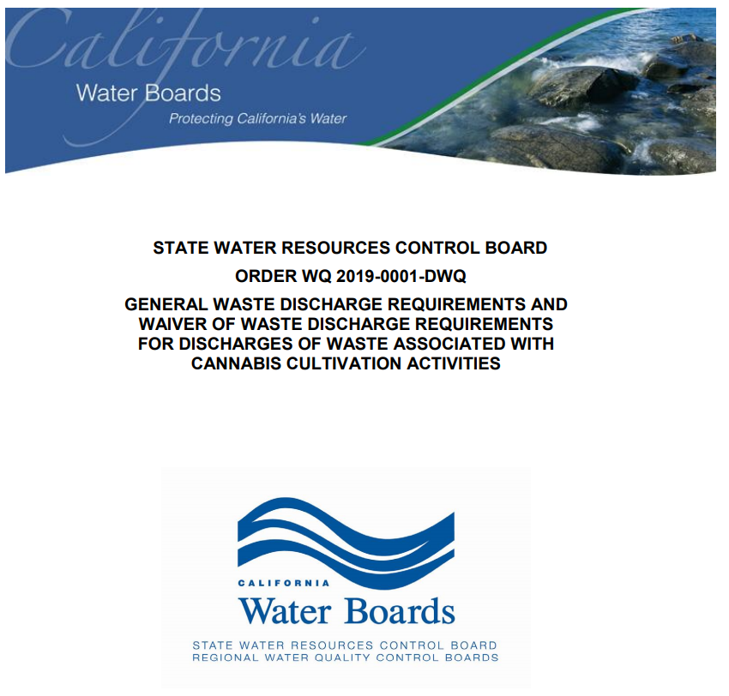
Notes:
Today, I am going to go over the Cannabis General order 2019. First of all, lets see how many of you have seen this document/book/digital copy before? This is the one of the document you should have on site (available either paper or digital form) all the time during the operation. Its free to download and you can print yourself if you wish to keep hard copy.

Slide 4
ACRONYMS AND ABBREVIATIONS
BPTC: Best Practicable Treatment or Control
CDFA: California Department of Food and Agriculture
CDFW: California Department of Fish and Wildlife
CEQA: California Environmental Quality Act
CDFW: California Department of Fish and Wildlife
DPR: Department of Pesticides Regulation
ILRP: Irrigated Lands Regulatory Program
NOA: Notice of Applicability
NOT: Notice of Termination
NPDES: National Pollutant Discharge Elimination System

Slide 5
FINDINGS – BACKGROUND
Cannabis cultivation in California has grown exponentially in recent years and is often located in sensitive environmental areas
Water Code section 13149 required the State Water Board to adopt principles and guidelines for diversion and use of water for cannabis cultivation in areas where cannabis cultivation may have the potential to substantially affect instream flows.
The State Water Board does not, in any way authorize, endorse, sanction, permit or approve the cultivation, use, sale or other activities associated with cannabis. Individuals engaging in cannabis cultivation and other activities risk prosecution under federal law.
Section 19332 (d) directs the State Water Board, with CDFW and CDFA, that individual and cumulative effects of water diversion and discharges associated with cannabis cultivation do not affect the instream flow needed for fish spawning, migration, rearing, and the flows needed to maintain natural flow variability.
Notes:
In the first couple of slides we will go through how we get here, we as water board and other state and local agencies to regulate cannabis cultivation. we will look at some water codes from California Law that led us to regulate the discharge from cannabis cultivation. There are two parts of cannabis cultivation regulations (out of many) that Water boards regulate, Water Rights part and Water Quality part. This General order was adopted to regulate both parts and I will only go over Water Quality regulation part. I will have the contact info about water right part, if you need.
The principles and guidelines- instream flow objectives, limits on diversions, and requirements for screening of diversions and elimination of barriers to fish passage.

Slide 6
FINDINGS – BACKGROUND
This General Order Implements the Cannabis Policy requirements that address waste discharges associated with cannabis cultivation activities
Two Regional Water Boards have adopted orders related to cannabis cultivation on 2015, Central Valley Region and North Coast Region.
If a Regional Water Board determines that due to site-specific conditions, coverage under this General Order will not be protective of water quality, the Regional Water Board may issue site-specific WDRs for discharges from a cannabis cultivation site.
The Cannabis Policy provides a statewide tiered approach.
The Cannabis Policy provides criteria to evaluate the threat to water quality based on site conditions.
Dischargers must implement all applicable BPTC measures described in Attachment A
Notes:
4. This will describe the water quality policy structure, and requirements, reporting, and guidance, how to apply, terminate, applicable fees and reporting requirements.
6. It is the intent of the water board enroll all eligible dischargers under this general order, however site specific WDR may issue
7. Tiered based on project size (footprint)
8. Threat based on disturbed area, slope and proximity to a surface water body.
9. Best practicable treatment or control
Dischargers that cultivate in multiple areas within a parcel or contiguous parcels shall add all the disturbed areas together to calculate the total disturbed area.
b. Risk determination based on the site conditions shall be based on the greatest threat to water quality.
c. Dischargers that cultivate cannabis on non-contiguous parcels must evaluate each parcel for regulatory coverage separately.

Slide 7

FINDINGS – BACKGROUND
Personal use exempt dischargers meeting the criteria don’t need to apply for converge , however, conditionally exemption, either indoor or outdoor will be covered under the waiver of WDRs in this General Order.
Site development and/or access road building activities should have followed the Handbook for Forest Ranch, & Rural Road (Road Handbook).
Notes:
10. Tier 1 and 2 must have risk characterized
11.

Slide 8
FINDINGS – BACKGROUND
EXEMPTIONS FOR CERTAIN CULTIVATION ACTIVITIES
Personal use – disturb less than 1000 sq. ft. and lowest threat to water quality. – not a commercial activities. Not required to submit any application information. the personal use exemption, a Discharger must comply with all of the following conditions:
The cultivation area shall be contiguous (all located in one area).
The disturbed area complies with the setback requirements contained in this General Order (see Attachment A) and occupies less than 1,000 square feet.
No part of the disturbed area is located on land with a slope greater than 20-percent.
The Discharger implements all applicable BPTC measures listed in Attachment A.
Notes:
12. The 1,000 square feet personal use exemption criteria provides sufficient area for outdoor cultivation of six mature plants for non-medical use, or 500 square feet of cannabis plant canopy as allowed for medical cultivation purposes.
The exemptions apply per parcel or contiguous parcels; no coalitions, cooperatives, or other combination of cultivation
If the personal use exemption does not apply, the Discharger shall contact the Regional Water Board to determine if the activity qualifies for coverage as conditionally exempt, or Tier 1 or Tier 2 enrollment.

Slide 9
FINDINGS – BACKGROUND
EXEMPTIONS FOR CERTAIN CULTIVATION ACTIVITIES
Conditionally Exempt– outdoor disturb less than 2000 sq. ft. and lowest threat to water quality. Required to submit any application information. the personal use exemption, a Discharger must comply with all of the following conditions:
The cultivation area shall be contiguous (all located in one area).
The disturbed area complies with the setback requirements contained in this General Order (see Attachment A) and occupies less than 2,000 square feet.
No part of the disturbed area is located on land with a slope greater than 20-percent.
d. The Discharger implements all applicable BPTC measures listed in Attachment A.

Slide 10
FINDINGS – BACKGROUND
EXEMPTIONS FOR CERTAIN CULTIVATION ACTIVITIES
Conditionally Exempt– The Conditional exemption does not alter any other legal requirements
Completely Indoor : a structure with a permanent roof, relatively impermeable floor, and
  Discharge all industrial wastewater generated to a permitted wastewater treatment collection system
  Collect all wastewater in an appropriate storage container to be stored and properly disposed by hauler
  Discharges of irrigation tailwater, hydroponic wastewater or other industrial wastewaters from indoor to an on-site wastewater treatment system like septic tank and leach
  Still require to apply for permit.

Slide 11
FINDINGS – BACKGROUND
EXEMPTIONS FOR CERTAIN CULTIVATION ACTIVITIES
Conditionally Exempt– The Conditional exemption does not alter any other legal requirements
Completely Indoor
Permanent Roof, Floor Semi-Impermeable

Slide 12
FINDINGS – BACKGROUND
WATER CODE CONSIDERATIONS
Water Code section 13260(a) requires obtain coverage under WDR or a waiver to discharge any waste to the waters of the state
Water Code section 13146 requires implement the Regional Water Board’s Water Quality Control Plan (Basin Plan).
Water Code section 13263(i) and 13269 – General Order and waiver conditions
Water Code section 13263(g) – All discharges of waste into waters of the state are privileges not rights.
Water Code section 106.3 – it is the policy of the State of California that every human being has the right to safe, clean, affordable and accessible water .
Notes:
15. any person, citizen, or domiciliary discharging waste or proposing to discharge waste within any region, other than to a community sewer system, that could affect the quality of the waters of the state, file a report of waste discharge (RWD) to obtain coverage under WDRs or a waiver or WDRs.
16. This General Order requires Dischargers to comply with all applicable Basin Plan requirements, including prohibitions and/or water quality objectives governing the discharge.
17. The State Water Board’s authority to regulate discharges associated with cannabis cultivation. All discharges regulated under this order will be from similar operations and/or activities related to cannabis cultivation, which pose similar types of threat to water quality. The discharges will use similar treatment methods (e.g., filtration, settling, setbacks, application to land, etc.). Individual WDRs are not necessary
18. no discharge of waste into waters of the state, whether or not the discharge is made pursuant to waste discharge requirements, shall create a vested right to continue the discharge.

Slide 13
FINDINGS – BACKGROUND
REGULATORY CONSIDERATIONS
The Cannabis Policy includes instream flow objectives, limits on diversions.
Health and Safety Code Section 11362.2 - local municipalities have land use authority and this General Order does not supersede any requirements, ordinances or regulations of local municipalities.
Those requirements, ordinances or regulations may change over time.
The Regional Water Boards Executive Officer may terminate permits coverage under the General Order if needed to protect water quality.
Industrial hemp is exempt from regulation under this General Order.
Activities performed in and around stream and lake subject to the Forest Practice Rules shall be implemented.
Diversion of water or any alteration of a lake, streambed requires CDFW notification and permitting.
Notes:
20. The Cannabis Policy includes instream flow objectives, limits on diversions, requirements for screening of diversions and elimination of barriers to fish passage. Cannabis cultivation activities statewide are required to comply with the requirements of the Cannabis Policy.
22. Authorization to discharge waste from cannabis cultivation activities under this General Order may be revoked based on those conditions.
24. Industrial hemp is regulated by the CDFA, commencing with section 81000 of the Food and Agricultural Code. Cultivation of industrial hemp shall be performed consistent with the Regional Water Board’s ILRP.
25. The California Forest Practice Rules designate watercourse (stream) and lake protection zones, protective measures based on the beneficial use, and whether the watercourse is natural or manmade. Activities performed in areas subject to the Forest Practice Rules shall be implemented consistent with the permitting, licensing, and performance standards of the Forest Practice Rules, and the requirements of the Cannabis Policy and this General Order, whichever is more protective.
26. Diversion of water or any other alteration of a lake or streambed (including alterations that result from construction or modification of culverts, etc.) requires CDFW notification and permitting. CDFW manages California’s fish and wildlife resources and habitats for their ecological value and enjoyment by the public. CDFW may issue Lake or Streambed Alteration Agreements (also known as “1600 Agreements”) that may limit water diversions to ensure that public resources are protected or impose additional conditions

Slide 14
FINDINGS – BACKGROUND
APPLICATION/TERMINATION PROCESS AND FEES
Applicants must comply with the setback and slope limits.
Applicants seeking coverage under the Waiver or that are required to enroll are required to pay an application fee. The application and annual fee schedule is presented in California Code of Regulations, title 23, section 2200
To apply for coverage under this General Order, the Discharger shall submit an application through the Internet.
Dischargers that want to terminate coverage under this General Order shall submit a Notice of Termination (NOT), provided in Attachment C.
Notes:
26 – 42 are region specific and TMDL specific.
43. Because such Dischargers pose a higher risk to water quality and will require a higher level of Regional Water Board oversight, they are subject to a higher application and annual fee. When the site is reconfigured to comply with the setbacks, the Discharger can request the Regional Water Board to reclassify the site to a lower risk level and allow a lower annual fee to be assessed
44. Water Code sections 13260(d)(1)(A) and 13269 (a)(4)(A) requires persons subject to waste discharge requirements or a waiver of waste discharge requirements to pay an annual fee according to a fee schedule established by the State Water Board. The application and annual fee schedule is presented in California Code of Regulations, title 23, section 2200 et seq.
45. to self-certify that all applicable BPTC measures are being implemented, or will be implemented by the onset of the winter period, following the enrollment date. The notice of receipt will expire within 30 days of issuance if the Discharger fails to complete the application by submitting the application fee to the State Water Board.

Slide 15
FINDINGS – BACKGROUND
PROVISIONS
All technical reports shall be submitted to the appropriate Regional Water Board by transmitting the report in portable document format (pdf) to the e-mail address provided in the NOR.
  SMP – within 90 days of the issuance of a NOR - all Tiers
  Site Erosion and Sediment Control Plan (SESC) – the plan shall be approved prior to implementation
  Disturbed Area Stabilization Plan (DASP) – the plan shall be approved period to implementation
  NMP for the facility – within 90 days of the issuance of a notice of receipt.
  NOT – at least 90 days prior to ending cannabis cultivation – all tiers and CE. NOTF with site closure report.
Notes:
SMP – within 90 days of the issuance of a NOR. The Site Management Plan may include a schedule to achieve compliance, but all work must be completed by the onset of winter period each year.
IV - The NMP shall calculate all the nitrogen applied to the cannabis cultivation area (dissolved in irrigation water, originating in soil amendments, and applied fertilizers) and describe procedures to limit excessive fertilizer application.

Slide 16
FINDINGS – BACKGROUND
PROVISIONS – Standard for all Dischargers
The requirements prescribed herein do not authorize the commission of any act causing damage to the property of another, or protect the Discharger from liabilities under federal, state or local laws.
This General order does not relieve the Discharger from responsibility to obtain other necessary local, state, or federal permits.
The requirements of this General Order are severable.
The Discharger shall ensure that all site operating personnel are familiar with the contents of the General Order.
Notes:
c. The requirements of this General Order are severable. If any provision of this General Order is held invalid, the remainder of this General Order shall not be affected.
d. A copy of this General Order and technical reports required by this General Order shall be kept at the cultivation site. Maintenance of electronic copies of the documents, that can immediately be viewed, is acceptable.

Slide 17
FINDINGS – BACKGROUND
PROVISIONS – Standard for all Dischargers
The state Water Board will review this General Order periodically and will revise requirements when necessary.
The Regional Board Executive Officer or State Water Board Division of Water Quality Deputy Director or the State Board Chief Deputy Director may terminate a Discharger’s coverage under this General Order for cause including, but not limited to, any of the following:
  Violation of any of the terms or conditions
  Obtaining this General Order by misrepresentation or failure to disclose fully
  A change in any condition that results in either a temporary or permanent need to reduce or eliminate the authorized discharge activities
  A material change in the activity, character, location or volume of discharge.
  Adoption of a TMDL amendment, new TMDL or TMDL alternative.

Slide 18
FINDINGS – BACKGROUND
PROVISIONS – Standard for all Dischargers
Before making a material change in the activity, character, location or volume of discharge, the Discharger shall notify the Regional Water Board.
Except for material determined to be confidential in accordance with California law, all reports prepared shall be available for public inspection at the offices of the Regional Water Board.
Notes:
A material change includes, but is not limited to, any of the following:
i. An increase in cultivation area
ii. A significant change in the operational activities that have the potential to increase or create a discharge to waters of the state (e.g., new green houses, change in wastewater disposal method, or new activity such as cannabis manufacturing).
The Regional Water Board Executive Officer may require resubmittal of application information, technical reports, or certifications.

Slide 19
FINDINGS – BACKGROUND
PROVISIONS – Standard for all Dischargers
The discharger shall permit representatives of the Water Board to enter premises where cannabis is cultivated, processed, wastes are treated, stored or disposed. Sample, photograph, and/or video record any cultivation activity, discharge, waste material, waste treatment system, or monitoring device.
Notes:
The Discharger shall permit representatives of the Regional Water Board and/or the State Water Board, upon presentation of credentials, to:
Enter premises where cannabis is cultivated or processed, wastes are treated, stored, or disposed of, and facilities in which any records are kept.
Copy any records required under terms and conditions of this General Order.
Inspect at reasonable hours, monitoring equipment required by this General Order
Sample, photograph, and/or video record any cultivation activity, discharge, waste material, waste treatment system, or monitoring device.

Slide 20
FINDINGS – BACKGROUND
PROVISIONS – Standard for all Dischargers
Any of the following changes must immediately be reported to the Regional Water Board Executive Officer:
i. A change in ownership of the parcel where the cultivation activities take place. The Discharger or owner must notify the succeeding owner of the existence of this General Order by letter, a copy of which shall immediately be forwarded to the Regional Water Board’s Executive Officer.
ii. A change of the permitted facility operator.
iii. A change in a third-party representative.

Slide 21
ATTACHMENT A: CANNABIS POLICY ATTACHMENT A DEFINITIONS AND REQUIREMENTS FOR CANNABIS CULTIVATION ORDER WQ 2019-0001-DWQ

Slide 22
ATTACHMENT A - DEFINITIONS
Access Road – that provides access to one or more cannabis cultivation areas.
Cannabis Cultivation – Any activity involving or necessary for the planting, growing, pruning, harvesting, drying, curing, or trimming of cannabis.
Cannabis Cultivation Area – is defined by the following:
  a) For in-ground plants, - defined by the perimeter of the area planted, including any immediately adjacent surrounding access pathways.
  b) For plants grown outdoors in containers , - perimeter of the area that contains the containers, including any immediately adjacent surrounding access pathways. The area is not limited to the sum of the area of each individual container.
  c) For plants grown indoors, that do not qualify for the CE, it is defined by the entire area contained in the structure where cultivation occurs including areas used for storage of materials, equipment, or items related to cannabis cultivation .
Notes:
This section provides definitions for 108 terms used throughout the Order. Many useful definitions can be found here, including: Watercourse (Class 1-4 which determines setback requirements), Land Disturbance (what counts towards the ‘disturbed area’ calculation that defines the Tier enrollment needed), and Qualified Professional (what type of credentials someone needs to have to create reports for your site)

Slide 23
ATTACHMENT A - DEFINITIONS
Disturbed Area – defined as Land Disturbance – where natural conditions have been modified.
- includes all activities whatsoever associated with developing or modifying land for cannabis cultivation related activities or access.
- include, but not limited to, construction of roads, buildings, water storage areas; excavation, grading, and site clearing.
- also includes cultivation area, storage areas where soil or soil amendments are located.
Notes:
Disturbed land includes cultivation areas, storage areas where soil or soil amendments (e.g., potting soil, compost, or biosolids) are located.
Access roads that are designed, constructed, and maintained, or are reconstructed consistent with the Handbook for Forest, Ranch, and Rural Roads (Road Handbook), and that implement the interim and long-term erosion prevention and soil stabilization measures contained in Attachment A, are not considered disturbed areas for the purpose of tier determination under the Cannabis Cultivation General Order.

Slide 24
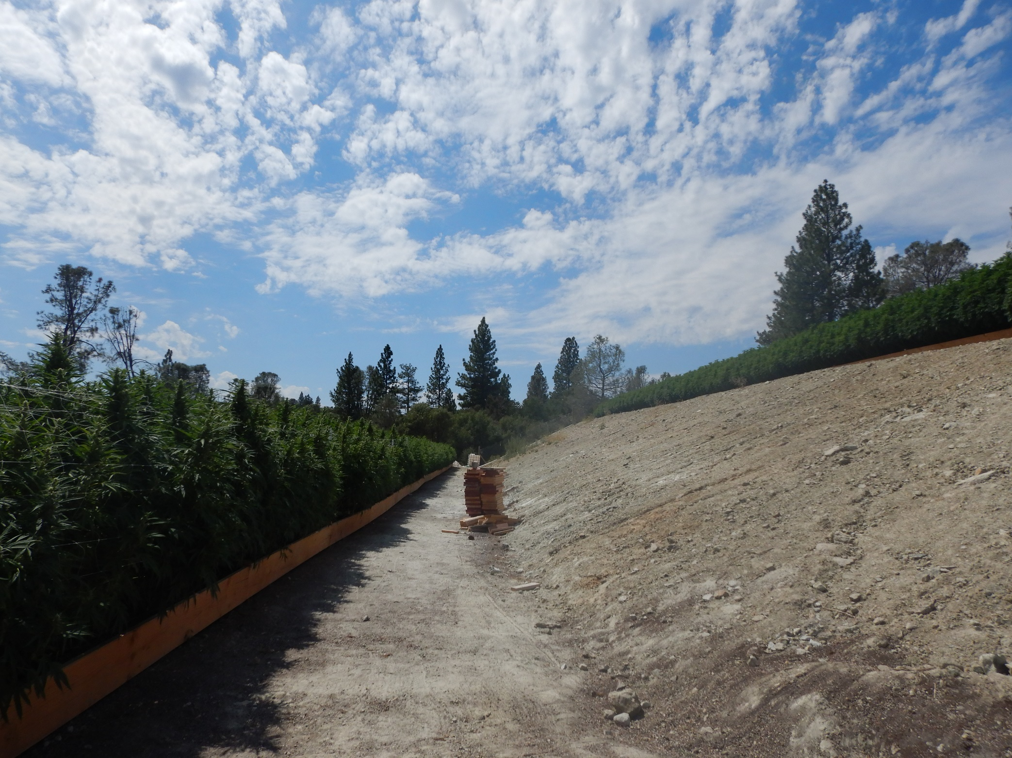
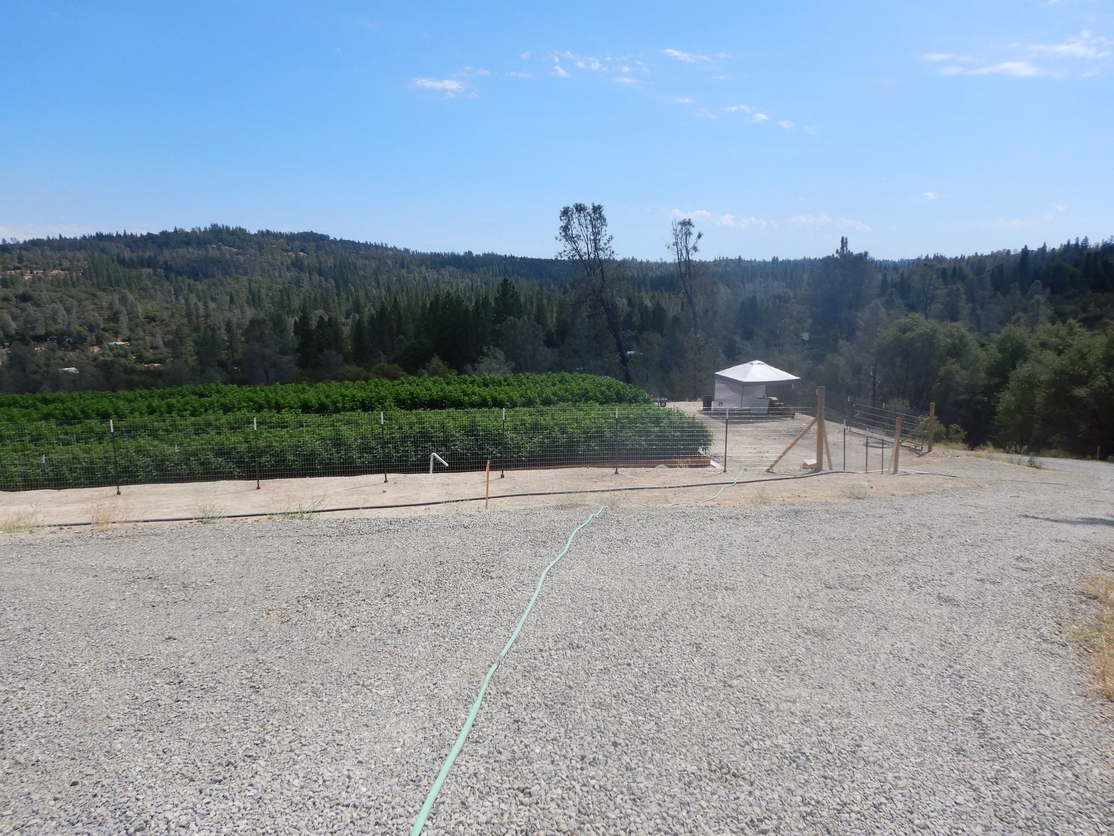
ATTACHMENT A - DEFINITIONS
Notes:
Example for cultivation area vs disturbed area

Slide 25

ATTACHMENT A - DEFINITIONS
Slope for Risk Determination – shall be determined across the natural topography (preconstruction) of the land to be disturbed.
Notes:
Slope –Measure the highest and lowest elevations of the land to be disturbed, then measure the horizontal distance separating the highest and lowest elevations. Determine the slope using the formula below. (Multiple the ratio by 100 to find the percent value.) There may be more than one slope value if the low elevation has higher elevations in different directions. The highest slope value calculated (highest percentage numerically) is the value to be reported.
Slope – Value of slope expressed as a percentage.
Elevation difference – Report in feet to an accuracy of one inch or one tenth of a foot.
Horizontal distance – Report in feet to an accuracy of one inch or one tenth of a foot.

Slide 26
ATTACHMENT A - DEFINITIONS
Watercourse – a natural or artificial channel through which water flows
  Class I: Perennial Watercourse – flows for more than 9 months, habitat to sustain fish migration and spawning, fish present always or seasonally, and spring.
  Class II: Intermittent watercourse – flows 3 to 9 months, aquatic habitat for non-fish aquatic species, within 1000 ft of class I, fish bearing watercourse
  Class III: Ephemeral watercourse – flows less than 3 months, does not support riparian vegetation or aquatic life.
  Class IV: Other watercourse – does not support native aquatic species, are man-made, established domestic, agricultural or other beneficial use

Slide 27
ATTACHMENT A - DEFINITIONS
Winter Period – calendar dates from November 15 to April 1
Notes:
A Regional Water Board Executive Officer may impose a more restrictive winter period to protect water quality based on special county rules or as specified in a Basin Plan. The following special rules or basin plan requirements apply: i. Santa Clara County, Santa Cruz County, and Monterey County: October 15 to April 15; ii. Marin County: October 1 to April 15; and iii. Lahontan Regional Water Board: October 15 to May 1 (for elevations above 6,000 feet).

Slide 28
ATTACHMENT A –
GENERAL REQUIREMENTS AND PROHIBITIONS
Notes:
This section details general requirements for cultivators to be in compliance with the Water Boards general order. Many, if not most, are requirements by other agencies. Thus, we require for the cultivators to be in compliance with all state and local agencies to also be in complied with our agency. This includes and LSA with CDFW, CRI and BSA which is usually required at a county level before land disturbance, and all CalFIRE and CDFW laws. It also clarifies that the Order does not permit any discharges to surface waters or anything leading to the degradation of surface waters.

Slide 29
ATTACHMENT A –
GENERAL REQUIREMENTS AND PROHIBITIONS
1. Prior to commencing any cannabis cultivation activities, including cannabis cultivation land development or alteration, the cannabis cultivator shall comply with all applicable federal, state, and local laws, regulations, and permitting requirements, as applicable
4. The cannabis cultivator is responsible for meeting all requirements under the California ESA and the federal ESA.
Notes:
Construction Storm Water Permit
LSA Lake and Streambed Alteration Agreement (LSA Agreement) or consult with CDFW
shall not take any action which results in the taking of Special-Status Plants, protected species
California Endangered Species Act

Slide 30
ATTACHMENT A –
GENERAL REQUIREMENTS AND PROHIBITIONS
6. Cannabis cultivators shall ensure land disturbing activities are completed and site stabilization measures are in place prior to the onset of the winter period.
7. A California Licensed Timber Operator (LTO)3 shall be used if any commercial tree species are to be removed from the cannabis cultivation site.
Notes:
6 To avoid water quality degradation from erosion and sedimentation, land disturbance activities shall not occur during the winter period unless authorized by a Regional Water Board Executive Officer. All land disturbing activities during the winter period shall be supervised by a Qualified Professional.
calendar dates from November 15 to April 1
7. All timberland conversions shall be permitted and compliant with the Forest Practice Rules and CAL FIRE permitting requirements.

Slide 31
ATTACHMENT A –
GENERAL REQUIREMENTS AND PROHIBITIONS
9. During land disturbance activities, the cannabis cultivator shall review, evaluate and maintain records of daily weather forecast. The cannabis cultivator shall cease land disturbance activities and shall implement erosion control in which the applicable daily weather forecast reports a 50 percent or greater chance of precipitation greater than 0.5 inch per 24 hours.
10. Prior to commencing any cannabis land development or site expansion activities, the cannabis cultivator shall retain a Qualified Biologist to identify sensitive plant, wildlife species, or communities at the proposed development site.
Notes:
During land disturbance activities, the cannabis cultivator shall review and evaluate the applicable daily weather forecast and any applicable 24 hour forecast4 at least once per 24 hour period and maintain records of the weather forecast for each day land disturbance activities are conducted. The cannabis cultivator shall cease land disturbance activities and shall implement erosion control Requirements described in this Policy during any 24 hour period in which the applicable daily weather forecast or any 24 hour forecast reports a 50 percent or greater chance of precipitation greater than 0.5 inch per 24 hours.

Slide 32
ATTACHMENT A –
GENERAL REQUIREMENTS AND PROHIBITIONS
11. To prevent transfer of invasive species, all equipment used at the cannabis cultivation site shall be clean before arriving and before leaving the site.
13. The cannabis cultivator shall immediately report any significant hazardous material release or spill that causes a film or sheen on the water’s surface, leaves a sludge or emulsion beneath the water’s surface to the CalOES, Local Unified Program Agency, Regional Boards, and CDFW.

Slide 33
ATTACHMENT A –
GENERAL REQUIREMENTS AND PROHIBITIONS
18. Cannabis cultivators shall not commit trespass.
19. Prior to acting on a cannabis cultivator’s request to cultivate cannabis on tribal lands or within 600 feet of tribal lands, the Water Boards will notify the governing body of any affected California Native American tribe or the governing body’s authorized representative, as applicable. A 45-day review period will commence upon receipt of the notice by the affected tribe.
Notes:
18 easement, open space easement, or greenway easement. This includes, but is not limited to, land owned by the United States or any department thereof, the State of California or any department thereof, any local agency, or any other person who is not the cannabis cultivator. Trespass grow will be considered as illegal grow.
19. During the 45-day review period, the affected tribe may, at its discretion, accept, reject, or not act regarding the cannabis cultivation proposal. If the tribe rejects the proposed cultivation, the cannabis cultivator is prohibited from cultivating cannabis on or within 600 feet of the affected tribe’s tribal lands. If the affected tribe accepts the cannabis cultivation proposal or does not act during the 45-day review period, the Water Boards may proceed with a decision on the cannabis cultivation request as though the affected tribe accepted the cannabis cultivation proposal. The Water Boards will consider requests to extend the 45-day review period on a case by case basis.

Slide 34
ATTACHMENT A –
GENERAL REQUIREMENTS AND PROHIBITIONS
21. Prior to land disturbance activities for new or expanded cannabis cultivation activities, the cannabis cultivator shall either conduct or request a records search of potential Native American archeological or cultural resources at a California Historical Resources Information System (CHRIS) information center and document the results.
22. If any buried archeological materials or indicators10 are uncovered or discovered during any cannabis cultivation activities, all ground- disturbing activities shall immediately cease within 100 feet of the find.
Notes:
In the event that prehistoric archeological materials or indicators are discovered, the cannabis cultivator shall also notify the Native American Heritage Commission within 48 hours of any discovery and request a list of any California Native American tribes that are potentially culturally affiliated with the discovery. T
22 The cannabis cultivator shall notify the Appropriate Person within 48 hours of any discovery. The Appropriate Person is the Deputy Director if the cannabis cultivator is operating under the Cannabis SIUR, the Regional Water Board Executive Officer if the cannabis cultivator is operating under the Cannabis Cultivation General Order or Cannabis General Water Quality Certification, or both if the cannabis cultivator is operating under both programs.

Slide 35
ATTACHMENT A –
GENERAL REQUIREMENTS AND PROHIBITIONS
23. Upon discovery of any human remains, cannabis cultivators shall immediately comply with Health and Safety Code section 7050.5 and, if applicable, Public Resources Code section 5097.98. All ground-disturbing activities in the vicinity of the discovery shall stop immediately. The cannabis cultivator shall immediately notify the county coroner.
Notes:
Per Health and Safety Code section 7050.5, the coroner has two working days to examine human remains after being notified by the person responsible for the excavation, or by their authorized representative. If the remains are Native American, the coroner has 24 hours to notify the Native American Heritage Commission.

Slide 36
ATTACHMENT A –
GENERAL REQUIREMENTS AND PROHIBITIONS
25 & 26. Cannabis cultivators shall not discharge waste, irrigation runoff, tailwater, sediment, plant waste, chemicals, and hazardous material in a manner that creates or threatens to create a condition of pollution or nuisance, as defined by Water Code section 13050.
34. Cannabis cultivators shall implement interim Requirements immediately following land disturbance, to minimize discharges of waste constituents. Cannabis cultivators shall complete all winterization Requirements prior to the onset of the winter period.
Notes:
When I say “shall not discharge” here means directly discharge into the watercourse, like as in point source. For example if you have a sediment basin, you can not directly discharge water from the basin into the natural watercourse via a culvert, or narrow cannel. There must be setback distance as buffer between the source and watercourse.
34 interim requirements are during and after the construction, BMP required.

Slide 37
ATTACHMENT A –
GENERAL REQUIREMENTS AND PROHIBITIONS
36. The landowner is ultimately responsible for any water quality degradation that occurs on or emanates from its property and for water diversions that are not in compliance with this Policy.
Notes:
36. Landowners will be named as responsible parties and will be notified if a Cannabis Cultivation General Order Notice of Applicability or conditional exemption has been issued for cannabis activities on their property. The cannabis cultivator and the landowner will be held responsible for correcting non-compliance.

Slide 38
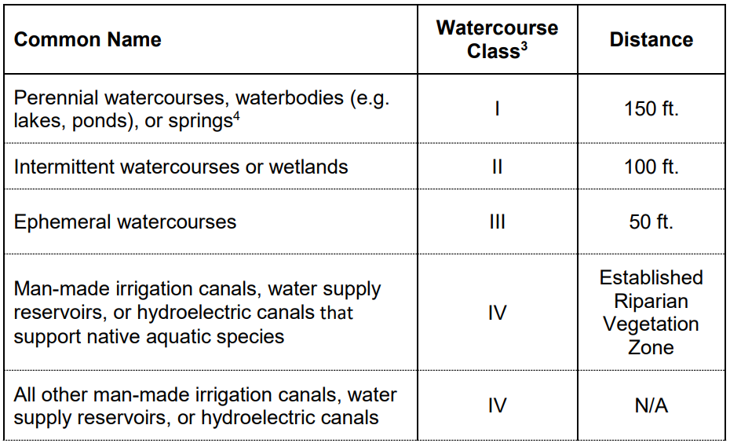
ATTACHMENT A –
GENERAL REQUIREMENTS AND PROHIBITIONS
37. Cannabis cultivators shall comply with the minimum riparian setbacks for all land disturbance, cannabis cultivation activities, and facilities (e.g., material or vehicle storage, petroleum powered pump locations, off-stream water storage areas, and chemical toilet placement).
Notes:
If the cannabis cultivation site cannot be managed to protect water quality, the Executive Officer of the applicable Regional Water Board may revoke authorization for cannabis cultivation activities at the cannabis cultivation site.

Slide 39
ATTACHMENT A –
GENERAL REQUIREMENTS AND PROHIBITIONS
38. Indoor cannabis cultivation structures are exempt from the riparian setback (Requirement 37) and tribal buffer (Requirement 19) if either of the following conditions are met:
The indoor cannabis cultivation structure has a building permit, valid certificate of occupancy and connected to industrial wastewater treatment collection system OR collected by permitted wastewater hauler at a permitted wastewater treatment facility that accepts cannabis cultivation wastewater.
Notes:
Indoor cannabis cultivation is cannabis cultivation that occurs within a structure with a permanent roof, a permanent relatively impermeable floor (e.g., concrete or asphalt paved), and either 1) discharges all industrial wastewaters generated to a permitted wastewater treatment collection system and facility that accepts cannabis cultivation wastewater; or 2) collects all industrial wastewater in an appropriate storage container to be collected and properly disposed of by a permitted wastewater hauler at a permitted wastewater treatment facility that accepts cannabis cultivation wastewater.

Slide 40
ATTACHMENT A –
SECTION 2 – REQUIREMENTS RELATED TO WATER DIVERSIONS AND WASTE DISCHARGE FOR CANNABIS CULTIVATION

Slide 41
ATTACHMENT A –
Section 2 REQUIREMENTS
Limitations on Earthmoving:
1. Cannabis cultivators shall not conduct grading activities on slopes exceeding 50 percent grade
2. Finished cut and fill slopes, including side slopes between terraces, shall not exceed slopes of 50 percent.
3. Cannabis cultivators shall not drive or operate vehicles or equipment's within the riparian setbacks or within waters of the state.
Notes:
1. or as restricted by local county or city permits, ordinances, or regulations for grading, agriculture, or cannabis cultivation; whichever is more stringent shall apply. The grading prohibition on slopes exceeding 50 percent does not apply to site mitigation or remediation if the cannabis cultivator is issued separate WDRs or an enforcement order for the activity by the Regional Water Board Executive Officer.
3. Cannabis cultivators shall not drive or operate vehicles or equipment within the riparian setbacks or within waters of the state unless authorized under 404/401 CWA permits, a CDFW LSA Agreement, coverage under the Cannabis Cultivation General Order water quality certification, or site-specific WDRs issued by the Regional Water Board. This requirement does not prohibit driving on established, maintained access roads that are in compliance with this Policy.

Slide 42
ATTACHMENT A –
Section 2 REQUIREMENTS
Limitations on Earthmoving:
4. Cannabis cultivation land development and access road construction shall be designed by Qualified Professionals.
5. The cannabis cultivator shall control all dust related to cannabis cultivation activities to ensure dust does not produce sediment- laden runoff and prohibiting land disturbance activities when instantaneous wind speeds exceed 25 miles per hour.
Notes:
5. The cannabis cultivator shall implement dust control measures, including, but not limited to, pre-watering of excavation or grading sites, use of water trucks, track-out prevention, washing down vehicles or equipment before leaving a site, and prohibiting land disturbance activities when instantaneous wind speeds (gusts) exceed 25 miles per hour

Slide 43
ATTACHMENT A –
Section 2 REQUIREMENTS
Construction Equipment Use and Limitations:
7. Cannabis cultivators shall stage and store equipment, materials, fuels, lubricants, solvents, or hazardous or toxic materials in locations that minimize the potential for discharge to water of the state.
Designate an area outside the riparian setback
Frequently inspect equipment and vehicles for leaks
Immediately clean up leaks
Properly disposed or recycle off-site the fluids generated from emergency repairs
Properly dispose of all construction debris off-site.
Use dry cleanup methods
Notes:
At a minimum, the following measures shall be implemented:
a) Designate an area outside the riparian setback for equipment storage, shortterm maintenance, and refueling. Cannabis cultivator shall not conduct any maintenance activity or refuel equipment in any location where the petroleum products or other pollutants may enter waters of the state as per Fish and Game Code section 5650 (a)(1).
b) Frequently inspect equipment and vehicles for leaks.
c) Immediately clean up leaks, drips, and spills. Except for emergency repairs that are necessary for the safe transport of equipment or vehicles to an appropriate repair facility; performing equipment or vehicle repairs, maintenance, and washing onsite is prohibited.
d) If emergency repairs generate waste fluids, ensure they are contained and properly disposed or recycled off-site.
e) Properly dispose of all construction debris off-site.
f) Use dry cleanup methods (e.g., absorbent materials, cat litter, and/or rags) whenever possible. Sweep up, contain, and properly dispose of spilled dry materials.

Slide 44
ATTACHMENT A –
Section 2 REQUIREMENTS
Erosion Control:
8. The cannabis cultivator shall use appropriate erosion control measures to minimize erosion of disturbed areas, potting soil, or bulk soil amendments to prevent discharges of waste.
9. The cannabis cultivator shall not plant or seed noxious weeds. Prohibited plant species include those identified in the California Invasive Pest Plant Council’s database, available
at: www.cal-ipc.org/paf/
Notes:
8. Fill soil shall not be placed where it may discharge into surface water. If used, weed-free straw mulch shall be applied at a rate of two tons per acre of exposed soils and, if warranted by site conditions, shall be secured to the ground.
9. Locally native, non-invasive, and nonpersistent grass species may be used for temporary erosion control benefits to stabilize disturbed land and prevent exposure of disturbed land to rainfall. Nothing in this term may be construed as a ban on cannabis cultivation that complies with the terms of this Policy.

Slide 45
ATTACHMENT A –
Section 2 REQUIREMENTS
Erosion Control:
10. The cannabis cultivator shall incorporate erosion control and sediment detention devices and materials into the design, work schedule and implementation of the cannabis cultivation activities.
Interim erosion prevention and sediment capture measures shall be implemented within seven days of completion of grading and land disturbance activities:
Erosion prevention measures are required for any earthwork that uses heavy equipment like bulldozer, compactor, excavator etc.
Erosion prevention and sediment capture measures may include:

Slide 46
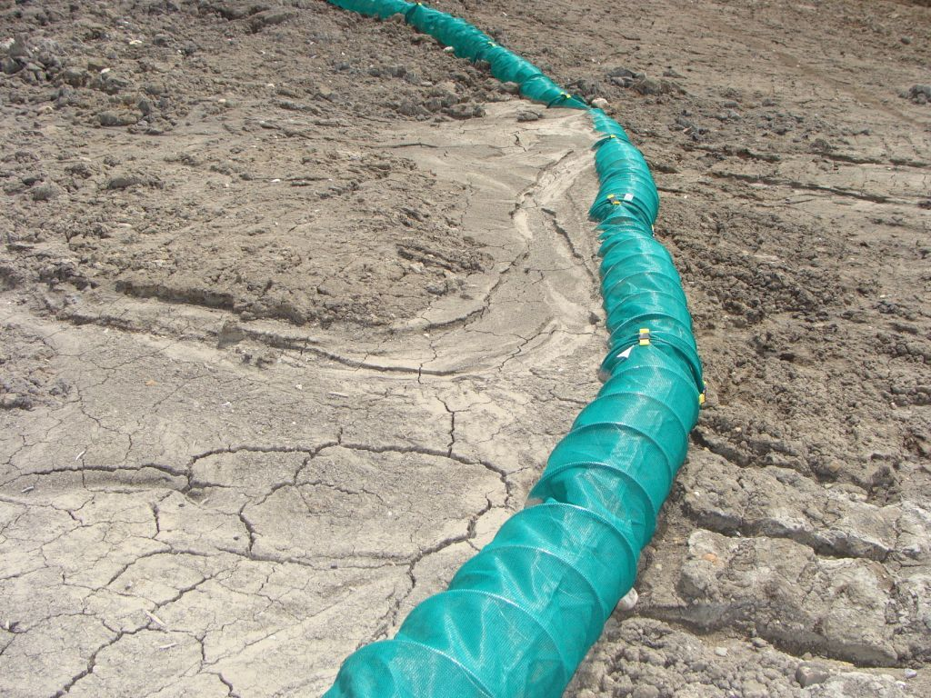
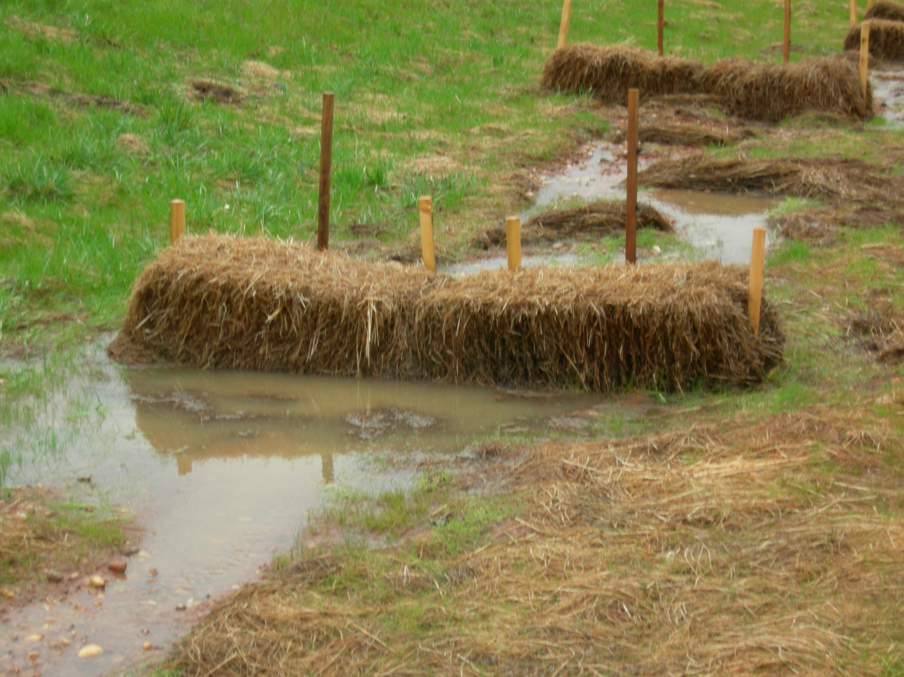
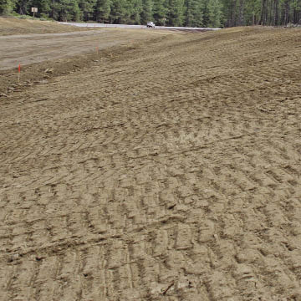
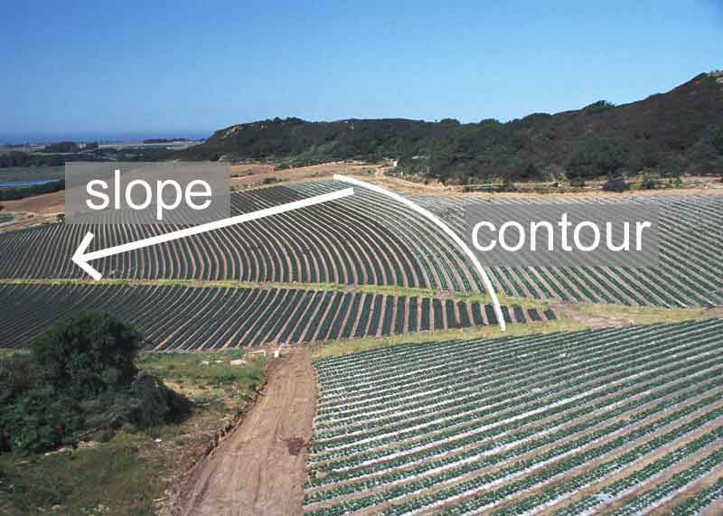
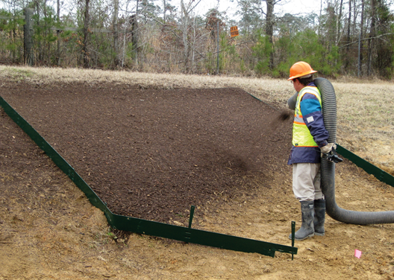
ATTACHMENT A –
Section 2 REQUIREMENTS
Erosion Control: Sediment Capture:
Surface Contouring Gravel bag berms
Slope Roughening Fiber rolls
Upslope storm water diversion Straw bale barriers
Mulching, Silt fences
Hydroseeding Sediment settling basins
Revegetation
Rock slope protection
Notes:
Mulching should be seed free or at least invasive species free

Slide 47
ATTACHMENT A –
Section 2 REQUIREMENTS
Erosion Control:
Maintenance of all erosion protection and sediment capture measures is required year-round.
Notes:
Early monitoring allows for identification of problem areas or underperforming erosion or sediment control measures. Verification of the effectiveness of all erosion prevention and sediment capture measures is required as part of winterization activities.

Slide 48
ATTACHMENT A –
Section 2 REQUIREMENTS
Erosion Control:
11. Cannabis cultivators shall only use geotextiles, fiber rolls, and other erosion control measures made of loose-weave mesh like jute, coconut fiber.
Cannabis cultivators shall not use synthetic monofilament netting materials (plastic or nylon nets). This prohibition includes photo-or bio-degradable plastic netting.
Notes:
To minimize the risk of ensnaring and strangling wildlife, cannabis cultivators shall not use synthetic (e.g., plastic or nylon) monofilament netting materials for erosion control for any cannabis cultivation activities. This prohibition includes photo- or bio-degradable plastic netting.

Slide 49
ATTACHMENT A –
Section 2 REQUIREMENTS
Erosion Control:
12. Cultivation sites constructed on or near slopes with a slope greater than or equal to 30 percent shall be inspected for indications of instability.
If indicators of instability are present, the cannabis cultivator shall consult with a Qualified Professional to design measures to stabilize the slope to prevent sediment discharge to surface waters.
Notes:
Indications of instability include the occurrence of slope failures at nearby similar sites, weak soil layers, geologic bedding parallel to slope surface, hillside creep (trees, fence posts, etc. leaning downslope), tension cracks in the slope surface, bulging soil at the base of the slope, and groundwater discharge from the slope. If indicators of instability are present, the cannabis cultivator shall consult with a Qualified Professional to design measures to stabilize the slope to prevent sediment discharge to surface waters.

Slide 50
ATTACHMENT A –
Section 2 REQUIREMENTS
Erosion Control:
14. Cannabis cultivators shall monitor erosion control measures during and after each storm event that produces at least 0.5 in/day or 1.0 inch/7 days of precipitation, and repair or replace, as needed, ineffective erosion control measures immediately.
Notes:
Records shall be kept for 3 years.

Slide 51
ATTACHMENT A –
Section 2 REQUIREMENTS
Access Road/Land Development and Drainage:
15. Access roads shall be constructed consistent with the requirements of California Code of Regulations Title 14, Chapter 4.
The Road Handbook describes how to implement the regulations and is available at
http://www.pacificwatershed.com/PWA-publications-library . Existing access roads shall be upgraded to comply with the Road Handbook.

Slide 52
ATTACHMENT A –
Section 2 REQUIREMENTS
Access Road/Land Development and Drainage:
16. Cannabis cultivators shall obtain all required permit and approvals prior to the construction of any access road from CDFW, County or Local Agencies.
17. Cannabis cultivators shall ensure that all access roads are hydrologically disconnected to receiving waters.
18. New access road alignments should be constructed with grades (slopes) of 3 -8 percent, whenever possible.
Notes:
17. Cannabis cultivators shall ensure that all access roads are hydrologically disconnected to receiving waters to the extent possible by installing disconnecting drainage features, increasing the frequency of (inside) ditch drain relief as needed, constructing out-sloped roads, constructing energy dissipating structures, avoiding concentrating flows in unstable areas, and performing inspection and maintenance as needed to optimize the access road performance.
18. Forest access roads should generally be kept below 12-percent except for short pitches of 500 feet or less where road slopes may go up to 20-percent. These steeper access road slopes should be paved or rock surfaced and equipped with adequate drainage. Existing access roads that do not comply with these limits shall be inspected by a Qualified Professional to determine if improvements are needed.

Slide 53
ATTACHMENT A –
Section 2 REQUIREMENTS
Access Road/Land Development and Drainage:
19. Cannabis cultivators shall decommission or relocate existing roads away from riparian setbacks whenever possible.
20. If site conditions prohibit drainage structures (including rolling dips and ditch-relief culverts), the cannabis cultivator shall use bioengineering techniques as the preferred measure to minimize erosion (e.g., live fascines). If bioengineering cannot be used, then engineering fixes such as armoring, and velocity dissipaters may be used for problem sites. The maximum distance between water breaks shall not exceed those defined in the Road Handbook.

Slide 54
ATTACHMENT A –
Section 2 REQUIREMENTS
Access Road/Land Development and Drainage:
21. Cannabis cultivators shall have a Qualified Professional design the optimal access road alignment, surfacing, drainage, maintenance requirements, and spoils handling procedure.
24. cannabis cultivators shall ensure that access roads are out-sloped whenever possible.
25. If unable to eliminate inboard or inside ditches, the cannabis cultivator shall ensure adequate ditch relief culverts to prevent down-cutting of the ditch and to reduce water runoff concentration, velocity and erosion.
Notes:
24 Cannabis cultivators shall ensure that access roads are out-sloped whenever possible to promote even drainage of the access road surface, prevent the concentration of storm water flow within an inboard or inside ditch, and to minimize disruption of the natural sheet flow pattern off a hill slope to a stream.
25 Ditches shall be designed and maintained as recommended by a Qualified Professional. To avoid point-source discharges, inboard ditches and ditch relief culverts shall be discharged onto vegetated or armored slopes that are designed to dissipate and prevent runoff channelization. Inboard ditches and ditch relief culverts shall be designed to ensure discharges into natural stream channels or watercourses are prevented.

Slide 55
ATTACHMENT A –
Section 2 REQUIREMENTS
Access Road/Land Development and Drainage:
26. Cannabis cultivators shall ensure that access roads are not allowed to develop or show evidence of significant surface rutting or gullying.
28. access road storm water drainage structures shall not discharge onto unstable slopes, earthen fills or directly to a waterbody.
29. Sediment control devices like check dams, sand/gravel bag barriers etc. shall be used when it is not practical to disperse storm water before discharge to a waterbody.
Notes:
26. Cannabis cultivators shall use water bars and rolling dips as designed by a Qualified Professional to minimize access road surface erosion and dissipate runoff.
27. Cannabis cultivators shall not remove more vegetation than necessary to keep water moving, as vegetation prevents scour and filters out sediment.
28. Drainage structures shall discharge onto stable areas with straw bales, slash, vegetation, and/or rock riprap.
29. Where potential discharge to a wetland or waterbody exists (e.g., within 200 feet of a waterbody) access road surface drainage shall be filtered through vegetation, slash, other appropriate material, or settled into a depression with an outlet with adequate drainage. Sediment basins shall be engineered and properly sized to allow sediment settling, spillway stability, and maintenance activities.

Slide 56
ATTACHMENT A –
Section 2 REQUIREMENTS
Drainage Culverts:
30. Cannabis cultivators shall regularly inspect ditch-relief culverts whenever possible (15 – 24 – inch diameter pipes or minimum 18- inch diameter pipe in woody debris area.
31. Cannabis cultivators shall ensure that all permanent watercourse crossings that are constructed or reconstructed are capable of accommodating the estimated 100-year flood flow, including debris and sediment loads.
Notes:
30. Cannabis cultivators shall regularly inspect ditch-relief culverts and clear them of any debris or sediment. To reduce ditch-relief culvert plugging by debris, cannabis cultivators shall use 15- to 24-inch diameter pipes, at minimum. In forested areas with a potential for woody debris, a minimum 18-inch diameter pipe shall be used to reduce clogging. Ditch relief culverts shall be designed by a Qualified Professional based on site-specific conditions.
31. Watercourse crossings shall be designed and sized by a Qualified Professional.

Slide 57
ATTACHMENT A –
Section 2 REQUIREMENTS
Cleanup, Restoration, and Mitigation:
32. Cannabis cultivators shall limit disturbance to existing grades and vegetation to the actual site of the cleanup or remediation.
33. Cannabis cultivators shall avoid damage to native riparian vegetation. Restored areas must be mulched, using at least 2 – 4 inches of weed-free, clean straw or similar biodegradable mulch over the seeded area.
Cannabis cultivators shall stabilize and restore any temporary work areas with native vegetation to pre-cannabis cultivation or pre-legacy conditions or better.

Slide 58
ATTACHMENT A –
Section 2 REQUIREMENTS
Cleanup, Restoration, and Mitigation:
34. Cannabis cultivators shall avoid damage to oak woodlands (plant 3 oak trees for every one oak tree damaged or removed). Trees may be planted in groves in order to maximize wildlife benefits and shall be native to the local county.
35. Cannabis cultivators shall develop a monitoring plan that evaluates the revegetation plan for five years. Cannabis cultivators shall maintain annual inspections for the purpose of assessing an 85 % survival and growth of revegetated areas within a five-year period.
Notes:
35. Cannabis cultivators shall develop a revegetation plan for:
• All exposed or disturbed riparian vegetation areas,
• any oak trees that are damaged or removed, and
• temporary work areas.
The presence of exposed soil shall be documented for three years following revegetation work. If the revegetation results in less than an 85 percent success rate, the unsuccessful vegetation areas shall be replanted. Cannabis cultivators shall identify the location and extent of exposed soil associated with the site; pre- and post-revegetation work photos; diagram of all areas revegetated, the planting methods, and plants used; and an assessment of the success of the revegetation program. Cannabis cultivators shall maintain a copy of the revegetation plan and monitoring results onsite and make them available, upon request, to Water Boards staff or authorized representatives. An electronic copy of monitoring results is acceptable in Portable Document Format (PDF).

Slide 59
ATTACHMENT A –
Section 2 REQUIREMENTS
Stream Crossing Installation and Maintenance:
39. Cannabis cultivators shall avoid or minimize temporary stream crossings. Temporary stream crossings that impede fish passage are strictly prohibited on permanent or seasonal fish-bearing streams.
40. Cannabis cultivators shall avoid or minimize use of heavy equipment in a watercourse. Temporary work pads and other channel protection shall be moved as soon as possible once the use of heavy equipment is complete.
Notes:
39. When necessary, temporary stream crossings shall be located in areas where erosion potential and damage to the existing habitat is low. Cannabis cultivators shall avoid areas where runoff from access roadway side slopes and natural hillsides will drain and flow into the temporary crossing.
40. If use is unavoidable, heavy equipment may only travel or work in a waterbody with a rocky or cobbled channel. Wood, rubber, or clean native rock temporary work pads shall be used on the channel bottom prior to use of heavy equipment to protect channel bed and preserve channel morphology.

Slide 60
ATTACHMENT A –
Section 2 REQUIREMENTS
Stream Crossing Installation and Maintenance:
41. Cannabis cultivators shall avoid or minimize work in or near a stream, creek, river, lake, pond, or other waterbody. If work in a waterbody cannot be avoided, activities and associated workspace shall be isolated from flowing water by directing the water around the work site.
42. – 47: Temporary Watercourse Diversion and Dewatering: All Live Watercourses.
48. Cannabis cultivators shall ensure that watercourse crossings are designed by a Qualified Professional.
Notes:
41 If water is present, then the cannabis cultivator shall develop a site-specific plan prepared by a Qualified Professional. The plan shall consider partial or full stream diversion and dewatering. The plan shall consider the use of coffer dams upstream and downstream of the work site and the diversion of all flow from upstream of the upstream dam to downstream of the downstream dam, through a suitably sized pipe with intake screens that protect and prevent impacts to fish and wildlife. Cannabis cultivation activities and associated work shall be performed outside the waterbody from the top of the bank to the maximum extent possible.
42-47 talked about specification and materials fro coffer dams, what other permits needed, dewatering methods. Ect.

Slide 61
ATTACHMENT A –
Section 2 REQUIREMENTS
Stream Crossing Installation and Maintenance:
49. Cannabis cultivators shall ensure that all access road watercourse crossing structures allows for the unrestricted passage of water.
50. Cannabis cultivators shall ensure that watercourse crossing allow migration of aquatic life during all life stages supported.
51. Cannabis cultivators shall conduct regular inspection and maintenance of stream crossings to ensure crossings are not blocked by debris.

Slide 62
ATTACHMENT A –
Section 2 REQUIREMENTS
Stream Crossing Installation and Maintenance:
52. Cannabis cultivators shall only use rock fords for temporary seasonal crossings on small watercourses where aquatic life passage is not required during the time period of use.
53. Cannabis cultivators shall ensure that culverts used at watercourse crossings are designed to direct flow and debris toward the inlet (e.g., use of wing-walls, pipe beveling, rock armoring, etc.) to prevent erosion of road fill, debris blocking the culvert, and watercourses from eroding a new channel.
Notes:
52. Rock fords shall be oriented perpendicular to the flow of the watercourse and designed to maintain the range of surface flows that occur in the watercourse. When constructed, rock shall be sized to withstand the range of flow events that occur at the crossing and rock shall be maintained at the rock ford to completely cover the channel bed and bank surfaces to minimize soil compaction, rutting, and erosion. Rock must extend on either side of the ford up to the break in slope. The use of rock fords as watercourse crossings for all-weather access roads is prohibited.

Slide 63
ATTACHMENT A –
Section 2 REQUIREMENTS
Stream Crossing Installation and Maintenance:
54. Cannabis cultivators shall regularly inspect and maintain the condition of access roads, access road drainage features, and watercourse crossings. At a minimum, perform inspections prior to the onset of fall and winter precipitation and following storm events that produce at least 0.5 in/day or 1.0 inch/7 days of precipitation.
Notes:
54.. Cannabis cultivators are required to perform all of the following maintenance upon discovery:
• Remove any wood debris that may restrict flow in a culvert.
• Remove sediment that impacts access road or drainage feature performance. Place any removed sediment in a location outside the riparian setbacks and stabilize the sediment.
• Maintain records of access road and drainage feature maintenance and consider redesigning the access road to improve performance and reduce maintenance needs.

Slide 64
ATTACHMENT A –
Section 2 REQUIREMENTS
Stream Crossing Installation and Maintenance:
55. Cannabis cultivators shall compact access road crossing approaches and fill slopes during installation and shall stabilize them with rock or other appropriate surface protection to minimize surface erosion.
56. Cannabis cultivators shall ensure that culverts used at watercourse crossing are: installed parallel to the watercourse alignment to the extent possible, sufficient length to extend beyond stabilized fill/sidecast material and embedded or installed at the same level and gradient of the streambed .
Notes:
55. When possible, cannabis cultivators shall ensure that access roads over culverts are equipped with a critical dip to ensure that, if the culvert becomes blocked or plugged, water can flow over the access road surface without washing away the fill prism. Access road crossings where specific conditions do not allow for a critical dip or in areas with potential for significant debris accumulation, shall include additional measures such as emergency overflow culverts or oversized culverts that are designed by a Qualified Professional.

Slide 65
ATTACHMENT A –
Section 2 REQUIREMENTS
Soil Disposal and Spoils Management:
57. Cannabis cultivators shall store soil, construction, and waste materials outside the riparian setback.
58. Cannabis cultivators shall separate large organic materials from soil materials.
59. Cannabis cultivators shall store erodible soil, soil amendments, and spoil piles to prevent sediment discharges in storm water.
Notes:
57. Such materials shall not be stored in locations of known slope instability or where the storage of construction or waste material could reduce slope stability.
58. Cannabis cultivators shall separate large organic material (e.g., roots, woody debris, etc.) from soil materials. Cannabis cultivators shall either place the large organic material in long-term, upland storage sites, or properly dispose of these materials offsite.
59. Storage practices may include use of tarps, upslope land contouring to divert surface flow around the material, or use of sediment control devices (e.g., silt fences, straw wattles, etc.).

Slide 66
ATTACHMENT A –
Section 2 REQUIREMENTS
Soil Disposal and Spoils Management:
60. Cannabis cultivators shall contour and stabilize stored spoils to mimic natural slope contours and drainage pattern.
61. For soil disposal sites cannabis cultivators shall:
• revegetate soil disposal sites with a mix of native plant species,
• cover the seeded and planted areas with mulched straw at a rate of two tons per acre, and
• apply non-synthetic netting or similar erosion control fabric (e.g., jute) on slopes greater than 2:1 if the site is erodible.

Slide 67
ATTACHMENT A –
Section 2 REQUIREMENTS
Riparian and Wetland Protection and Management:
63. Cannabis cultivators shall not disturb aquatic or riparian habitat, such as pools, spawning sites, large wood, or shading vegetation unless authorized under a CWA section 404 permit, CWA section 401 certification, Regional Water Board WDRs (when applicable), or a CDFW LSA Agreement.

Slide 68
ATTACHMENT A –
Section 2 REQUIREMENTS
Water Conservation and Use:
95. Cannabis cultivators shall on a monthly basis, at a minimum, inspect their entire water delivery system for leaks and immediately repair any leaky faucets, pipes, connectors or other leaks.
96. Cannabis cultivators shall use weed-free mulch in cultivation areas that do not have ground cover to conserve soil moisture and minimize evaporative loss.
97. Cannabis cultivators shall implement water conserving irrigation methods (e.g., drip or trickle irrigation, micro-spray, or hydroponics).

Slide 69
ATTACHMENT A –
Section 2 REQUIREMENTS
Water Conservation and Use:
98. Cannabis cultivators shall maintain daily records of all water used for irrigation of cannabis.
Cannabis cultivators shall retain, for a minimum of five years, irrigation records at the cannabis cultivation site and shall make all irrigation records available for review by the Water Boards, CDFW, and any other authorized representatives of the Water Boards or CDFW.
Notes:
98. Cannabis cultivators shall maintain daily records of all water used for irrigation of cannabis. Daily records may be calculated by the use of a measuring device or, if known, by calculating the irrigation system rates and duration of time watered (e.g., irrigating for one hour twice per day using 50 half-gallon irrigation emitters equates to 50 gallons per day (1 hour x 2 times per day x 50 irrigation emitters x 0.5 gallons per irrigation emitter per hour) of water used for irrigation).

Slide 70
ATTACHMENT A –
Section 2 REQUIREMENTS
Irrigation Runoff:
99. Cannabis cultivators shall on a weekly basis, at a minimum, during period of use inspect for leaks in mainlines, laterals, in irrigation connections, sprinkler heads, irrigation emitters, or at the ends of drip tape and feeder lines and immediately repair any leaks found upon detection.
100. The irrigation system shall be designed to include redundancy (e.g., safety valves) in the event that leaks occur, so that waste of water and runoff is prevented and minimized.
Notes:
101. Cannabis cultivators shall regularly replace worn, outdated, or inefficient irrigation system components and equipment to ensure a properly functioning, leak-free, and efficient irrigation system at all times.
102. Cannabis cultivators shall minimize irrigation deep percolation24 by applying irrigation water at agronomic rates.

Slide 71
ATTACHMENT A –
Section 2 REQUIREMENTS
Fertilizers, Pesticides, Petroleum Products:
103. Cannabis cultivators shall not mix, prepare, over apply or dispose of agricultural product/chemicals in any location where they could enter the riparian setback or waters of the state.
The use of agricultural chemicals inconsistently with product leveling, storage instructions or DPR requirements for pesticide application is prohibited.
Disposal of unused product and containers shall be consistent with labels.
Notes:
Pesticide is defined as follows: - Per California Code of Regulations Title 3. Division 6. Section 6000: (a) Any substance or mixture of substances that is a pesticide as defined in the Food and Agricultural Code and includes mixtures and dilutions of pesticides; (b) As the term is used in Section 12995 of the California Food and Agricultural Code, includes any substance or product that the user intends to be used for the pesticidal poison purposes specified in Sections 12753 and 12758 of the Food and Agricultural Code. - Per California Food and Agricultural Code section 12753(b), the term “Pesticide” includes any of the following: Any substance, or mixture of substances which is intended to be used for defoliating plants, regulating plant growth, or for preventing, destroying, repelling, or mitigating any pest, as defined in Section 12754.5, which may infest or be detrimental to vegetation, man, animals, or households, or be present in any agricultural or nonagricultural environment whatsoever. - In laymen’s terms: “pesticide” includes: rodenticides, herbicides, insecticides, fungicides, and disinfectants. 26 More information on DPR requirements is available at: http://www.cdpr.ca.gov/docs/legbills/laws_regulations.htm, http://www.cdpr.ca.gov/docs/county/cacltrs/penfltrs/penf2017/2017atch/attach0301.pdf, and http://www.cdpr.ca.gov/docs/cannabis/index.htm

Slide 72
ATTACHMENT A –
Section 2 REQUIREMENTS
Fertilizers, Pesticides, Petroleum Products:
104. Cannabis cultivators shall keep and use absorbent materials designated for spill containment and spill cleanup equipment on-site for use in an accidental spill of fertilizers, petroleum products, hazardous materials and other substances which may degrade waters of the state.
105. Cannabis cultivators shall establish and use a separate storage area for pesticides, and fertilizers, and another storage area for petroleum or other liquid chemicals.
All storage areas shall have appropriate secondary containment structures, as necessary, to protect water quality and prevent spillage, mixing, discharge, or seepage.
Notes:
105 Cannabis cultivators shall establish and use a separate storage area for pesticides, and fertilizers, and another storage area for petroleum or other liquid chemicals (including diesel, gasoline, oils, etc.). All such storage areas shall comply with the riparian setback Requirements, be in a secured location in compliance with label instructions, outside of areas of known slope instability, and be protected from accidental ignition, weather, and wildlife. All storage areas shall have appropriate secondary containment structures, as necessary, to protect water quality and prevent spillage, mixing, discharge, or seepage. Storage tanks and containers must be of suitable material and construction to be compatible with the substances stored and conditions of storage, such as pressure and temperature.

Slide 73
ATTACHMENT A –
Section 2 REQUIREMENTS
Fertilizers, Pesticides, Petroleum Products:
106. Cannabis cultivators shall ensure that any temporary storage areas have a permanent cover and side-wind protection or be covered during non-working days and prior to and during rain events.
110. Cannabis cultivators shall not apply agricultural chemicals within 48 hours of any weather pattern that is forecast to have a 50 % or greater chance of precipitation of 0.25 inches or greater per 24 hours.

Slide 74
ATTACHMENT A –
Section 2 REQUIREMENTS
Fertilizers, Pesticides, Petroleum Products:
111. To minimize infiltration and water quality degradation, cannabis cultivators shall irrigate and apply fertilizer consistent with the crop need (agronomic rage).
113. Cannabis cultivators shall ensure that potting soil or soil amendments are placed and stored with covers to protect from rainfall and erosion.
115. Cannabis cultivators shall implement integrated pest management strategies where possible to reduce the need and use of pesticides and the potential for discharges to waters of the state.
Notes:
111. When used, cannabis cultivators shall apply nitrogen to cannabis cultivation areas consistent with crop need (i.e., agronomic rate). Cannabis cultivators shall not apply nitrogen at a rate that may result in a discharge to surface water or groundwater that causes or contributes to exceedance of water quality objectives, and no greater than 319 pounds/acre/year unless plant tissue analysis performed by a qualified individual demonstrates the need for additional nitrogen application. The analysis shall be performed by an agricultural laboratory certified by the State Water Board’s Environmental Laboratory Accreditation Program.

Slide 75
ATTACHMENT A –
Section 2 REQUIREMENTS
Fertilizers, Pesticides, Petroleum Products:
116. Cannabis cultivators shall only refuel vehicles or equipment outside of riparian setbacks. Cannabis cultivators shall inspect all equipment using oil, hydraulic fluid, or petroleum products for leaks prior to use and shall monitor equipment for leakage.
117. Cannabis cultivators shall store petroleum and similar fluids in a manner that provides chemical compatibility, provides secondary containment, and protection from accidental ignition, the sun, wind, and rain.
118. UST is allowed if compliant with all applicable local, state and federal laws.
Notes:
116. Stationary equipment (e.g., motors, pumps, generators, etc.) and vehicles not in use shall be located outside of riparian setbacks. Spill and containment equipment appropriate for the conditions at and near the site (e.g., oil spill booms if surface water could be impacted by a spill, sorbent pads, etc.) shall be stored onsite at all locations where equipment is used or staged.
118.
Use of an underground storage tank(s) for the storage of petroleum products is allowed if compliant with all applicable federal, state, and local laws; regulations; and permitting requirements.

Slide 76
ATTACHMENT A –
Section 2 REQUIREMENTS
Cultivation Related Waste:
119. Cannabis cultivators shall contain and regularly remove all debris and trash associated with cannabis cultivation activities from the cannabis cultivation site.
120. Cannabis cultivators shall only dispose, or reuse spent growth medium in a manner that prevents discharge of soil and residual nutrients and chemicals to the riparian setback or waters of the sate.
Notes:
119. Cannabis cultivators shall only dispose of debris and trash at an authorized landfill or other disposal site in compliance with state and local laws, ordinances, and regulations. Cannabis cultivators shall not allow litter, plastic, or similar debris to enter the riparian setback or waters of the state. Cannabis plant material may be disposed of onsite in compliance with any applicable CDFA license conditions
120. Spent growth medium (e.g., soil and other organic media) shall be covered with plastic sheeting or stored in water tight dumpsters prior to proper disposal or reuse. Spent growth medium should be disposed of at an authorized landfill or other disposal site in compliance with state and local laws, ordinances, and regulations. Proper reuse of spent growth medium may include incorporation into garden beds or spreading on a stable surface and revegetating the surface with native plants. Cannabis cultivators shall use erosion control techniques, as needed, for any reused or stored spent growth medium to prevent polluted runoff.

Slide 77
ATTACHMENT A –
Section 2 REQUIREMENTS
Cultivation Related Waste:
121. and 121 wastewater tanks or storage containers specification and installation.
Cannabis cultivators shall retain, for a minimum of five years, appropriate documentation for any industrial wastewater collected to a storage tank for disposal at a permitted wastewater facility that accepts cannabis cultivation wastewater.
Documentation shall be made available, upon request, to Water Boards or CDFW staff and any other authorized representatives of the Water Boards or CDFW.
Notes:
Nothing in this requirement supersedes other applicable state, county, or local requirements for the installation of wastewater tanks or storage containers, whichever is more stringent shall apply.

Slide 78
ATTACHMENT A –
Section 2 REQUIREMENTS
Refuse and Domestic Waste:
123. Cannabis cultivators shall ensure that debris does not contaminate soil or enter the riparian setback or waters of the state.
124. Cannabis cultivators shall ensure onsite wastewater treatment systems (e.g., septic system) are permitted by the local agency or applicable Regional Water Board.
125. If used, chemical toilets or holding tanks shall be maintained in a manner appropriate for the frequency and conditions of usage, sited in stable locations, and comply the riparian setback requirements.
Notes:
123. Cannabis cultivators shall ensure that debris, soil, silt, bark, slash, sawdust, rubbish, creosote-treated wood, raw cement and concrete or washings thereof, asphalt, paint or other coating material, oil or other petroleum products, or any other substances which could be hazardous to any life stage of fish and wildlife or their habitat (including food sources)
124. Cannabis cultivators shall not dispose of domestic wastewater unless it meets applicable local agency and/or Regional Water Board requirements. Cannabis cultivators shall ensure that human or animal waste is disposed of properly.

Slide 79
ATTACHMENT A –
Section 2 REQUIREMENTS
Winterization:
127. Cannabis cultivators shall block or otherwise close any temporary access roads to all motorized vehicles no later than the onset of the winter period each year.
128. Cannabis cultivators shall not operate heavy equipment of any kind at the cannabis cultivation site during the winter period.
Notes:
128. Cannabis cultivators shall not operate heavy equipment of any kind at the cannabis cultivation site during the winter period, unless authorized (1) in a site management plan as described below, or (2) for emergency repairs contained in an enforcement order issued by the State Water Board, Regional Water Board, or other agency having jurisdiction. Use of heavy equipment (e.g. agricultural equipment) for routine cannabis cultivation soil preparation or planting may be authorized in a site management plan approved by the applicable Regional Water Board Executive Officer or designee if both of the following conditions are met: a) all soil preparation and planting activities occur outside of the riparian setbacks; and b) all soil preparation and planting activities are located on an average slope equal to or less than five percent (5%) (e.g., valley floor).

Slide 80
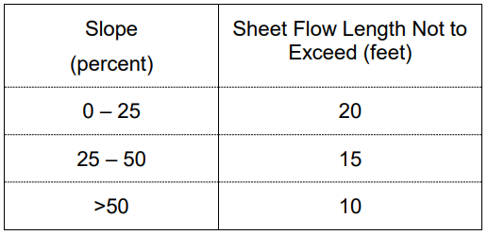
ATTACHMENT A –
Section 2 REQUIREMENTS
Winterization:
129. Cannabis cultivators shall apply linear sediment controls along the toe of the slope, face of the slope and at the grade breaks of exposed slopes to comply with sheet flow length.
Notes:
129 Cannabis cultivators shall apply linear sediment controls (e.g., silt fences, wattles, etc.) along the toe of the slope, face of the slope, and at the grade breaks of exposed slopes to comply with sheet flow length29 at the frequency specified below. Sheet flow length is the length that shallow, low velocity flow travels across a site.

Slide 81
ATTACHMENT A –
Section 2 REQUIREMENTS
Winterization:
130. Cannabis cultivators shall maintain all culverts, drop inlets, trash racks and similar devices to ensure that they are not blocked by debris or sediment.
131. Cannabis cultivators shall stabilize all disturbed area, construction entrances and exits to control erosion and sediment discharges from land disturbance.
132. Cannabis cultivators shall cover and berm all loose stockpiled construction materials. The cannabis cultivator shall have adequate cover and berm materials available onsite.
Notes:
130. The outflow of culverts shall be inspected to ensure erosion is not undermining the culvert. Culverts shall be inspected prior to the onset of fall and winter precipitation and following precipitation events that produce at least 0.5 in/day or 1.0 inch/7 days of precipitation to determine if maintenance or cleaning is required.
132. Cannabis cultivators shall cover and berm all loose stockpiled construction materials (e.g., soil, spoils, aggregate, etc.) that are not actively (scheduled for use within 48 hours) being used as needed to prevent erosion by storm water. The cannabis cultivator shall have adequate cover and berm materials available onsite if the weather forecast indicates a probability of precipitation.

Slide 82
ATTACHMENT A –
Section 2 REQUIREMENTS
Winterization:
133. Cannabis cultivators shall apply erosion repair and control measures to the bare ground.
134. As part of the winterization plan approval process, the Regional Water Board may require cannabis cultivators to implement additional site-specific erosion and sediment control requirements if the implementation of the Requirements in this section do not adequately protect water quality
Notes:
133. Cannabis cultivators shall apply erosion repair and control measures to the bare ground (e.g., cultivation area, access paths, etc.) to prevent discharge of sediment to waters of the state.

Slide 83
  Section 3 and 4
    Instream Flow Requirements and Gage Assignments
          These are guidelines for those with the SUIR water right permit. Questions should be directed to Water Rights.
Contacts:
https://www.waterboards.ca.gov/waterrights/
https://www.waterboards.ca.gov/water_issues/programs/cannabis/cannabis_water_rights.html
E-mail: CannabisReg@waterboards.ca.gov
Phone: 916-319-9427 or 916-341-5300

Slide 84
  Waterboards Cannabis: https://www.waterboards.ca.gov/water_issues/programs/cannabis/
  Division of Water Rights: https://www.waterboards.ca.gov/waterrights/
  Division of Water Rights Cannabis: https://www.waterboards.ca.gov/water_issues/programs/cannabis/cannabis_water_rights.html
  Central Valley Regional Water Quality Control Board: https://www.waterboards.ca.gov/centralvalley/
  Cannabis Cultivation Waste Discharge Regulatory Program: https://www.waterboards.ca.gov/centralvalley/water_issues/cannabis/
  Cannabis General Order: https://www.waterboards.ca.gov/centralcoast/water_issues/programs/cannabis_cultivation/docs/cango2019_with_attachment_a.pdf
Permitting Supervisor:
Elizabeth Betancourt
Phone: 530-224-4995
Elizabeth.Betancourt@waterboards.ca.gov
Main office:
Phone: 530-224-4845
Fax: 530-224-4857
Permitting Staff:
Harihar Nepal
Phone: 530-224-4115
Harihar.nepal@waterboards.ca.gov
Enforcement Staff:
Ryan Cornwall
Phone: 530-224-4851
Ryan.cornwall@waterboards.ca.gov

Slide 85
SECTION 5 – PLANNING AND REPORTING
Required to submit technical reports to the appropriate Regional Water Boards
The report(s) shall be transmitted in portable document format (PDF)
Email to the email address provided in the NOR as proof of enrollment.
Conditionally exempt cannabis cultivators that can no longer meet the requirements to qualify for conditional exemptions may have to enroll as a Tier 1 or Tier 2 site.

Slide 86
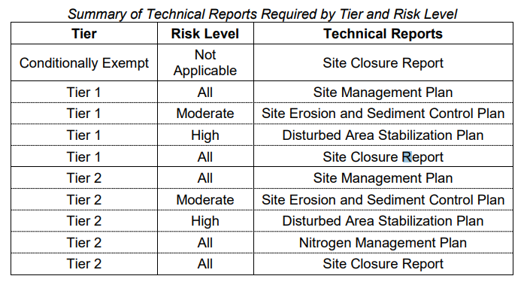
SECTION 5 – PLANNING AND REPORTING
Notes:
Site Management Plan Within 90 days of the issuance of a notice of receipt, Tier 1 and Tier 2 cannabis cultivators shall submit and implement a Site Management Plan that describes how the cannabis cultivator is complying with the Requirements listed in Attachment A. The plan shall describe how the Best Practicable Treatment or Control (BPTC) measures are implemented (e.g., for petroleum fuel storage, specify the specific product or means of compliance).

Slide 87
SECTION 5 – PLANNING AND REPORTING
Site Management Plan
  Within 90 days of the issuance of a notice of receipt
  Required for all tier and risk level
  the plan shall describe how BPTC measures are implemented all work must be completed by the onset of the winter period of each year.
  Attachment D will provide guidance on the contents of the SMP.
Notes:
Site Management Plan Within 90 days of the issuance of a notice of receipt, Tier 1 and Tier 2 cannabis cultivators shall submit and implement a Site Management Plan that describes how the cannabis cultivator is complying with the Requirements listed in Attachment A. The plan shall describe how the Best Practicable Treatment or Control (BPTC) measures are implemented (e.g., for petroleum fuel storage, specify the specific product or means of compliance).

Slide 88
SECTION 5 – PLANNING AND REPORTING
Nitrogen Management Plan
  Within 90 days of the issuance of a notice of receipt
  With cannabis cultivation area, or aggregate of cultivation areas, greater than 1 acre.
  The NMP shall calculate all nitrogen and phosphorus applied to the cannabis cultivation (dissolved in irrigation water, originating in soil amendments and applied fertilizers

Slide 89
SECTION 5 – PLANNING AND REPORTING
Site Erosion and Sediment Control Plan
  For moderate risk
  The plan should describe how the discharger will implement the requirements listed in Attachment A
  The report shall include an analysis of slope stability.
  Shall be prepared by a qualified professional

Slide 90
SECTION 5 – PLANNING AND REPORTING
Qualified Professional
  A CA Registered Professional Civil Engineer
  A CA Registered Professional Geologist
  A CA Certified Engineering Geologist
  A CA Registered Landscape Architect
  A professional Hydrologist
  CPESC, CPSWQ registered through EnviroCert Int.
  CPESC registered through NICET
Notes:
Certified Professional in Erosion and Sediment Control (CPESC)
Certified Professional in Storm Water Quality (CPSWQ)
National Institute for Certification in Engineering Technologies (NICET)

Slide 91
SECTION 5 – PLANNING AND REPORTING
Disturbed Area Stabilization Plan
  Only for high risk
  shall be prepared by a Qualified Professional as described in this attachment (Attachment A).
  Attachment D of the Cannabis Cultivation General Order provides guidance on the contents of the Disturbed Area Stabilization Plan
Notes:
Tier 1 or Tier 2 cannabis cultivators classified as high risk (any portion of the disturbed area exists within the riparian setbacks Requirements specified in Section 1 of this Policy except as authorized under 404/401 CWA permits, a CDFW LSA Agreement, coverage under the Cannabis Cultivation General Order water quality certification, or site-specific WDRs issued by the Regional Water Board )

Slide 92
SECTION 5 – PLANNING AND REPORTING
Site Closure Report
  All tiers and risk levels
  describes how the site will be decommissioned to prevent sediment and turbidity discharges that degrade water quality.
  If construction activities are proposed in the Site Closure Report, a project implementation schedule shall be included in the report.
Notes:
A Notice of Termination must be submitted (Attachment C of the Cannabis Cultivation General Order) with the Site Closure Report.

Slide 93
SECTION 6 – USEFUL GUIDANCE DOCUMENTS
Handbook for Forest, Ranch, & Rural Roads: A Guide for Planning, Designing, Constructing, Reconstructing, Upgrading, Maintaining, and Closing Wildland Roads http://www.pacificwatershed.com/sites/default/files/RoadsEnglishBOOKapril2015b.pdf
A Water Quality and Stream Habitat Protection Manual for County Road Maintenance in Northwestern California Watersheds http://www.5counties.org/roadmanual.htm
Construction Site BMP Fact Sheets http://www.dot.ca.gov/hq/construc/stormwater/factsheets.htm
United States Environmental Protection Agency Riparian/Forested Buffer https://nepis.epa.gov/Exe/ZyPDF.cgi/2000W45Y.PDF?Dockey=2000W45Y.PDF
Spoil Pile BMPs http://michigan.gov/documents/deq/deq-wb-nps-sp_250905_7.pdf
Water Tanks: Guidelines for Installation and Use http://www.waterandseptictanks.com/Portals/0/files/GUIDELINES-FOR-INSTALLATIONOF-WATER-TANKS-_rev1_-03-20-08-_2_.pdf

Slide 94
ATTACHMENT B:
MONITORING AND REPORTING PROGRAM

Slide 95
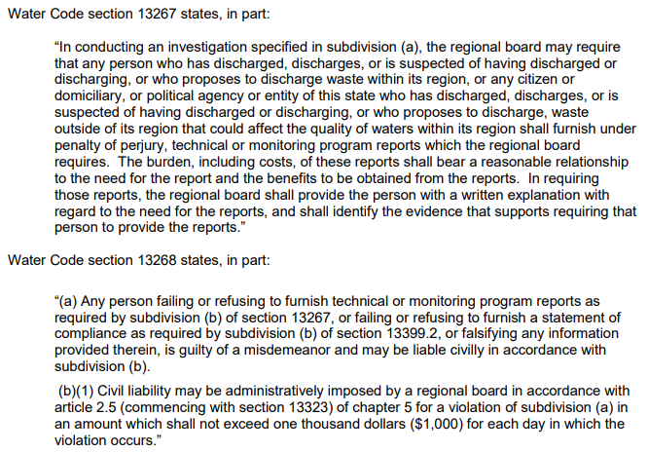
ATTACHMENT B: MONITORING AND REPORTING PROGRAM (MRP)
The MRP is issued pursuant to Water Code section 13267

Slide 96
ATTACHMENT B: MONITORING AND REPORTING PROGRAM (MRP)
  Facility Status Report
  Site maintenance Status Report
  Storm water runoff monitoring Report
  Any other reports required by Regional Water Board
  All Reports shall be submitted no later than March 1 following the year being monitored.
  All report shall be submitted electronically

Slide 97
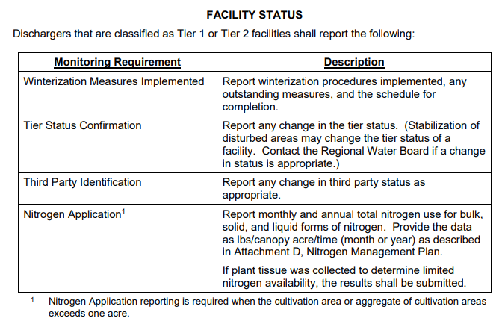
ATTACHMENT B: MONITORING AND REPORTING PROGRAM (MRP)

Slide 98
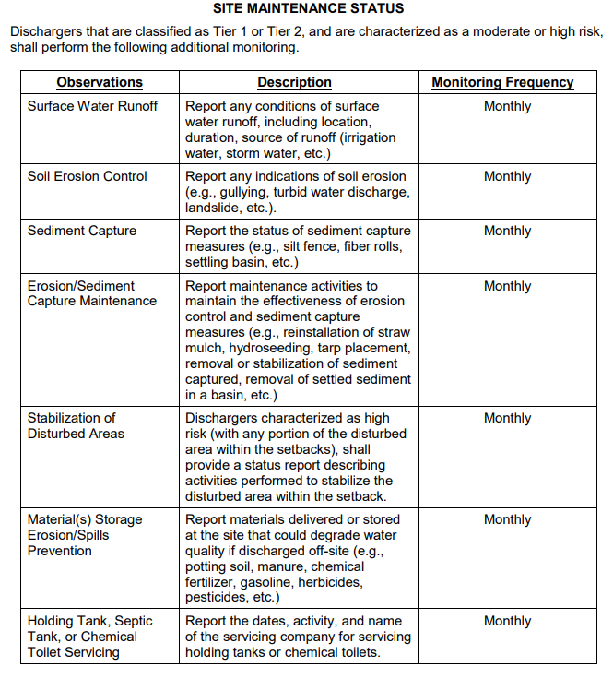
ATTACHMENT B: MONITORING AND REPORTING PROGRAM (MRP)

Slide 99
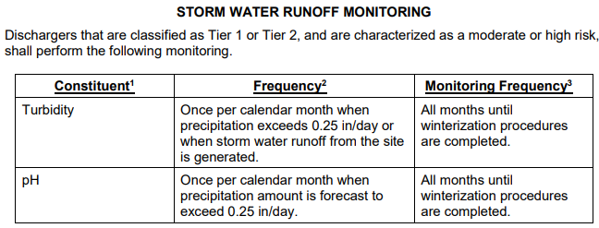
ATTACHMENT B: MONITORING AND REPORTING PROGRAM (MRP)

Slide 100
ATTACHMENT B: MONITORING AND REPORTING PROGRAM (MRP)
The user of the field test instruments (for pH, DO, EC) shall be trained in proper use and maintenance of the instruments
The instruments shall be field calibrated prior to sampling
Field calibration reports shall be maintained and available for at least 3 years
Instruments should shall be serviced by the manufacturer or authorized representative at the recommended frequency.

Slide 101
ATTACHMENT B: MONITORING AND REPORTING PROGRAM (MRP)
All samples shall be representative of the volume and nature of the discharge or matrix of material sampled.
The name of the sampler, sample type (grab or composite), date, time, location, bottle type shall be recorded on the sample chain of custody form.

Slide 102
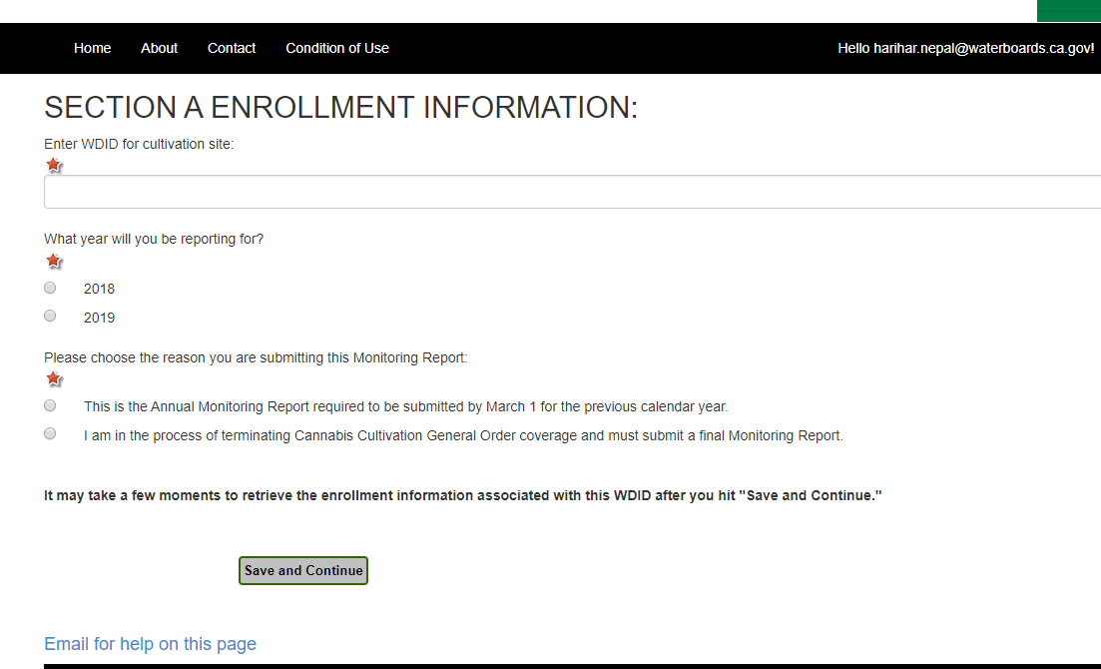
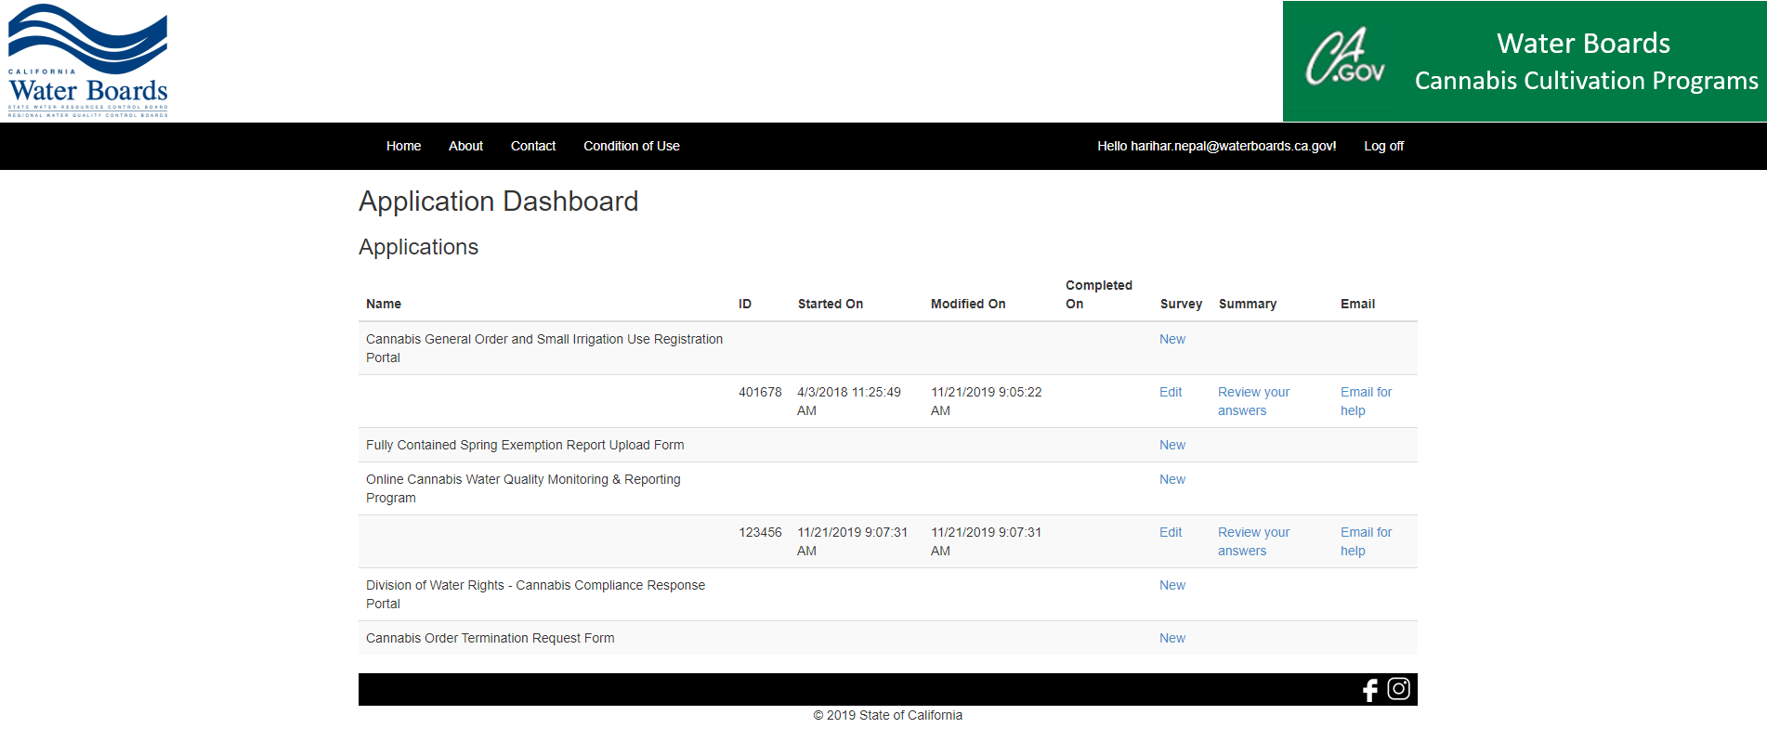
ATTACHMENT B: MONITORING AND REPORTING PROGRAM (MRP)
How to submit Annual Monitoring Report
  1. Log in to your Water Boards Cannabis Cultivation Programs Portal
Notes:
You all should already have created an account when applying for coverage under tha cannabi cultivation general order, use that log in information.
If you forgot your password, select “log in” and “Forgot your Password” at the bottom of the screen. You will be emailed a new password to log in and continue with next step
On the dashboard, select “online 2019 cannabis water quality monitoring and reporting program. Enter your WDID (new that starts with 5S57CC******.
After you submit your report, you will receive an email with a copy of the completed report.

Slide 103
ATTACHMENT C:
NOTICE OF TERMINATION (NOT)

Slide 104
ATTACHMENT C: NOTICE OF TERMINATION
The Discharger shall submit a NOT to Water Board requesting termination of coverage under General Order WQ 2019-0001-DWQ
Termination is 2 step process:
  Submittal of NOT form by Discharger, and/or Landowner
  Site closure report (will discuss in Attachment D)
  The Regional Water Board may inspect the condition of the site prior to terminating coverage

Slide 105
ATTACHMENT C: NOTICE OF TERMINATION

Slide 106
ATTACHMENT D:
TECHNICAL REPORT GUIDANCE

Slide 107
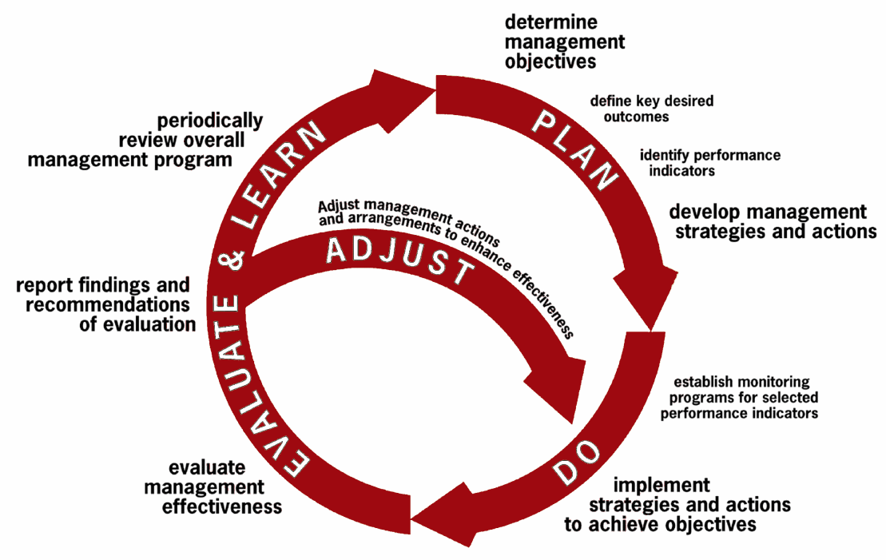
ATTACHMENT D: TECHNICAL REPORT GUIDANCE
Site Management Plan

Slide 108
ATTACHMENT D: TECHNICAL REPORT GUIDANCE
Site Management Plan
  Required for all Tiers, and Risk level except CE
  The plan outline below is a general guidance for the Discharger and consultants.
  How to implement the Best Practical Treatment or Control (BPTC)
1.0 Sediment Discharge BPTC Measures
1.1 Site Characteristics
1.1.1 Map
1.1.2 access road, traffic, and maintenance
1.1.3 vehicle stream crossing including type of crossing.

Slide 109
ATTACHMENT D: TECHNICAL REPORT GUIDANCE - SMP
1.0 Sediment Discharge BPTC Measures
1.2 Sediment Erosion Prevention and Sediment Capture
1.2.1 Erosion Prevention BPTC Measures : Describe the BPTC, schedule, and physical BPTC measures like straw much, slope stabilization, soil binders, culvert outfall armoring, vegetation preservation/replacement, hydro seeding etc.
1.2.2 Sediment Control BPTC Measures: schedule and types like silt fences, fiber rolls, settling ponds/areas, vegetated outfall, etc.
1.2.3 Maintenance Activities: how and when BPTC measures will be monitored and maintained.
1.2.4 Described the interim and long-term soil stabilization

Slide 110
ATTACHMENT D: TECHNICAL REPORT GUIDANCE - SMP
2.0 Fertilizer, pesticide, herbicide and Rodenticide BPTC measure
2.1 summary table that identifies the products
how to store, and use at the site,
if not consumed during the growing season, how to remove from the site or stored on site
2.2 site map of storage locations
2.3 Bulk and concentrated chemicals are stored, mixed, applied and empty containers disposed.
2.4 procedures for spill prevention and cleanup.
Notes:
You can use a single map and point this requirement to that map.

Slide 111
ATTACHMENT D: TECHNICAL REPORT GUIDANCE - SMP
3.0 Petroleum Products BPTC measure
3.1 summary table that identifies the products: fuels, lubricants, etc
how to store, and use at the site,
if not consumed during the growing season, how to remove from the site or stored on site
3.2 site map of storage locations
3.3 fuels, lubricants, and other petroleum products are stored, mixed, applied and empty containers disposed.
3.4 procedures for spill prevention and cleanup.

Slide 112
ATTACHMENT D: TECHNICAL REPORT GUIDANCE - SMP
4.0 Trash/refuse, and domestic wastewater BPTC measures
4.1 types of trash/refuse that will be generated
4.1.1 a site map of location
4.2 number of employees, visitors or residents at the site
4.2.1 type of domestic wastewater generated
4.2.2 how the domestic wastewater is disposed.
4.2.2.1 onsite wastewater treatment plant
4.2.2.2 chemical toilets or holding tank. Provide the name of the servicing company and frequency of service.
4.2.2.3 a site map where the domestic wastewater treatment, storage or disposal area are located.

Slide 113
ATTACHMENT D: TECHNICAL REPORT GUIDANCE - SMP
5.0 Winterization BPTC measures
5.1 Activities that will be performed to winterize the site to prevent discharge of waste.
5.2 Maintenance of all drainage or sediment capture features like culverts, trenches, ponds
5.3 Need of any revegetation activities at the beginning or end of the precipitation season
5.4 If any BPTC measure can’t be completed before the onset of winter period, contact the Regional Water Board to establish a compliance schedule.

Slide 114
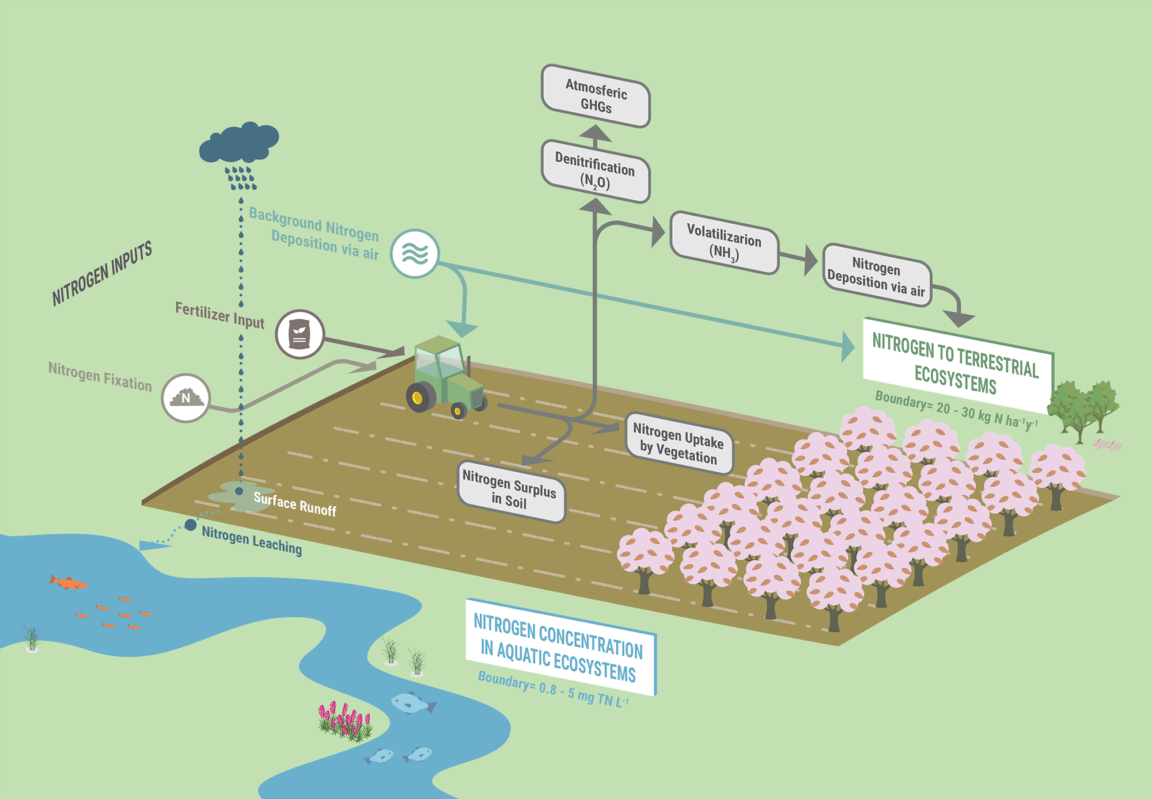
ATTACHMENT D: TECHNICAL REPORT GUIDANCE
NITROGEN MANAGEMENT PLAN

Slide 115
ATTACHMENT D: TECHNICAL REPORT GUIDANCE - NMP
1.0 Facility Description
1.1 Location and Configuration
1.1.1 description of the site, and growing methods
1.1.2 described the canopy area at plant maturity
1.1.3 topo maps showing nearby water bodies, roads etc.
1.1.4 facility plan – scaled drawing

Slide 116
ATTACHMENT D: TECHNICAL REPORT GUIDANCE - NMP
2.0 Source of Nitrogen
2.1 Bulk Materials - growing medium or amendment to growing medium; example: potting soil, manure, biosolids etc.
2.2 Dry fertilizers - added to a growing medium or mixed with irrigation water; example: bone/feather meal, pelletized manure, biosolids, palletized chemical fertilizer etc.
2.3 Liquid fertilizer – added to irrigation water or applied directly to the crop; example: fish emulsion, chemical fertilizers etc.

Slide 117
ATTACHMENT D: TECHNICAL REPORT GUIDANCE - NMP
3.0 Nitrogen storage, use and disposal practices
3.1 delivery schedule: as needed or at the beginning of the season
3.2 storage
3.3 mixing of nitrogen containing materials
3.4 “spent” is either removed from the site or incorporated into the site soils.
3.5 process of amendments

Slide 118
ATTACHMENT D: TECHNICAL REPORT GUIDANCE - NMP
4.0 Nitrogen Application Rate
4.1 Monthly Applied Nitrogen
4.2 Limited Nitrogen Availability – additional nitrogen may be applied if the need is demonstrated based on a plant tissue sample analysis

Slide 119
ATTACHMENT D: TECHNICAL REPORT GUIDANCE - NMP
EXAMPLE NITROGEN REPORTING WORKSHEET
application rate shall be reported as pounds per canopy acre
anticipated canopy acreage at plant maturity
the nitrogen applied shall only be calculated for the month in which it is applied
the N, P, and K on the fertilizer labels represents the % of each nutrient in the fertilizer source
for bulk materials, the seller can provide a list of nutrient content
for liquid fertilizer, density is needed (volume and weight of the product can be used to calculate the density

Slide 120
ATTACHMENT D: TECHNICAL REPORT GUIDANCE - NMP
EXAMPLE NITROGEN REPORTING WORKSHEET

Slide 121
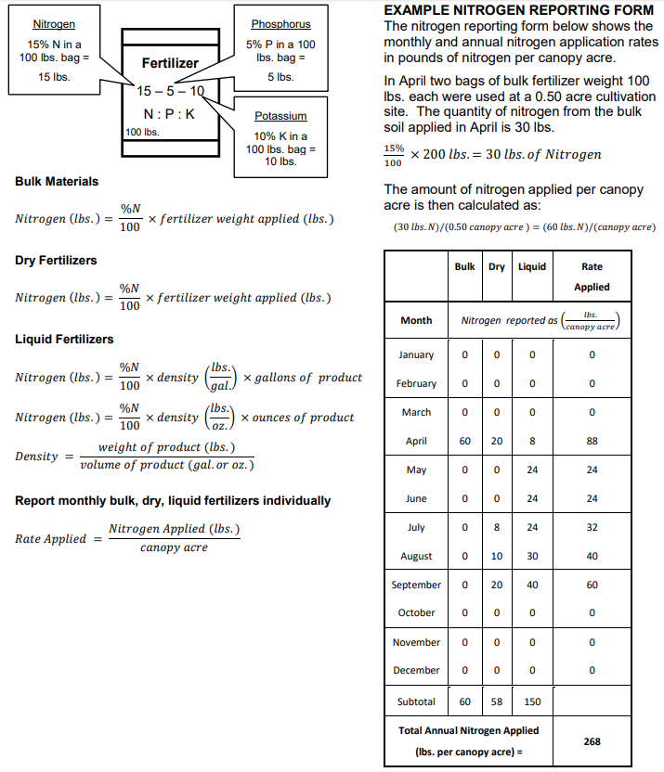

Slide 122
ATTACHMENT D: TECHNICAL REPORT GUIDANCE
SITE EROSION AND SEDIMENT CONTROL PLAN (SESCP) – moderate risk
The plan shall be prepared by a qualified professional
Site specific factors shall be considered
The plan shall include a slope stability study
Shall be implemented prior to the onset of winter period
Interim soil stabilization BPTC shall be performed as soon as practicable

Slide 123
ATTACHMENT D: TECHNICAL REPORT GUIDANCE - SESCP
1.0 Site Description
1.1 Topography, vegetation, elevation, historic precipitation pattern, soil types, surface waterbodies etc..
1.2 Site Disturbances
1.2.1 Historic disturbance
1.2.2 Recent or planned disturbance
1.2.3 Area of special concern
1.2.4 storm water runoff sampling locations
1.3 Erosion prevention BPTC measures

Slide 124
ATTACHMENT D: TECHNICAL REPORT GUIDANCE - SESCP
1.4 Sediment control BPTC measures
1.5 Maintenance activities
2.0 Winterization
2.1 Prevention measures

Slide 125
ATTACHMENT D: TECHNICAL REPORT GUIDANCE
DISTURBED AREA STABILIZATION PLAN (DASP) – high risk
The plan shall be prepared by a qualified professional
High risk site classification is a temporary condition
Site specific factors like slope, precipitation amounts, soil type, vegetation status shall be considered in determining the appropriate WQ protection plan
The plan shall include an implementation schedule
Interim soil stabilization BPTC measures shall be performed as soon as practicable
Note - Certain activities within the setbacks that are authorized by a California Department of Fish and Wildlife Lake or Streambed Alteration Agreement, an Army Corps section 404 permit, a Regional Water Board section 401 water quality certification, or waste discharge requirements issued by a Regional Water Board or the State Water Board may be performed within the setbacks contained in the General Order and do not trigger a high risk Discharger classification.

Slide 126
ATTACHMENT D: TECHNICAL REPORT GUIDANCE - DASP
1.0 Site Description
1.1 Topography, vegetation, elevation, historic precipitation pattern, soil types, surface waterbodies etc..
1.2 Site map showing the location of all water bodies, applicable setbacks and stormwater runoff sampling locations.
1.3 Description of how the area will be disturbed
1.4 Describe the native vegetation exists in the disturbed area

Slide 127
ATTACHMENT D: TECHNICAL REPORT GUIDANCE - DASP
2.0 Erosion prevention BPTC measures
2.1 Describe the BPTC,
physical BPTC measures
schedule

Slide 128
ATTACHMENT D: TECHNICAL REPORT GUIDANCE - DASP
3.0 Sediment control BPTC measures
3.1 Describe the BPTC,
physical BPTC measures
schedule

Slide 129
ATTACHMENT D: TECHNICAL REPORT GUIDANCE - DASP
4.0 Maintenance Activities
5.0 Long term Stabilization measures
6.0 Compliance with General Order Schedule limits

Slide 130
ATTACHMENT D: TECHNICAL REPORT GUIDANCE
SITE CLOSURE REPORT (SCR)
Required when cultivation activities at the site cease
The SCR shall be submitted with a completed NOTF

Slide 131
ATTACHMENT D: TECHNICAL REPORT GUIDANCE - SCR
1.0 Time of cease
2.0 Description of BPTC
3.0 Either construction activities are proposed as a part of the closure activities
4.0 Final annual monitoring report for that year
5.0 General housekeeping is done

Slide 132
  Main Page: https://www.waterboards.ca.gov/
  Waterboards Cannabis: https://www.waterboards.ca.gov/water_issues/programs/cannabis/
  Division of Water Rights: https://www.waterboards.ca.gov/waterrights/
  Division of Water Rights Cannabis: https://www.waterboards.ca.gov/water_issues/programs/cannabis/cannabis_water_rights.html
  Central Valley Regional Water Quality Control Board: https://www.waterboards.ca.gov/centralvalley/
  Cannabis Cultivation Waste Discharge Regulatory Program: https://www.waterboards.ca.gov/centralvalley/water_issues/cannabis/
  Redding office:
Permitting Supervisor:
Elizabeth Betancourt
Phone: 530-224-4995
Elizabeth.Betancourt@waterboards.ca.gov
Main office:
Phone: 530-224-4845
Fax: 530-224-4857
Permitting Staff:
Harihar Nepal
Phone: 530-224-4115
Harihar.nepal@waterboards.ca.gov
Enforcement Staff:
Ryan Cornwall
Phone: 530-224-4851
Ryan.cornwall@waterboards.ca.gov

