Slide 1
Yolo County Cannabis Land Use Ordinance BOARD OF SUPERVISORS Workshop January 19, 2021

Slide 2
Purpose of Meeting
Receive staff presentation on CLUO and FEIR
Respond to Board of Supervisors questions
Accept public comments
Provide individual direction regarding additional information, data, or technical support needed for February 23rd hearing

Slide 3
Background
March 2016 -- Board adopts Licensing Ordinance for cannabis cultivation
October 2017 -- Board adopts Guiding Principles for CLUO
April 2018 -- Board approves release of first Draft CLUO
October 2019 -- County releases Revised Draft CLUO and Draft EIR
September 2020 -- County releases Staff-Proposed Revised Draft CLUO and Final EIR
December 2020 -- Planning Commission recommends certification of FEIR and adoption of CLUO
January 2021 – Board of Supervisors holds CLUO Workshop

Slide 4
Overview of CLUO and Use Permits
Comprehensive regulations
Section 8-2.1408 (Performance Standards) has 48 specific requirements
Requires public notice and hearing(s)
Discretionary land use process vs ministerial licensing process
CUP runs with the site vs License runs with the licensee
Long-term vs annual
Recommended caps on use permits and licenses

Slide 5
Overview of Final EIR
Two volumes = Draft EIR plus Final EIR
5 Equal Weight Alternatives
Proposed CLUO (with other existing state and local requirements) mitigates most impacts
Visual Character impacts and Odor impacts remain significant and unavoidable
78 Comment Letters – 955 Comments – 1/4 on EIR/CEQA
17 Master Responses
Individual responses to all questions and comments

Slide 6
ALTERNATIVE | KEY FEATURES
No Project – Existing Licensing Program | Existing Conditions Cap of 78 cultivation licenses Licensing ordinance applies CLUO and mitigation measures do not apply 75/1,000-foot buffers
Alt 1 – Cultivation (Ancillary Nurseries and Processing Only) with Existing Limits (Existing Operations with CLUO) (CEQA Preferred Alternative) | No Project plus CLUO and EIR mitigations Cap of 78 cultivation licenses Ancillary nurseries and processing (for on-site product only) Licensing ordinance applies CLUO and mitigation measures apply 75/1,000-foot buffers
Alt 2 – All license Types with Moderate Limits | Alternative 1 limits plus non-cultivation uses Cap of 132 licenses (80 cultivation/52 non-cultivation) Licensing ordinance applies CLUO and mitigation measures apply 1,000-foot buffers
Alt 3 – All License Types with High Limits | Alternative 2 limits X 2 Cap of 264 licenses (160 cultivation/104 non-cultivation) Licensing ordinance applies CLUO and mitigation measures apply 75-foot buffers
Alt 4 – Mixed Light/Indoor License Types Only with Moderate Limits, No Hoop Houses or Outdoor Types | Alternative 2 limits No outdoor uses All uses in greenhouses or indoors Cap of 132 licenses (80 cultivation/52 non-cultivation) Licensing ordinance applies CLUO and mitigation measures apply No buffers
Alt 5 – All License Types with Moderate Limits, wthin Ag Zones Only, No Retail | Alternative 2 limits Cannabis uses in AG zones only No Retail Cap of 130 licenses (80 cultivation/50 non-cultivation) Licensing ordinance applies CLUO and mitigation measures apply 1,000-foot buffers

Slide 7
Master Responses
MR 1: No Project Alt and No Cannabis Alt
MR 2: Baseline Conditions Used in the Draft EIR
MR 3: Range of Alts Evaluated in the Draft EIR
MR 4: CEQA Alts and County Decision-Making
MR 5: Cannabis as an Agricultural Crop
MR 6: Economic Effects and Property Values
MR 7: Code Enforcement and Crime
MR 8: Marijuana and Hemp
MR 9: Buffers

Slide 8
Master Responses (continued)
MR 10: CUP Process and Overconcentration
MR 11: Cultural Change
MR 12: Expression of Opinion/Preference
MR 13: Cannabis Tax Revenue
MR 14: County Cannabis Disclosures
MR 15: Traffic Analysis
MR 16: Cannabis Licensing Program
MR 17: Consolidated Cannabis Campus

Slide 9
Key CLUO Decisions
Base EIR Alternative
Range of Cannabis Uses/Types
Allowed Locations
Use Permit Cap
License Type Caps
Buffers
Over-Concentration Threshold
Personal Use

Slide 10
BASE ALTERNATIVE?
KEY CLUO DECISIONS
CANNABIS TYPES/USES?
OVER-CONCENTRATION THRESHOLD?
ALLOWED LOCATIONS?
BUFFERS?
USE PERMIT CAP?
LICENSE TYPE CAPS?
PERSONAL USE?

Slide 11
CAC Composite Recommendation
CLUO Key Issue | CAC Composite Recommendations
Base CEQA Alternative | 2 supported Alternative 2 3 supported Alternative 4
Cannabis Types (Section 8-2.1405) | 2 supported cultivation only 3 supported all use types 1 supported all types except retail
Allowed Locations | See Attachment D
Use Permit Cap (Section 8-2.1406(g)) | 1 supported 60 2 supported 130-132 1 supported 106 1 supported no caps (market based)
License Type Caps (Section 8-2.1406(g)) | See Attachment D
Buffers (Sec 8-2.1408(E)) | 1supported 500/1,000 4 supported 1,000 1 supported 10,000
Over-Concentration (Section 8-2.1406(H)) | 1 supported a threshold of 6 3 supported a threshold of 12
Personal Use | See Attachment D

Slide 12
Overall Considerations for CLUO
EIR conclusions
EIR comments
CAC recommendations
Guiding principles
Neighbor concerns
Operator concerns
Practice in other counties
Enforcement experience
Best practices in land use and planning
Facts and science

Slide 13
Staff/Commission Recommendation
CLUO Key Issue | Staff Recommendation | Planning Commission
Base CEQA Alternative | Alternative 2 | Same
Cannabis Types (Section 8-2.1405) | All | All except Retail Storefront
Allowed Locations | Per Section 8-2. 1407 | Same
Use Permit Cap (Section 8-2.1406(g)) | 132 | Same
License Type Caps (Section 8-2.1406(g)) * (0 in Guinda/Rumsey) | Personal (in/out) = no cap Cultivation (in/out) = 95 Nurseries = 5 Processing = 7* Manufacturing = 6* Testing = 2* Distribution = 7* Retail (Store) = 5 Retail (Non-Store) = no cap Microbusiness = 5 | Same except: Retail (Store) = 0
Buffers (Sec 8-2.1408(E)) | 200/600/1,000 | 600/1,000
Over-Concentration (Section 8-2.1406(H)) | < 10 w/in 6 mi = acceptable > 10 w/in 6 mi = unacceptable | Same
Personal Use | < 6 plants Indoor or outdoor Any zone No buffers Other regs apply | Same

Slide 14
Considerations for Use Permit and License Caps
Allows new cultivation opportunities
Starts slowly with a reasonable number
Allows for market growth overall
Reflects mid-point analyzed in EIR
Generally consistent with CACs
Reflects staff’s professional assessment

Slide 15
Staff and Planning Commission Recommended Buffers
CLUO Identified Sensitive Use | Staff Recommended Buffer | Planning Commission Buffer
Homes on AG parcels | >20 ac = 200 ft from building <20 ac = 600 ft from parcel | 1,000 ft from building
Homes on Residential parcels | 600 ft from zone boundary | 1,000 ft from zone boundary
Parks | 600 ft from parcel | Same
Day cares, places of worship, schools, treatment facilities, youth centers | 600 ft from building | Same
Tribal trust land and pending fee to trust land | 1,000 ft from parcel | Same

Slide 16
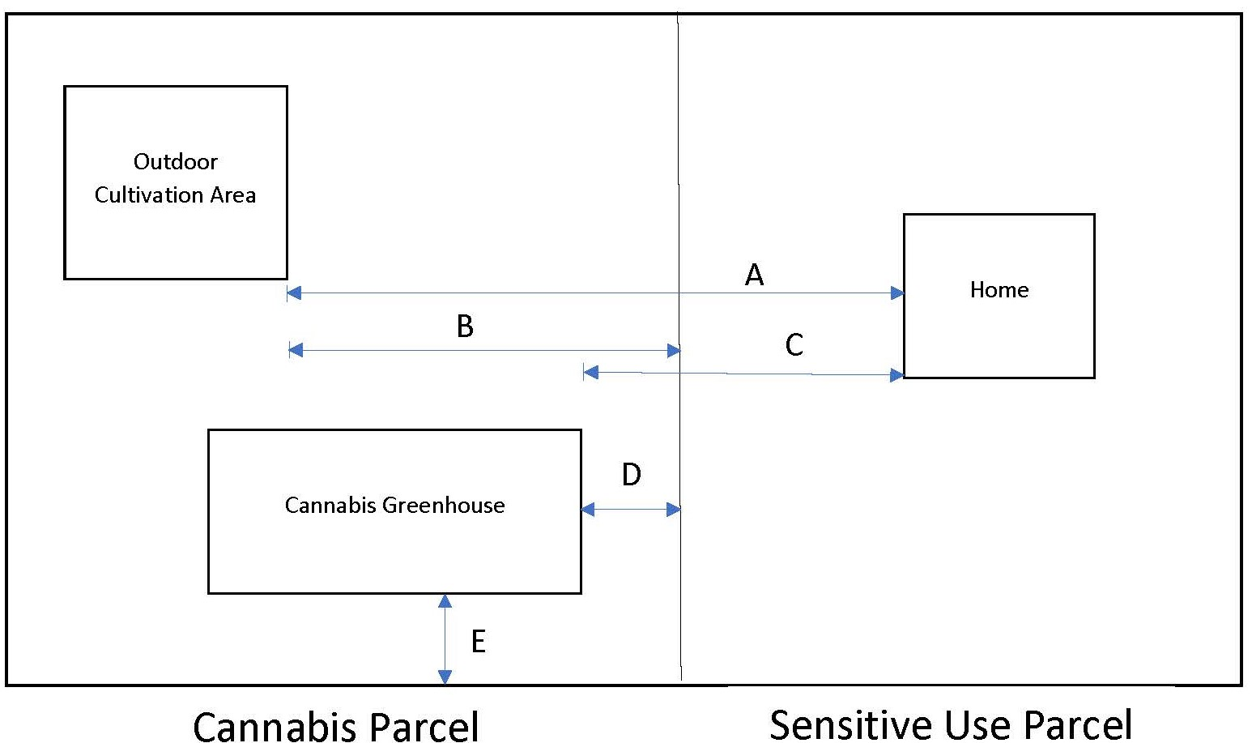
Buffer Exhibit

Slide 17
Considerations for Residential Buffers
County General Plan policy and zoning implementation
State default buffer of 600 ft
County Licensing program buffer is 75 ft
CACs and Planning Commission supported 1,000 ft buffers
Residential buffers in other counties primarily under 600 ft
Consultant odor modeling identifies 500 to 1,000 ft range as optimum
Implications of various buffer distances on land area required to operate successfully
Implications for currently licensed operations

Slide 18
Residential Buffer Implications
Based on preliminary rough GIS modeling, looking solely at buffers, and based on gross assumptions re: site boundaries and building size:
48% of 48 active licensees (50% of total 78) would potentially fail or have to relocate on-site under a 600 ft buffer measured from the residence
52% of 48 active licensees (53% of total 78) would potentially fail or have to relocate on-site under the staff proposed buffers
67% of 48 active licensees (67% of total 78) would potentially fail or have to relocate on-site under a 1,000 ft buffer measured from the residence
81% of 48 active licensees (81% of total 78) would potentially fail or have to relocate on-site under a 600 ft buffer measured from the parcel line of any residence
100% of 48 active licensees (100% of total 78) would potentially fail under a 1,000 ft buffer measured from the parcel line of any residence

Slide 19
Other Commission Recommendations
Assessment of program effectiveness every two years (Section 8-2.1413)
Setbacks for cannabis greenhouses in an Agricultural zone (Section 8-2.305 vs Section 8-2.1408(MM))
Buffer easements (Section 8.2-1408(E)(6)

Slide 20
Cannabis Greenhouse Setbacks
Existing setbacks in AG zones: 20 feet on the front and side; 25 feet in the rear (Section 8-2.305)
Planning Commission proposed setback: 100 feet on all sides (Section 8-2.1408(MM))
10 of 48 licensees have 28 approved cannabis greenhouses
Increased setbacks could cause 15 of 28 cannabis greenhouses to become non-conforming

Slide 21
Buffer Easement
Easements between cannabis operator and neighbors
Would allow for smaller buffer from a protected use
Would run with the land
Term would match the life of the Use Permit

Slide 22
Next Steps
February 23, 2021 Hearing and Intent to Approve
March 9, 2021 Final Action
April 9, 2021 effective date for ordinance
Staff will begin planning for implementation immediately
Develop forms, templates, and checklists
Assemble staff and consultants
Establish administrative procedures for accepting and processing use permit applications

Slide 23
Focus for February 23rd Deliberations
Retail Storefront
Residential Buffers
Buffer Easements and/or other buffer accommodations
Cannabis greenhouse setbacks
Other issues identified by Board members?

Slide 24
Recommended Action for February 23
Certify the Final EIR and make CEQA Findings
Amend the GP and adopt the CEQA MMRP
Adopt the CLUO adding Article 14 to Chapter 2 of Title 8 of the County Code
Adopt other amendments to County Code (amend Sections 8-1.802 and 8-2.217, and delete Section 8-2.116)
Later Follow Up Actions:
Amend County Licensing Ordinance
Additional “clean up” to Zoning Regulations

Slide 25
Thank you!

