Slide 1
Wild Wings County Service Area
Water Supply Update
July 7, 2021

Slide 2
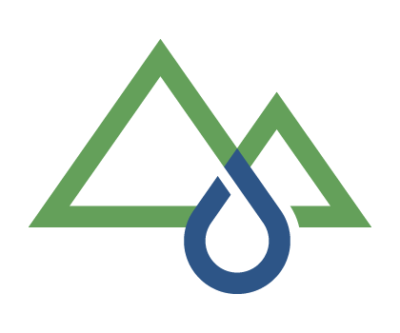
Topics
Summary of water shortage issues
Plan for changing Pumps
Considerations for replacement well

Slide 3
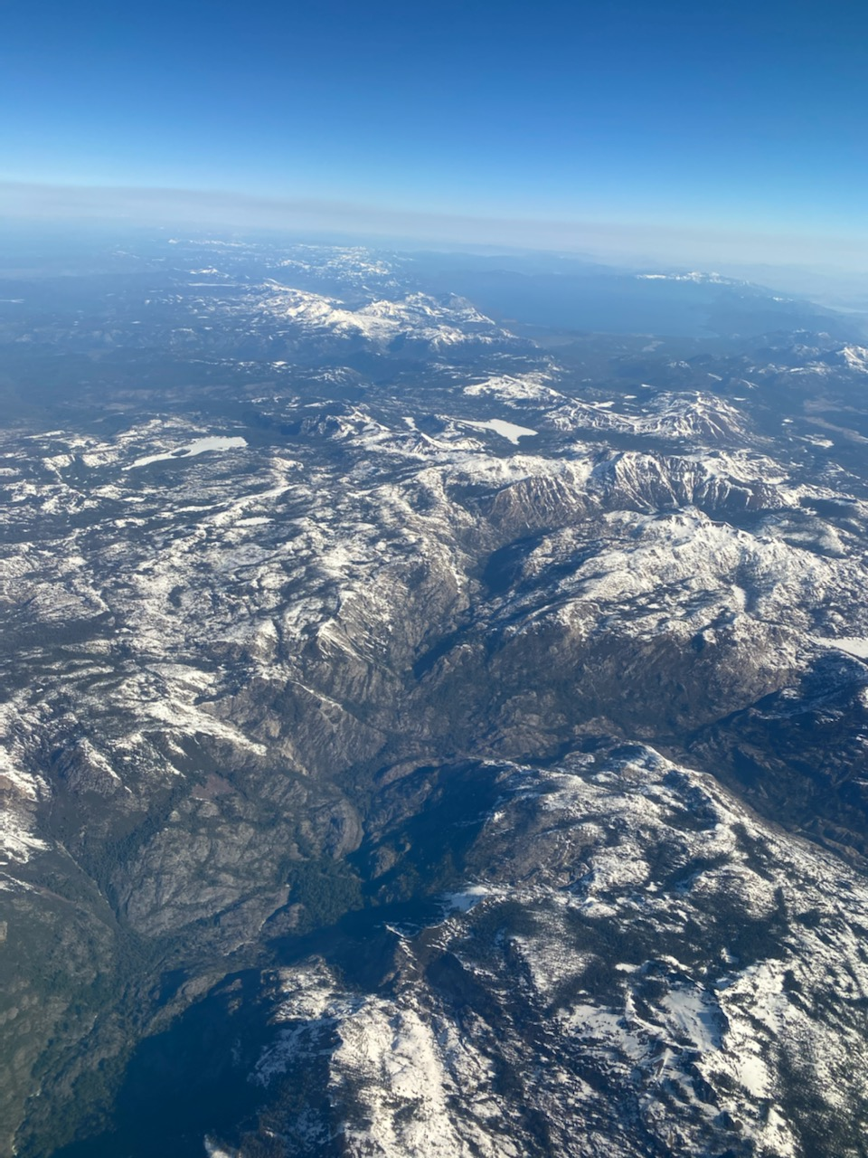
Photo of Sierra Nevada’s April 2021
Lake Tahoe
Dismal snow-pack

Slide 4
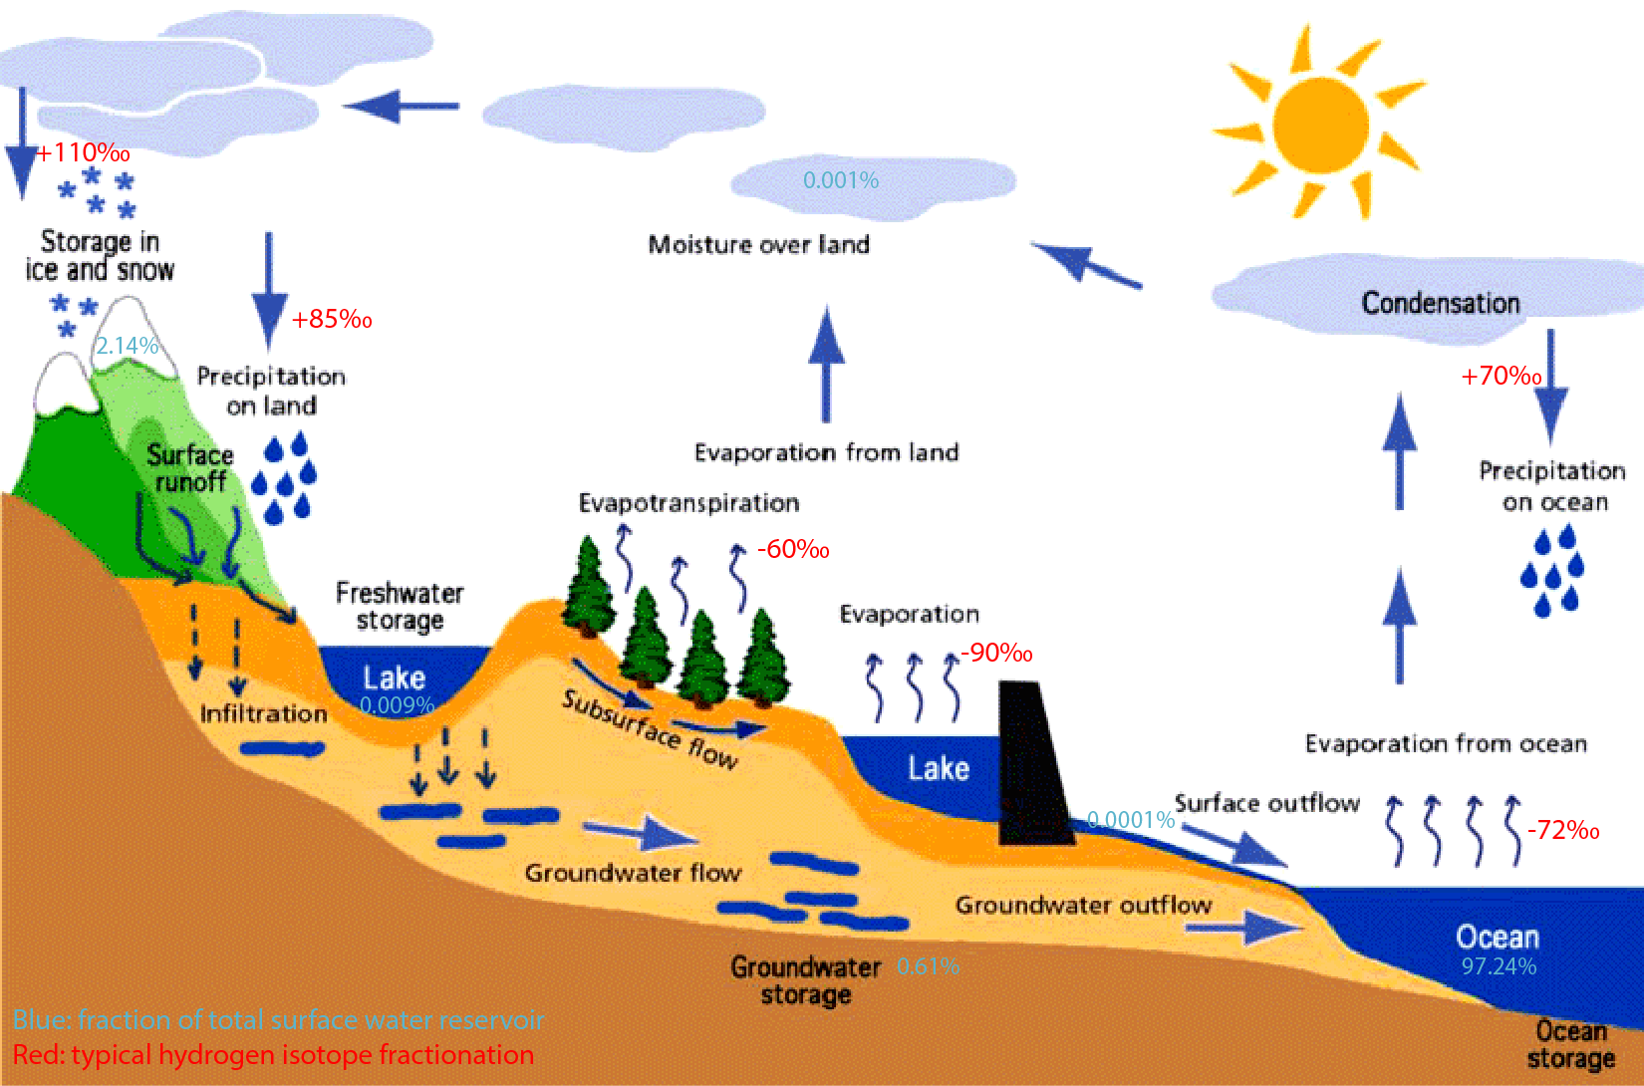
Hydrologic Cycle

Slide 5
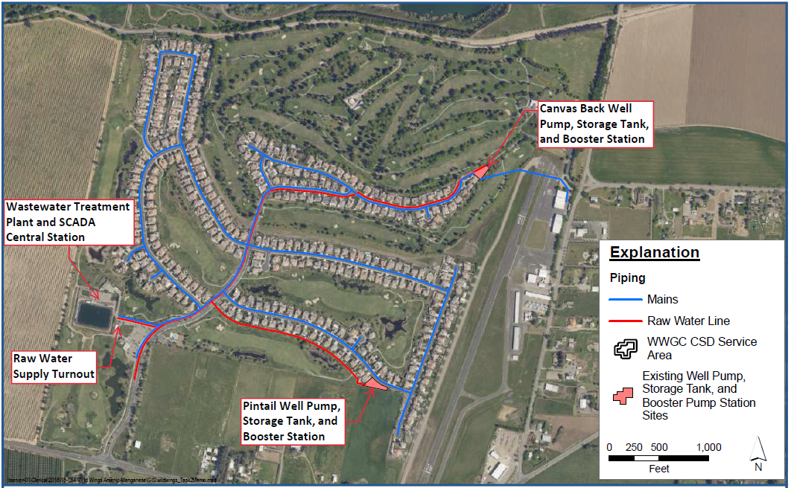
Map of Wild Wings Water System

Slide 6
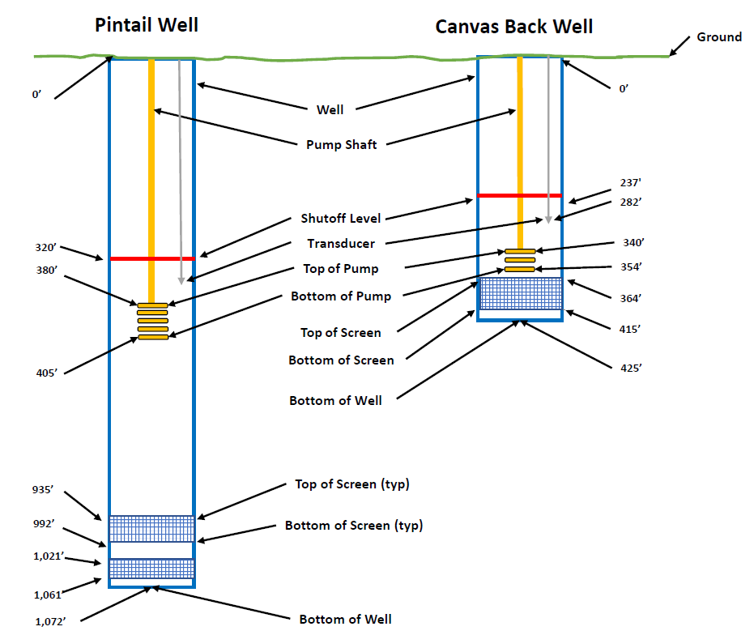
Illustration of Wild Wings Wells

Slide 7
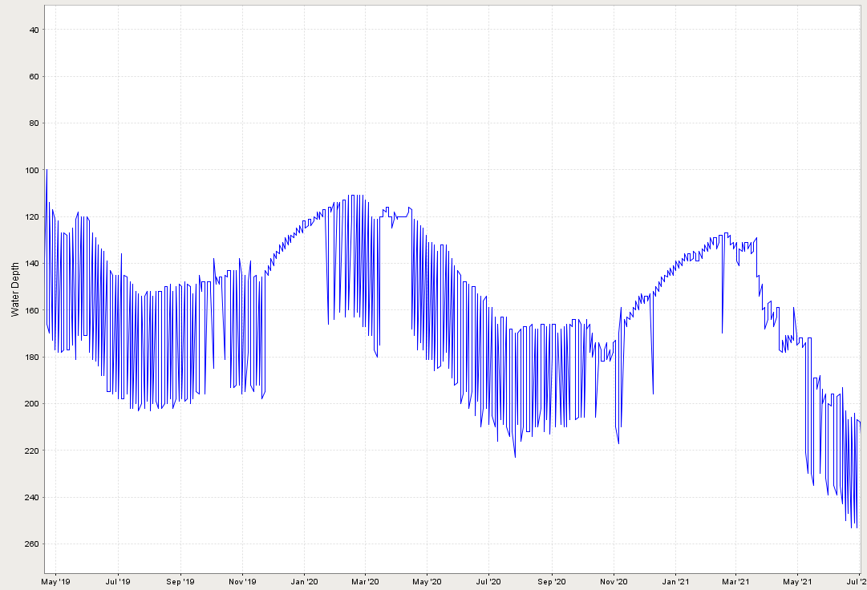
Canvas Back Depth to Water
Static Water Level
145’
160’
Pump Drawdown
210’
50 feet deeper than 2020
65 feet deeper than 2019

Slide 8
Canvas Back Water Supply
Canvas Back is used for irrigation supply and is a backup for Pintail for the Potable Water System.
Water Levels are lowest ever for this time of year
Typical Spring/Fall levels are 120 feet – 160 feet deep
Current level is 210 feet deep as of July 1, 2021
Levels are falling about 1-2 ft per day
The existing pump cannot supply water at these deeper levels.
A new pump was selected to increase water supply from the well. Limited pumps were available due to increased demand and supply chain impacts.

Slide 9
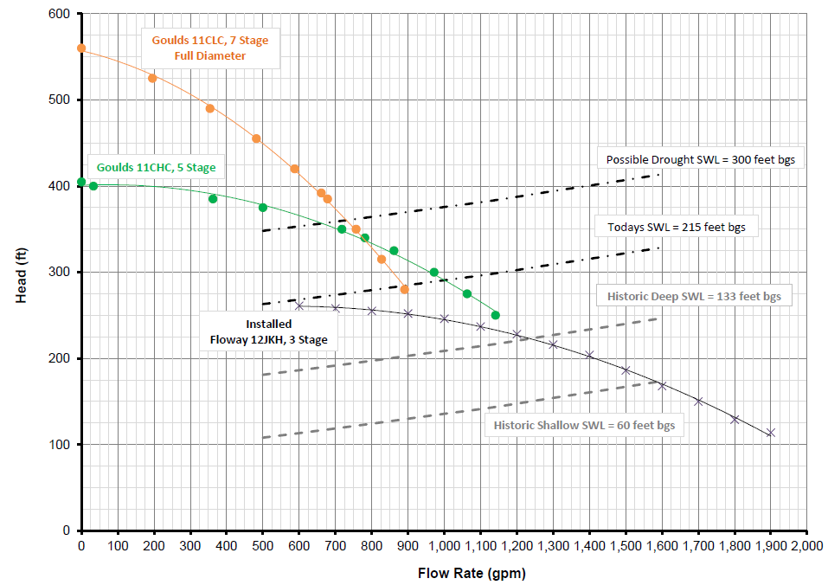
Canvas Back New Pump
Selected Pump
Existing Pump
Today’s Operation
Historical
Operation

Slide 10
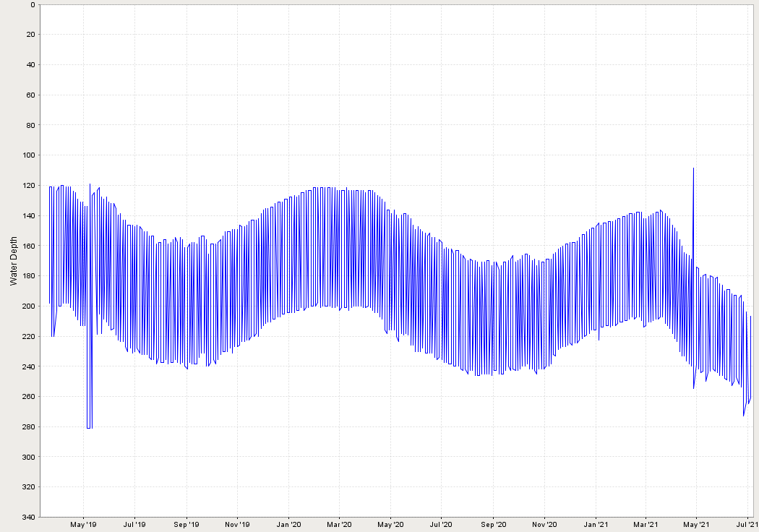
Pintail Depth to Water
Static Water Level
160’
145’
205’
45 feet deeper than 2020
60 feet deeper than 2019
Pump Drawdown

Slide 11
Pintail Water Supply
Pintail is the primary well for the Potable Water System.
Water Levels are lowest ever for this time of year
Typical Spring/Fall levels are 120 feet – 160 feet deep
Current level is 205 feet deep as of July 1, 2021
Levels are falling about 0.5-1.5 ft per day
The existing pump will not meet the minimum Potable Water demand if water levels continue dropping.
A new pump was selected to increase water supply from the well. Limited pumps were available due to increased demand and supply chain impacts.

Slide 12
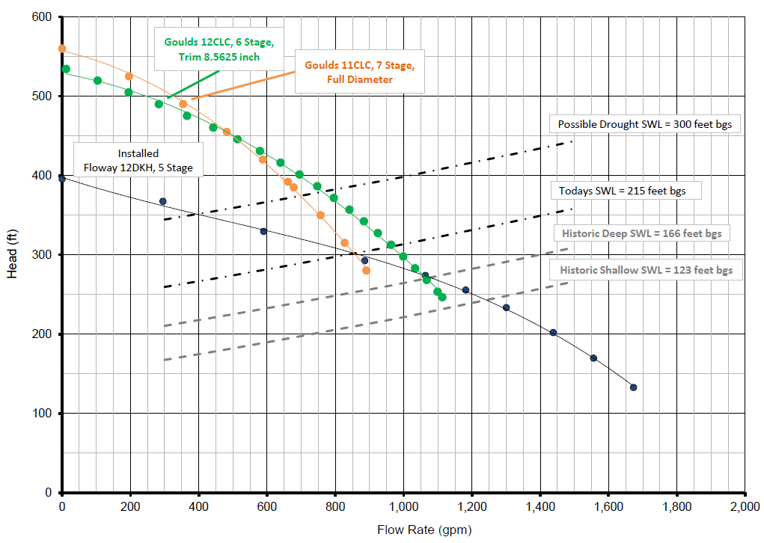
Pintail New Pump
Selected Pump
Existing Pump
Today’s Operation
Historical
Operation

Slide 13
Plan for Changing Pumps
Canvas Back
New pump is expected to be installed by next week.
Pump will make about 700-900 gpm in current conditions.
A deeper replacement well is being considered, if levels continue declining
Pintail
New pump may be available within 2 weeks.
Lower pump from 380 to 500 ft.
Pump will make about 650-850 gpm in current conditions.

Slide 14
What you can do to help
Conserving water to reduce peak use will help ensure the wells can meet the water demands through the summer.
Nearly 50% of water use in the summer is for outdoor landscaping.

Slide 15
Considerations for Replacement Well (Canvas Back)
Site Constraints
Hydrogeology
Cost
Schedule

