Slide 1
How to Create Community of Interest Maps in DistrictR

Slide 2
Start by clicking on Draw Communities. Then you can find your community by clicking on California, which will take you to the mapping tool

Slide 3
Use the hand to pan around the map, and zoom in by scrolling with your mouse or using the + and – in the upper lefthand corner to find your community

Slide 4
Once you find your community, use the paintbrush to fill the area. You can adjust the size of the paintbrush by toggling Brush Size.

Slide 5
If you make a mistake, use the eraser next to the paintbrush. You can also adjust the eraser size.

Slide 6
Next, name and describe your Community of Interest. Use the three prompts listed in the box.

Slide 7
You can create more than one Community of Interest by clicking the + next to Color. Name and describe them.

Slide 8
You can also add Important Places in your Community of Interest. Click the blue button that says “New” and click on the Important Place on the map. Name and describe it.

Slide 9
Use the magnifying glass to see different demographics in your community. You do not have to consider these when creating your Community of Interest.

Slide 10
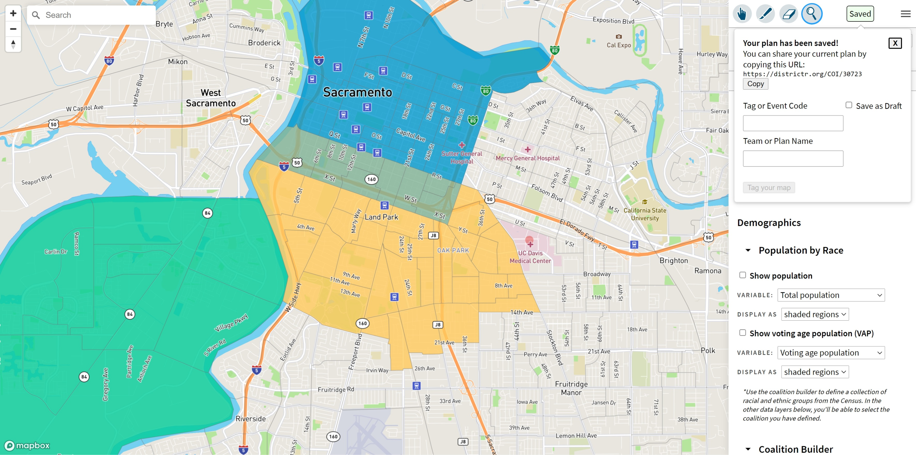
Finally, save your map in the upper righthand corner. Once you hit save, you will be able to copy the URL the save and send to friends or share on social media. Tag your COI with any relevant tags.

