Slide 1
Yolo County
2024 Point In Time Count GIS Map
Yolo County Health and Human Services Agency
Nolan Sullivan
Director

Slide 2
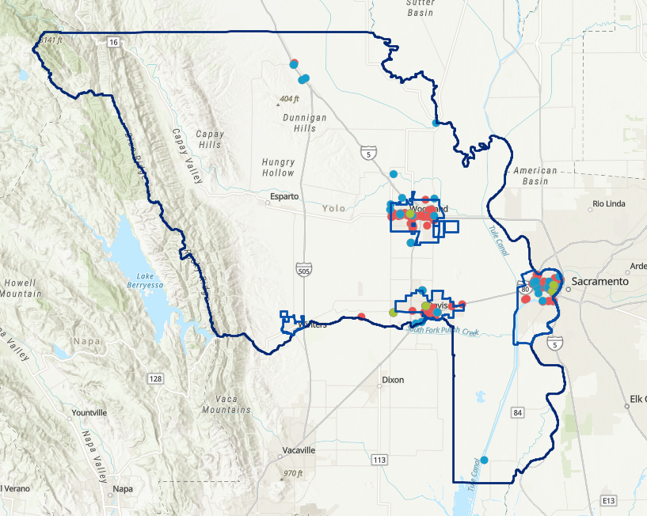
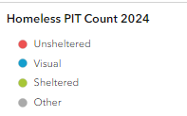
Countywide GIS Map–Total Homeless Population: 939

Slide 3
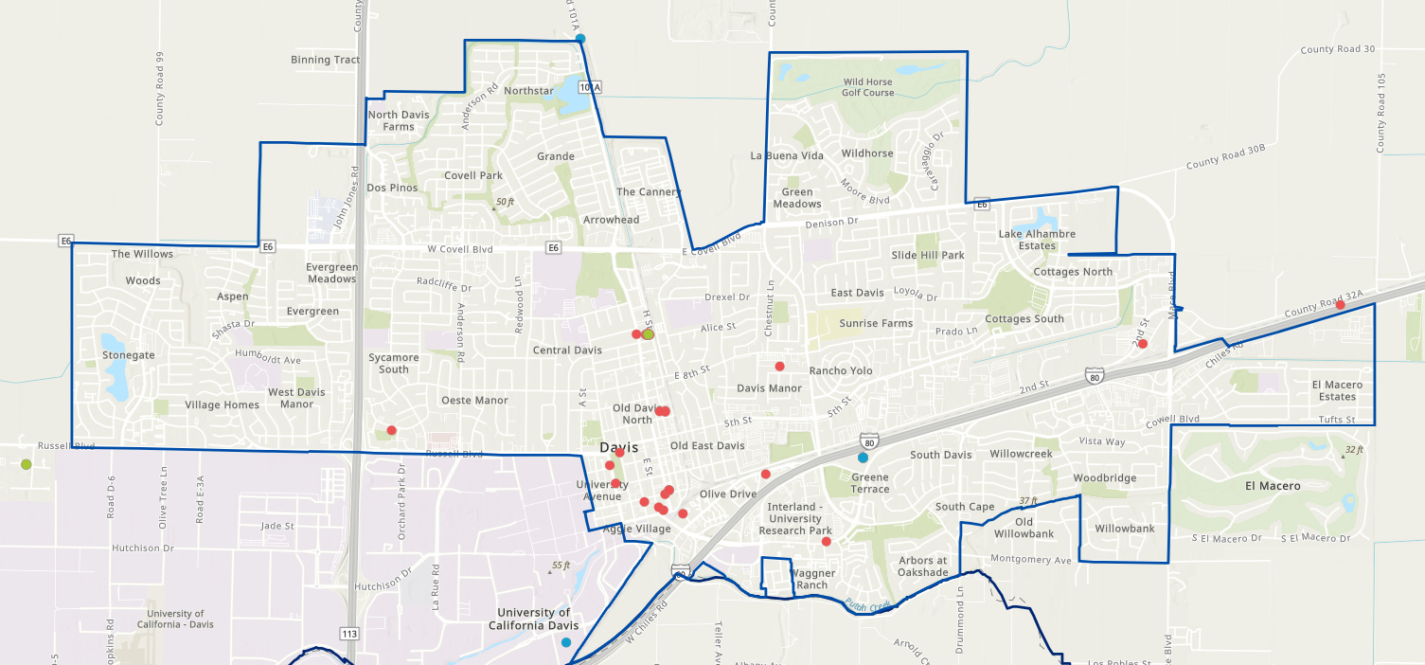
City of Davis-Total Homeless Population: 162

Slide 4
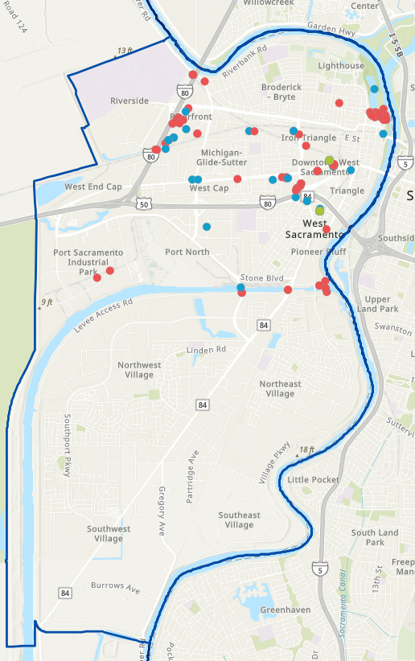
City of West Sacramento Total Homeless Population: 289
Support Staff Tasks

Slide 5
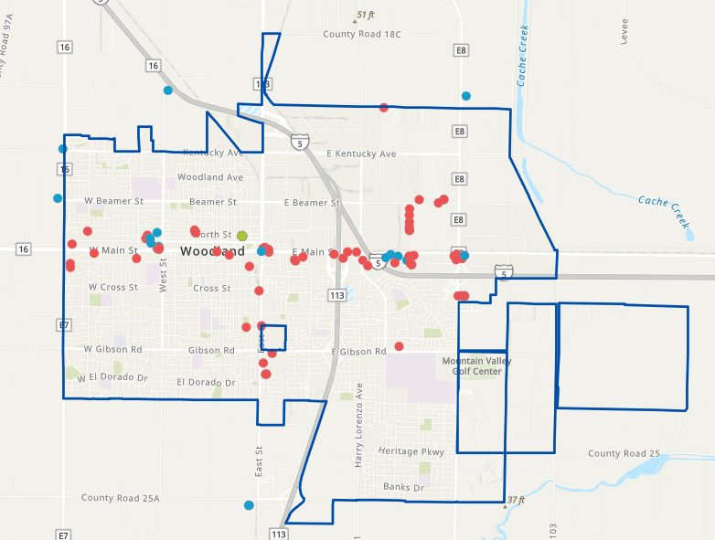
City of Woodland Total Homeless Population: 418
Notes:
Chart shows counties compared by the number of vets in the population being served per FTE.
It seems to indicate outside of San Bernardino we aren’t doing too poorly compared to other similar counties.

Slide 6
Questions?
Nolan Sullivan
Director
Yolo County Health and Human Services
Phone: (530)680-3826
Nolan.Sullivan@yolocounty.gov
…
Thank you
Notes:
Replace contact information or maybe remove slide altogether?

