Slide 1
Yolo County-Wild Wings CSA
Water/Wastewater Rates Update Project
Town Hall Meeting Presentation
Jason Coleman and Jacques DeBra, LSCE
July 11, 2024

Slide 2
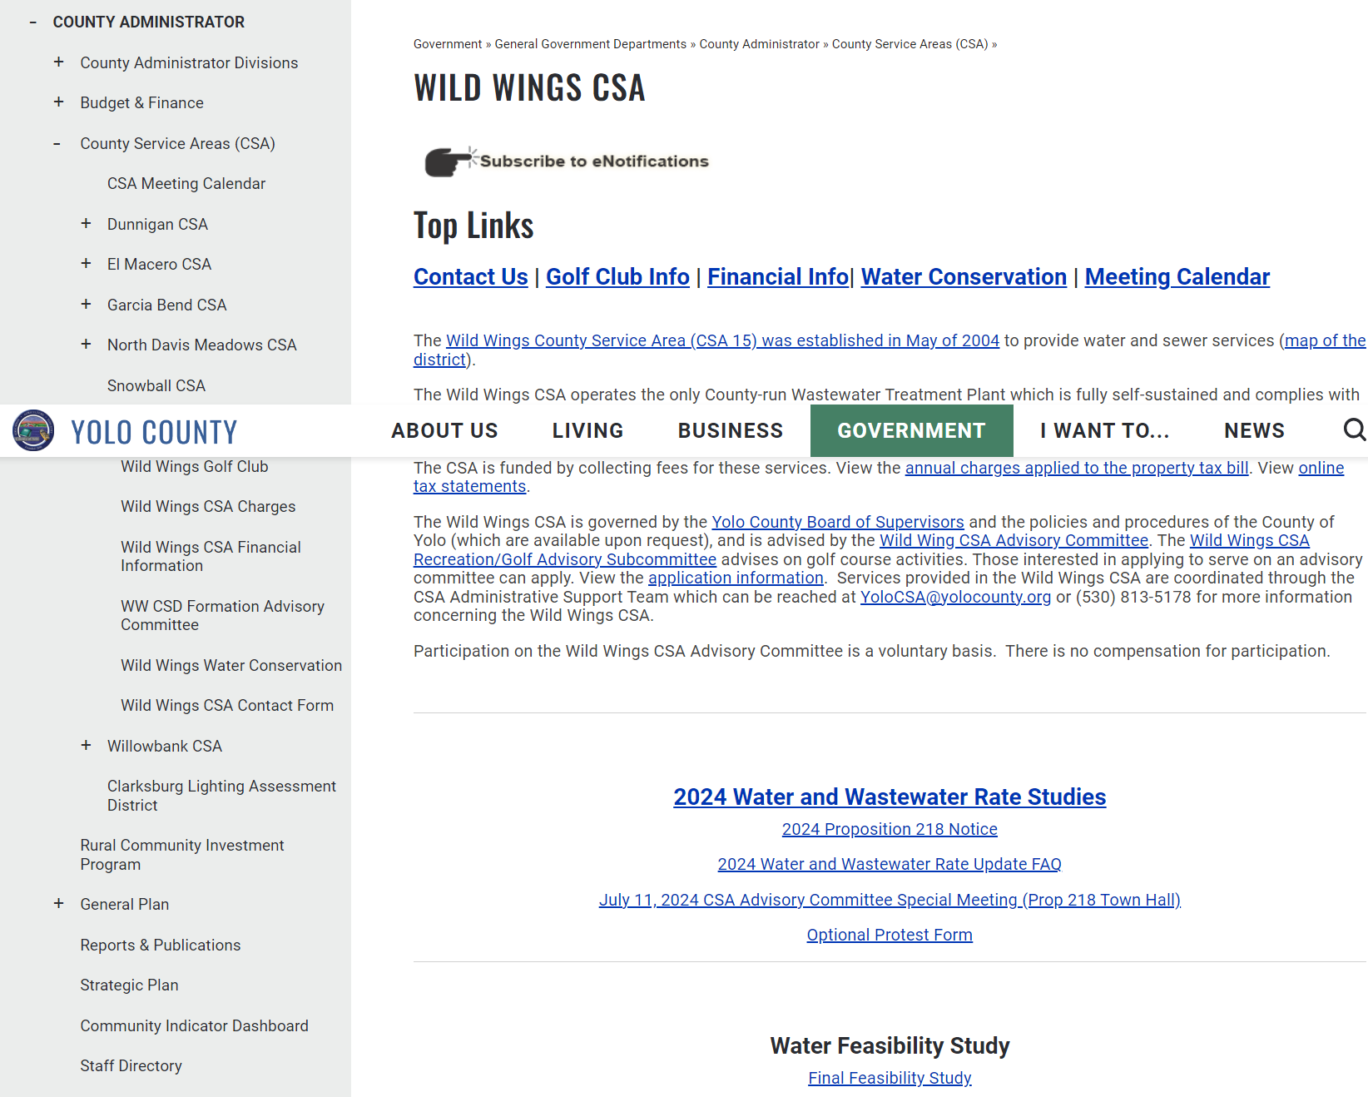
Yolo County - Wild Wings CSA Website (All Rate Information Available) https://www.yolocounty.org/government/general-government-departments/county-administrator/county-service-areas-csa/wild-wings-csa
On the website, you can:
Read the water and wastewater rate studies
View the Proposition 218 notice and learn about the process [mailed to residents]
Read the Frequently Asked Questions, which include examples of how the updated rates would be calculated [also mailed to residents]
Print an optional protest form [also mailed to residents]

Slide 3

Rates Development Process
Establish Revenue Needs
(Operational and Implementation Costs)
Revenue needs – Operations/Maintenance
Cost Allocation
By type – operations vs. implementation
Proposed Fees/Charges
Public notification
Revenue needs – Capital Projects/Improvements
Meet Wild Wings financial sustainability goal
Five-year Revenues and Expenses Projections
By user class – weight by effort
Stakeholder outreach
Public hearing and majority protest
By use – weight by water use
Proportional relative to user costs and service/benefit received
Adequate for Wild Wings to comply with SDWA/CWA

Slide 4
Yolo County - Wild Wings CSA
2018 vs. 2024 Rates: Large Utility Revenue Need Increases
SUSP Private Contractor Costs Increase = 19%
PG&E Energy Costs Increase = 12%
Capital Cost Increase = 25-35%
Supplies/Materials/Equipment = 20-35%
Compliance Costs (Treatment) = 30%
Labor/CPI = 25%
Supply chain/cost increases = 10-20%
Updated rates cover increased costs of service

Slide 5
Yolo County - Wild Wings CSA
Updated Rate Reports (approved by BOS)
Reports Include:
5-Year Revenue Requirements
Capital Improvement Plan
Regulatory Compliance
Cost Allocation
Proposed Rates
Prop. 218 Notice
Outreach
Rates Update Process

Slide 6
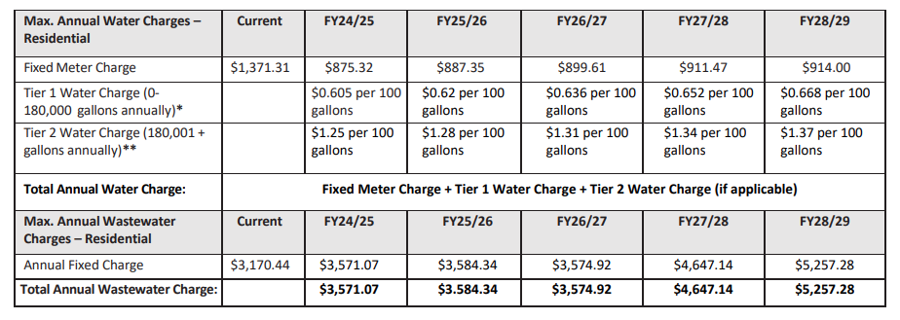
Yolo County - Wild Wings CSA
Proposed Water and Sewer Rates

Slide 7
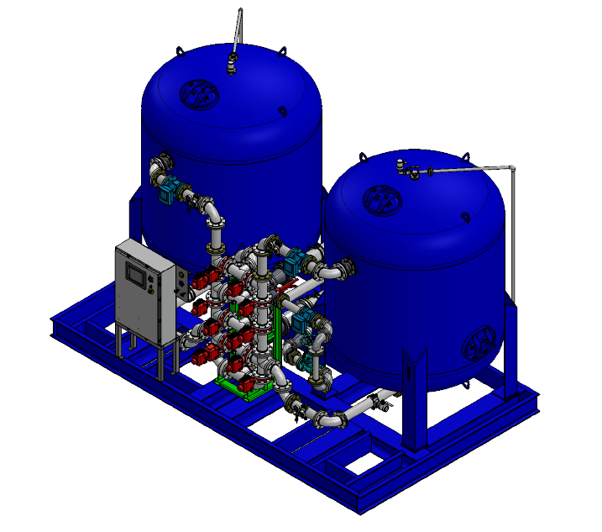
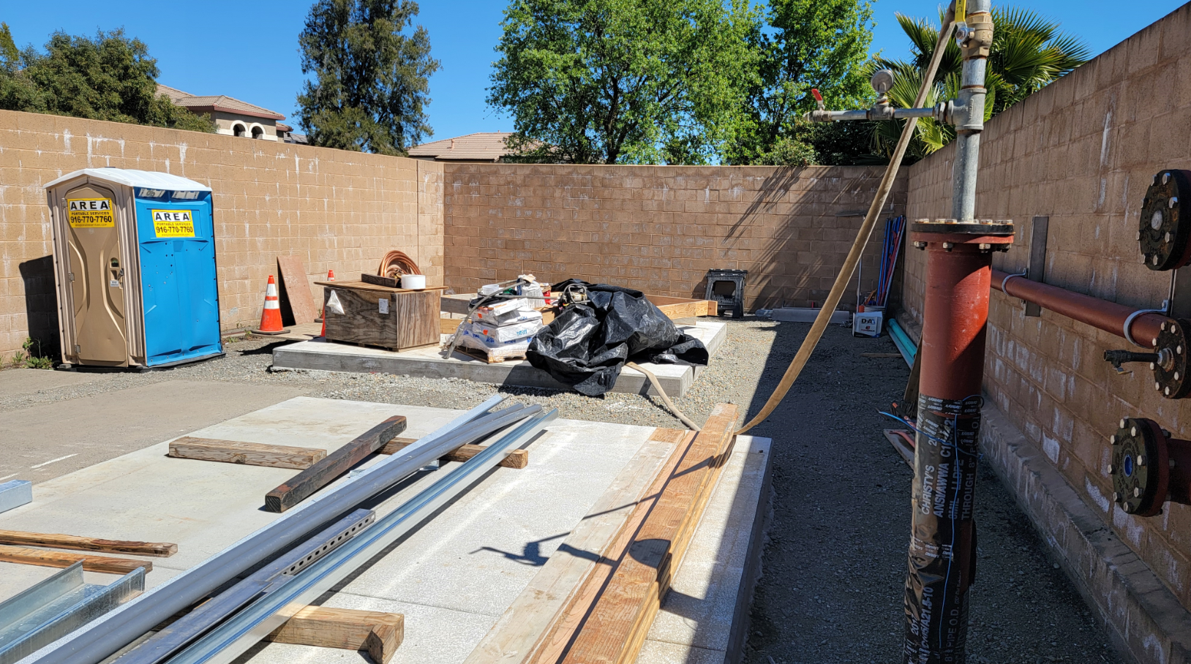
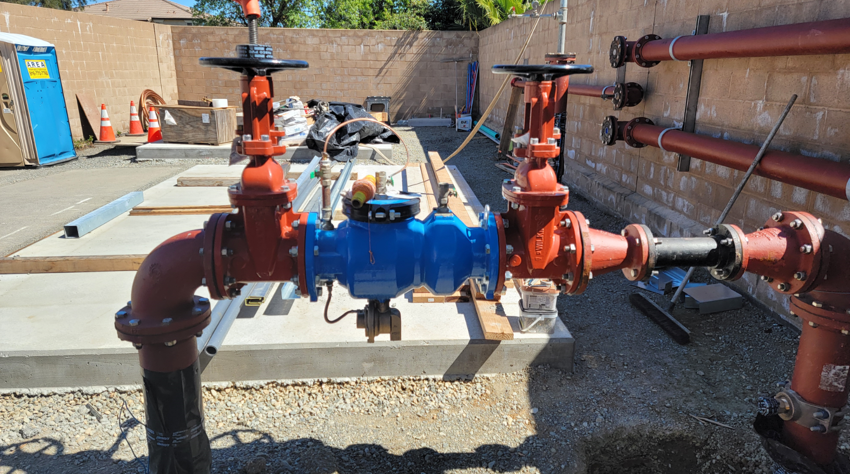
Yolo County - Wild Wings CSA
Capital Improvement Projects Updates
Pintail Arsenic Treatment System
Project Cost: Approximately $2 million
Scheduled Completion Date: December 2024 at the earliest
Project Benefits
Health – Reduces cancer risk and chronic health conditions.
Regulatory – Compliance with DDW, avoids fines and penalties
Economic – Lower healthcare costs, maintains property values
Operational – Allows for water to be treated from Pintail, Canvasback, and future Wood Duck well sites

Slide 8
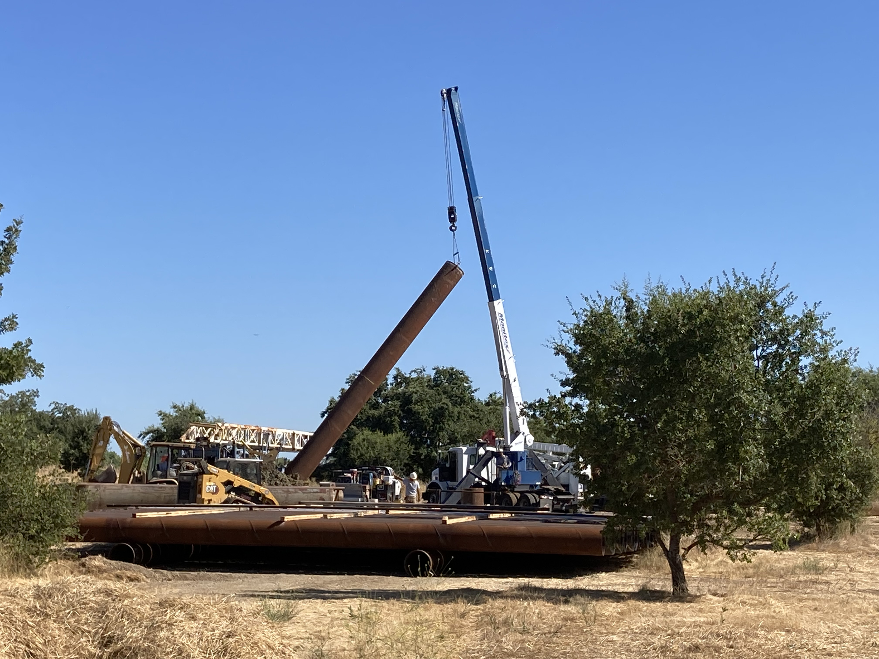
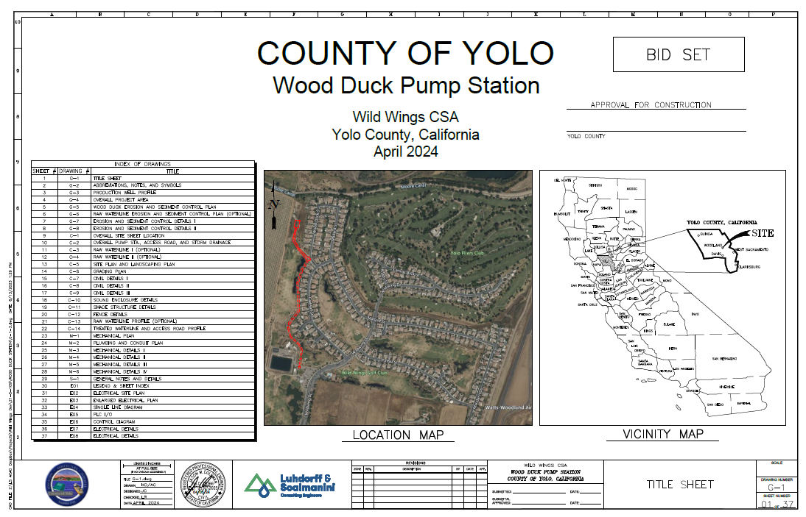
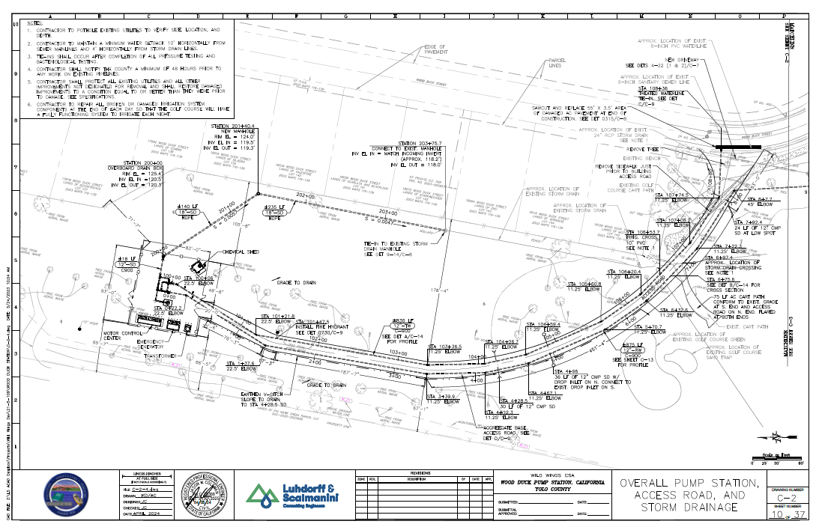
Yolo County - Wild Wings CSA
Capital Improvement Projects Updates
Wood Duck Well Pump Station
Estimated Project Cost: Approximately $4 million
Project Status: Design phase completed
Project Benefits:
Improves water source capacity reliability in the event Canvasback or Pintail source water is not available due to drought or well/pump failure
Freedom to use Canvasback Well for golf course irrigation needs
Ability to utilize DWR grant funds to partially fund project

Slide 9
Yolo County - Wild Wings CSA
Proposed Water and Sewer Rates
Annual Bill Calculation:
Fixed Charge + Tier 1 charges + Tier 2 charges [if applicable].
All customers pay the fixed charge.
Customers that use up to 180,000 gallons per year will not pay any Tier 2 charges [note this would be most Wild Wings residents]
The County will include water use from July 1 through June 30 each year [this is a fiscal year] to calculate the annual bill for each customer.
Water use for each customer will be calculated based on meter reading data collected through SUSP.
Meter reading information is available to each customer by registering an account with UBMax: https://billpay.ubmaxonline.com/UBMax/BillPayLoginAction.do

Slide 10
Yolo County - Wild Wings CSA
Proposed Water and Sewer Rates - Golf Course
Water system cost allocation for the golf course based on use of non-potable sources with lower cost factors.
Moore canal and/or ag purchases provide the golf course with low- cost supplies during normal and wet years with more Canvas Back well usage during dry years when surface water supplies are cutback.
Wastewater system cost allocation for the golf course based on % of total flows from the golf course treated at the wastewater treatment plant.
Current Measure O charge = $1,838/home
Proposed Measure O charge = $1,457/home.

Slide 11
Yolo County - Wild Wings CSA
Proposed Rates Evaluation Criteria
  Revenue Sufficiency – Meets revenue projection targets
  Revenue Stability – during rate implementation period
  All Beneficiaries Pay – based on cost allocation
  Equity – cost allocation [higher water users pay a higher proportion of water system costs]
  Affordability – economic impacts [small systems feel rate impacts due to small rate base]
  Simplicity – easy to understand [flat sewer rates and common two-tier water rate structure]
  Administrative ease – low implementation costs [property tax bill process]
  Enforceability – encourages efficient water use

Slide 12
Yolo County - Wild Wings CSA
Rate Updates Project – Next Steps
  July 11, 2024: Town Hall Meeting
  July 23, 2024: BOS Public Hearing on Proposed Rates
  [Protests due before close of public hearing]
  August 9, 2024: Rates roll submitted to Assessor’s Office
  December 10, 2024: If approved, new rates appear on property bill

