Slide 1
Grievance assessment
Grievance Received (by anyone). Resolved?
Considered informal grievance and no further action, no need to log
Yes
MTU
Admin
No
Forward grievance to Therapist for MTP related, try to resolve
Forward grievance to CCS Administrator for Admin or anything else not MTP related, try to resolve
Does person want to file a formal grievance?
Considered an Considered informal grievance and no further action, no need to log
No
Yes
Recording
CCS Administrator offer to help person complete a grievance form (required to help if requested)
Grievance Log
Web form filled out independently
Direct person to grievance web form
Printed grievance form (manually entered)

Slide 2
Intake
Web form will automatically send a letter with notice of receipt of the grievance. Paper forms will be entered manually by CCS Administrator to trigger a receipt letter.
Grievance Receipt Written Acknowledgement within 5 Days
Initial Screening
CCS Administratorinitial screening and determine where to send the grievance.
Investigation
CCS Administrator
- General County Complaints
MTP Supervising Therapist or Therapist
-MTP related service delivery
- MTU building/facilities
DHCS
- State policy related
Supervising Therapist or Nurse Case Managers
- Case related
-Service delivery related
CCS Administrator/MTP Supervising Therapist
- Admin Building/ Facilities related
- Security related
CCS Administrator complete the grievance.
(Exception filed and accepted, grievance resolved, grievance routed to correct agency)
Communication
If delayed, resolution delay letter must be sent to client no later than day 25.
If resolved, resolution letter must be sent to client within 5 days of resolution, and no later than day 35.
Closure
CCS Administrator complete the Grievance Log (Entire process must be completed within 30 days)

Slide 3
Grievance Log Elements
Grievance Log
Date grievance filed
Date grievance acknowledged
Method of grievance acknowledged (NL requires written response)
CCS Beneficiary Full Name
Case Number
Full Name of Who is Filing the Grievance
Relationship to the CCS Beneficiary
Full Name of the Representative Recording the Grievance
Type of Grievance
Category of Grievance
Description of Grievance
Description of Action Taken by County CCS Program to Investigate and Resolve Grievance
Grievance Status
Grievance Resolution Exception
Entity Redirect To
Full Name of Representative Responsible for Resolving Grievance
Date of Resolution
Date of Notification of CCS Representative of the Grievance Resolution
DHCS Grievance Log required reporting is detailed here on the tab called “Grievance Log”, the first tab.

Slide 4
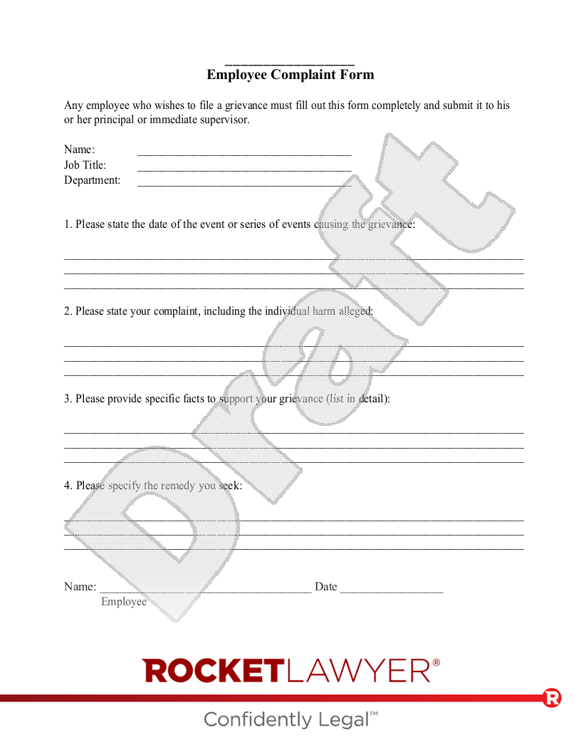
Grievance Form Fields
Date grievance filed
Date grievance acknowledged
CCS Beneficiary Full Name (if known)
Case Number
Full Name of Who is Filing the Grievance
Relationship to the CCS Beneficiary
Full Name of the Representative Recording the Grievance
Type of Grievance
Category of Grievance
Description of Grievance

